Slide 1
Kansas Partnership for Accessible Technology
January 29, 2009 Meeting

Slide 2
Welcome and Introductions
Notes:
Duncan – 15 Min.

Slide 3
Why Accessibility?
Notes:
Cole – 15 Min.

Slide 4
Demo
Notes:
Usability is Three Times Better for Non-Disabled Users
Usability measurements:
Screen Reader Users Screen Magnifier Users Control Group
Success Rate 12.5% 21.4% 78.2%
Time on Task (min:sec) 16:46 15:26 7:14
Errors 2.0 4.5 0.6
Subjective Rating (1–7 scale) 2.5 2.9 4.6
Relative values:
Relative score for users without disabilities
Success Rate 478%
Task Performance 222%
Error Avoidance 481%
Subjective Rating 172%
Overall Usability (geometric mean) 306%
Source: 2001 Nielsen Norman Group report Beyond ALT Text: Making the Web Easy to Use for Users with Disabilities

Slide 5
Digital Government
It is obvious that:
The Web, and IT in general, are increasingly important resources in many aspects of life, including government.
Online government resources are many, and increasing.
How many does your agency have?
Kansas.gov reports that they manage 183 applications and host approximately 560,000 files.
Notes:
Not just online: kiosks, smart cards, phone, email, etc.
Not just current, but also historical information.
[Click to reveal Kansas.gov stats.]

Slide 6
Digital Government
This is a good thing.
Digital government provides benefits and aligns with desirable government trends, e.g.:
Efficiency / cost savings / improved productivity
Transparency
Choice
Convenience
Anytime, on demand access to higher quality services
Elimination of physical barriers (distance, weather, etc.)
Greater citizen engagement and civic participation

Slide 7
Digital Government and Equal Opportunity
To function as intended, online resources must be available to all who require or would seek to use them (just like the rest of government).
Therefore it is essential that they be accessible in order to provide equal opportunity to all citizens, including people with disabilities.
Accessible web resources can help people with disabilities more actively participate in society, providing unprecedented access to information and interaction.
Accessible technologies can increase the productivity of citizens, including government workers and our business partners.
Notes:
Not being accessible means we’re unnecessarily limiting and underutilizing our potential resources.

Slide 8
20% of Adult Kansans Live with a Disability of Some Kind
Source: 2006 BRFSS Disability and Health Report
Notes:
Source: 2006 BRFSS Disability and Health Report
(BRFSS: Behavioral Risk Factor Surveillance System)
422,108 adult Kansans (20.4%) living with some type of disability
(defined as those who reported an activity limitation due to physical, mental, or emotional problems or who reported a health problem that requires them to use special equipment such as a cane, a wheelchair, a special bed, or a special telephone)
(The BRFSS, which is coordinated and partially funded by the Centers for Disease Control and Prevention, is the largest continuously conducted telephone survey in the world. It is conducted in every state, the District of Columbia, and several United States territories. The first BRFSS survey in Kansas was conducted as a point-in-time survey in 1990, and Kansas has conducted the BRFSS survey annually since 1992.)

Slide 9
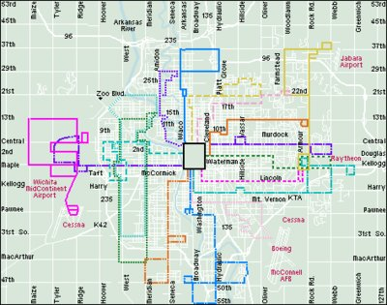
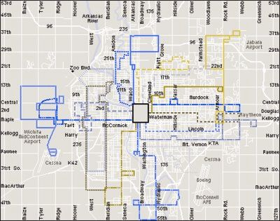
8% of Males Are Color Blind
Source: Prevent Blindness America
Notes:
Less than 1% of females.
Example simulates deuteranope (a form of red/green color deficit).
Source: Prevent Blindness America

Slide 10
Majority of Working-Age Adults Likely to Benefit from the Use of Accessible Technology
Source: Study commissioned by Microsoft, conducted by Forrester Research, Inc., 2003
Notes:
Furthermore…
As shown in the chart, 60% of working-age adults are likely or very likely to benefit from the use of accessible technology.

Slide 11
Majority of Working-Age Adults Likely to Benefit from the Use of Accessible Technology
This study uniquely identifies individuals who are not measured in other studies as “disabled” but who do experience difficulty in performing daily tasks and could benefit from the use of accessible technology.
Note that many or most of the individuals who have mild difficulties and impairments do not self-identify as having an impairment or disability

Slide 12
Majority of Computer Users Likely to Benefit from the Use of Accessible Technology
Source: Study commissioned by Microsoft, conducted by Forrester Research, Inc., 2003
Notes:
… and…
As shown in the figure, 57% of computer users are likely or very likely to benefit from the use of accessible technology.

Slide 13
Aging
Aging is also a factor
Aging sometimes results in combinations of accessibility issues:
Vision
Hearing
Dexterity
Memory

Slide 14
Aging
Source: 2000 Census
Notes:
13% of Kansans 65 and older (2% 85 and older)
Source: 2000 Census

Slide 15
The Population is Aging
The number of older people is increasing rapidly, and those reaching age 65 are living longer than ever before.
Shifting workplace demographics and delayed retirement.
Baby boomers start to turn 65 in 2011.
By 2030, the population age 65 and over will almost double nationally, as will the 85 plus population.
Source: U.S. Administration on Aging Strategic Action Plan 2007-2012 (April 2007)

Slide 16
Other Beneficiaries of Accessible Technology
Accessible web sites can benefit people with low literacy levels and people who are not fluent in the language of the site.
8.7% of Kansans speak a language other than English at home. (Source: 2000 Census)
Some aspects of web accessibility benefit people with low bandwidth connections.
Rural locations
Financial situation (Digital Divide)
Mobile technology

Slide 17
Technical Advantages
Reduce site development and maintenance time
Reduce errors
Reduce server load
Device independence

Slide 18
Financial Benefits
Increased web site use
Increases potential use by more people
Increases findability (search engine optimization)
Increases potential use in more situations
Increases usability
Improves customer satisfaction
Direct cost savings
Decreases personnel costs for maintenance
Decreases use of help desk resources
Decreases server capacity needed
Decreases reliance on inefficient, paper-based processes

Slide 19
Decreases Risk of High Legal Expenses
A recent high-profile lawsuit brought against Target by the National Federation for the Blind was settled for $6 million.
SAP settled a complaint filed against it by the state of Arkansas, after Arkansas was sued by the National Federation for the Blind of Arkansas. SAP has agreed to upgrade its product.
Web accessibility lawsuits have also been brought against:
State of Texas
Connecticut Attorney General’s Office
City of San Rafael
Southwest Airlines
American Airlines
Ramada and Priceline
AOL
Bank of America
H&R Block
Notes:
SAP provides the Arkansas Administrative Statewide Information System (HR/payroll/purchasing).
SAP situation reminiscent of our own dealings with PeopleSoft.

Slide 20
Gartner on Litigation Risk
A Gartner publication entitled Q&A on Web Site Accessibility (2008) addressed concern about accessibility-related lawsuits, saying:
“Although your organization may have been able to ignore issues related to accessibility thus far… this situation is unlikely to persist indefinitely. Your vulnerability will only increase over time.
“… it is worth embarking on an accessibility initiative as soon as can be managed, because the amount of potential damage will increase over time until remediation is complete.”

Slide 21
Forrester on Litigation Risk
A Forrester publication entitled Prepare to be Challenged on Web Accessibility Compliance (2007) noted:
“Increased activity in the courts and discussion in the press will mean greater risk….”

Slide 22
Accessibility Is the Law.

Slide 23
ADA
Americans with Disabilities Act of 1990 (ADA) (42 U.S.C. §§ 12101 et seq.)
prohibits discrimination on the basis of disability
ADA Title II: State and Local Government Activities (implementing regulation: 28 CFR Part 35)
requires that state and local governments give people with disabilities an equal opportunity to benefit from all of their programs, services, and activities
ADA Amendments Act of 2008 (Pub.L. 110–325)
effective January 1, 2009
significantly expands the scope of the ADA
Notes:
Federal laws

Slide 24
Section 504
Section 504 of the Rehabilitation Act of 1973, as amended (29 U.S.C. § 794)
Section 504 states that “no qualified individual with a disability in the United States shall be excluded from, denied the benefits of, or be subjected to discrimination under” any covered program or activity.

Slide 25
Section 508
Section 508 of the Rehabilitation Act of 1973, as amended (29 U.S.C. § 794d; implementing regulation: 36 CFR Part 1194)
Section 508 establishes requirements for electronic and information technology.

Slide 26
Section 255
Telecommunications Act of 1996 (47 U.S.C. §§ 255, 251(a)(2))
Section 255 and Section 251(a)(2) of the Communications Act of 1934, as amended by the Telecommunications Act of 1996, require providers of telecommunications services to ensure that such services are accessible to and usable by persons with disabilities.

Slide 27
Education Laws
Individuals with Disabilities Education Act (20 U.S.C. §§ 1400 et seq.)
requires public schools to make available to all eligible children with disabilities a free appropriate public education in the least restrictive environment appropriate to their individual needs
No Child Left Behind Act of 2001 (Pub.L. 107-110)
ensures that all children have a fair, equal, and significant opportunity to obtain a high-quality education, in part by meeting the educational needs of children with disabilities
In a rural state like Kansas, distance learning is likely to become increasingly important in meeting the needs of students. Accessible IT will enable such services to be provided in a nondiscriminatory manner.

Slide 28
Rights of Persons with Disabilities
Rights of persons with disabilities (K.S.A. 39-1101)
declares it to be the policy of the state “to encourage and enable the blind, the visually disabled and persons who are otherwise disabled to participate fully in the social and economic life of the state and to engage in remunerative employment”
Notes:
Kansas statutes

Slide 29
Employment Rights of Persons with Disabilities
Rights of persons with disabilities; employment (K.S.A. 39-1105)
“It is the policy of this state that the blind, the visually handicapped and persons who are otherwise physically disabled shall be employed in the service of the state, political subdivisions of the state, the public schools and in all other employment supported in whole or in part by public funds, on the same terms and conditions as the able-bodied, unless it is shown that the particular disability prevents the performance of the work involved.”

Slide 30
Kansas Acts Against Discrimination
Kansas Act Against Discrimination (K.S.A. 44-1001 et seq.)
“The practice or policy of discrimination against individuals in employment relations, [or] in relation to free and public accommodations… is a matter of concern to the state, since such discrimination threatens not only the rights and privileges of the inhabitants of the state of Kansas but menaces the institutions and foundations of a free democratic state. It is hereby declared to be the policy of the state of Kansas to eliminate and prevent discrimination in all employment relations, to eliminate and prevent discrimination, segregation, or separation in all places of public accommodations….
“It is also declared to be the policy of this state to assure equal opportunities and encouragement to every citizen regardless of… disability… in securing and holding, without discrimination, employment in any field of work or labor for which a person is properly qualified, to assure equal opportunities to all persons within this state to full and equal public accommodations…. It is further declared that the opportunity to secure and to hold employment, the opportunity for full and equal public accommodations as covered by this act and the opportunity for full and equal housing are civil rights of every citizen.”

Slide 31
ADA Accessibility Standards
Accessibility standards for public buildings or facilities (K.S.A. 58-1301 et seq.)
Incorporates Title II and III of the ADA, as well as their implementing regulations 28 CFR Part 35 and 36.

Slide 32
ITEC
Information technology executive council; powers and duties (K.S.A. 75-7203)
authorizes ITEC to adopt policies and rules and regulations

Slide 33
IT Policy 1210
Information Technology Policy 1210: State of Kansas Web Accessibility Requirements
establishes “a State of Kansas policy regarding accessibility requirements for all web based services, applications, and information available on state internet/intranet/extranet servers, including services that are developed internally, developed via contract, provided by third parties on behalf of state organizations, or purchased products”

Slide 34
Web ⊂ IT
These issues apply not only to the web, but also to other areas of IT.

Slide 35
IT + Business + Policy
The scope of the impacts — and of the solutions — reaches beyond just IT.
Requires policy and business ownership as well.

Slide 36
Partnership Organization and Responsibilities
Notes:
Duncan – 15 Min.

Slide 37
Background
1999: Web Accessibility Subcommittee (WAS) formed to address urgent need for state response to web accessibility issues. Focus limited to Web only.
2000-2001: ITEC Policy 1210 on Web Accessibility approved, guidelines rolled out over an 18-month period, supported by training
2002-2005: Continue to provide training, surveys, presentations to publicize effort, update guidelines and address emerging issues.
2005-2007: Strategic planning effort to determine how to approach growing need for resources/sponsorship
2008: Director hired, Partnership founded by Executive Order of the Governor

Slide 38
Issues 2000–2008
The initial efforts led by the Web Accessibility Subcommittee were highly successful and proved up the approach of using partnerships to gain participation and resources from stakeholders.
However, after the initial “campaign” approach to implementation, it became apparent that executive-level advocacy and policy support would be needed to focus resources and priority on the issues, ensuring accessible technology becomes and stays part of “business-as-usual”
Also, additional resources would be needed to address:
Training: Staff turnover and changing technologies drive a continuous need for training
Identification and resolution of issues: A resource to clarify issues and respond to questions
Assessment and monitoring : Need to understand levels of compliance and related issues
Procurement: Provide support to the process to ensure both off-the-shelf products and custom software development meet accessibility needs
Other technologies: The scope for accessible technology extends beyond just Websites and applications
Administrative support: Soliciting and incorporating stakeholder involvement and volunteer contributions into standards and the decision-making process
Notes:
Stress the importance of a policy-level committee.

Slide 39
Executive Order 08-12
The following purposes and charges are outlined in our establishing Executive Order:

Slide 40
1
The Partnership shall address web and information technology accessibility issues and provide policy, standards, guidelines, or procedural recommendations to the Information Technology Executive Council.

Slide 41
2
The Partnership shall coordinate, review, and provide recommendations on programs for enterprise wide assessment and monitoring of accessibility compliance.

Slide 42
3
The Partnership shall review annually and modify as required the State of Kansas Web Accessibility Requirements (Information Technology Policy 1210), and related documents (e.g., the State of Kansas Web Content Accessibility Guidelines), in response to any pertinent advances in technology and/or changes in federal accessibility standards.
Notes:
This is an annual responsibility.

Slide 43
4
The Partnership shall develop and provide information, training, support, and resources on web and information technology accessibility to agency web and information technology implementers and other stakeholders.

Slide 44
5
The Partnership shall aim to establish a leadership role for Kansas in the national effort to improve access to and use of information and services by individuals with disabilities.

Slide 45
6
The Partnership shall be a standing advisory committee to the Information Technology Executive Council, and other committees, boards and commissions as appropriate, and shall provide a copy of its annual report to the Council, as well as to the Governor and Legislature.
Notes:
The report is an annual responsibility.

Slide 46
IT Governance Model
Governor
Dept of Administration
Legislative
Legislative Coordinating Council
JCIT Oversight
Supreme Court
Office of Judicial Administration
Executive Branch
Chief Information
Technology Officer
Legislative Branch
Chief Information
Technology Officer
Judicial Branch
Chief Information
Technology Officer
Information Technology Executive Council (ITEC)
Cabinet Agency Heads, Branch CITOs, City- County- Private Sector CIOs, Regents, CITA
CITA
Chief
Information Technology
Architect
E-PMO
Enterprise
Project
Management
Office
GIS
Geographic
Information
Systems Policy
Board
KPAT
Kansas
Partnership for
Accessible
Technology
ITSC
Information
Technology
Security
Council
INK
Information Network
of Kansas
Board
Information Technology Advisory Board (ITAB)
State Agency- Regents- County- Local Government IT Directors, Associate Members, Technologists, Auditors
ITAB Subcommittees (as Identified)
IT Technical Architecture, Long Range Planning, Web Standards, Public Key Infrastructure, Electronic Records
Notes:
This is how we fit in in a formal way, but…

Slide 47
11
The Partnership shall work jointly with officials from other state agencies, organizations and county, municipal and tribal governments, as well as with businesses and organizations in the private sector whose products, services, or activities affect the accessibility of state services, programs, or systems.

Slide 48
Relationship to Stakeholder Communities
Kansas Partnership for Accessible Technology
Disability Support and Advocacy Community
State Agencies
Legislative Branch
Judicial Branch
Counties
Municipalities
Business Partners
Product and Service Vendors
Regents Institutions
Notes:
… this is how we really fit into the grand scheme of things.

Slide 49
Governance
Bring issues, concerns, needs, and emerging matters to the attention of the Partnership, on behalf of represented agencies; provide feedback on the effectiveness of efforts, practices, policies, etc.
Support policy-making and standard setting
Champion the importance of accessibility; use leadership positions to aid and support implementation. (sponsorship)
Notes:
General
Summarizes what’s needed from members at the highest level. More specifics to follow.
Do we need to establish Mission, Vision & Values?

Slide 50
Goals and Initiatives
Notes:
Cole – 20 Min.

Slide 51
Setting Standards
Develop standards for web accessibility and other technologies.
Harmonize our standards with external standards (W3C, Federal, etc.), and participate in shaping developing external standards when the opportunity exists.
Set standards for procurement/projects.
Fully incorporate accessibility into the Kansas Information Technology Architecture, as appropriate.
Review annually and modify as required existing requirements.
Notes:
Related to 1 & 3

Slide 52
Assessment
Monitor the status and implementation effectiveness of accessibility of information technology resources.
Establish accountability for accessibility of content.
Provide self-assessment capabilities consistent with aggregate monitoring.
Report status and progress to oversight groups and other stakeholders.
Identify and collect lessons learned / best practices.
Monitor, with other interested parties, technology evolution and adoption; identify and evaluate emerging accessibility issues and trends.
Notes:
Related to 2

Slide 53
Communication
Raise and maintain awareness of accessibility issues, requirements and responsibilities, and solutions.
Advocate for affected constituent groups.
Facilitate stakeholder input and listen to concerns.
Publicize resources made available; recommendations, policies, and standards; and progress.
Promote best practices, lessons learned, accomplishments, and the program.
Recognize and champion success.
Notes:
Related to 4

Slide 54
Assistance
Facilitate and support issue identification and resolution.
Design, develop, and deliver training.
Provide documentation and support for implementers.
Notes:
Related to 4

Slide 55
Proposed Prioritization
Guidelines: Review and craft a recommendation. Target having a recommendation for the April 2009 meeting.
Monitoring: Determine specifications, evaluate options and select a solution. Apply for INK grant. Timeline determined by INK grant process.
Communication: Develop a communication plan. Implement ASAP.
Communication & Assistance: Establish updated web site.
Training: Can begin preliminary design work now, complete once guidelines are determined. Target summer 2009 to begin delivering training.
Procurement Standards: Work with stakeholders to review and update procurements standards. Devise ways to raise visibility in procurement process, especially in early stages.
Architecture: Examine the Kansas Information Technology Architecture for places accessibility guidance would fit. Propose additions for next version.

Slide 56
Proposed Timeline

Slide 57
Ad Hoc Working Groups
Kansas Partnership for Accessible Technology
Director of Statewide Web/IT Accessibility
Training
Working
Group
Training Working Group
Training Working Group
…
Guidelines
Working
Group
Procurement
Working
Group
Assessment
Working
Group

Slide 58
Working Groups and Committees
Guidelines Working Group
Assessment Working Group
Communications Working Group
Training Working Group
Procurement Standards Working Group
Architecture Working Group
Annual Report Working Group
Goals, Mission, Vision & Values Committee?
Nominating Committee
Notes:
[Click to highlight which ones could be started now.]

Slide 59
What We Need from You
General Participation
Solicit and bring issues, needs, and feedback from the organizations and communities you represent to the attention of the Partnership
Commission working groups for Partnership initiatives as needed
Recommend subject matter experts from your organization for working group participation
Follow progress of working group designees
Evaluate and approve working group deliverables

Slide 60
What We Need from You
Policy review
Review and provide feedback on policy, drawing on your experience as policy makers and program administrators, as well as knowledge gathered in your organizations and communities
Facilitate implementation of policies and standards

Slide 61
What We Need from You
Sponsorship/Advocacy
Champion the importance of accessibility; use leadership positions to aid and support implementation
Advocate for accessibility in your communications with peers and partner organizations
Support the aims of the Partnership by making accessibility a priority in your organization
Share information from the Partnership with your organization

Slide 62
What We Need from You
Sponsorship/Advocacy (continued)
Promote the assessment process within your organization, and make sure it is participating and complying with the assessment
Identify and offer resources to help with the assistance effort
Assist in networking and referrals to elicit support, resources, and awareness
Share success stories

Slide 63
Web Content Accessibility Guidelines
Notes:
Cole – 20 Min.

Slide 64
Current Guidelines
Web Content Accessibility Guidelines for the State of Kansas
Version 3.0
January 13, 2003
Based in part on WCAG 1.0
Also encompasses Section 508
Notes:
The Web has changed a lot since 2003! (Or 1999, when WCAG 1.0, on which these were based, was completed) These guidelines are overdue to be revisited on that basis alone.
But now there is also the need to reconsider them in light of the major milestone that is WCAG 2.0.

Slide 65
WCAG 2.0
December 11, 2008
Supersedes WCAG 1.0
A primary goal of WCAG 2.0 is to provide a single shared standard for Web content accessibility that meets the needs of individuals, organizations, and governments internationally.
Notes:
I want to introduce WCAG 2.0, and how it compares and contrasts to WCAG 1.0 and, by extension the Kansas WCAG.

Slide 66
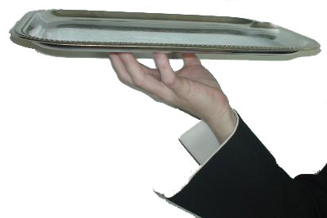
What WCAG 2.0 gives you
International, cooperatively developed Web standard
WCAG 2.0
Notes:
Let’s look at who develops WCAG and how…
---
[decorative image description: hand holding silver platter with “WCAG 2.0” on it]
(Image credit: Shawn Henry. Permission granted to use for other WCAG 2.0 presentations.)

Slide 67


Who develops WCAG
Standards making body for the Web
International, multi-stakeholder development
Formal process for broad public review
Notes:
The World Wide Web Consortium (W3C) is the leading standards making body for the Web. W3C develops the Web standards HTML, XML, CSS, etc. W3C follows a formal process to ensure international, multi-stakeholder development and review. We’ll talk more about that process in a minute.
Stakeholders include industry, government, and higher education.
The Web Accessibility Initiative (WAI) is part of W3C. WAI works with organizations around the world to develop strategies, guidelines, and resources to help make the Web accessible to people with disabilities.
WAI develops:
guidelines which are widely regarded as the international standard for Web accessibility
support materials to help understand and implement Web accessibility
resources, through international collaboration
WAI welcomes:
participation from around the world
volunteers to review, implement, and promote guidelines
dedicated participants in Working Groups
WAI has several different Working Groupings that:
develop guidelines for Web sites (“content”), authoring tools, browsers and other “user agents”
ensure that W3C technologies support accessibility
facilitate development of accessibility evaluation tools
conduct education and outreach
coordinate with research and development around accessibility issues
WCAG is developed within W3C WAI, following the W3C process. Let’s look at what that provides…
---
Note to presenters: Customize how much you cover what all WAI does. Make sure to include that WCAG is developed within W3C, the standards making body for the Web.
[Image description: W3C logo and Web Accessibility Initiative logo are right under “Who develops WCAG”]

Slide 68
Advances from WCAG 1.0 to WCAG 2.0
WCAG 2.0
Notes:
WCAG 1.0 was completed in May of 1999. The Web has changed a lot since then! Technologies continue to develop (-- very rapidly in some cases, and not rapidly enough to keep up in other cases). While WCAG 1.0 was extremely valuable in 1999, it doesn't apply well to some of today’s situations.
WCAG 2.0 is being developed to apply to these more advanced technologies and situations, and to incorporate what we’ve learned since 1999 in order to make WCAG 2.0 more useful and more effective.
Note that while the approach and a few of the requirements of WCAG 2.0 are a little different (which we’ll look at a little bit), the fundamental issues of Web accessibility are the same. Most Web sites that meet (“conform to”) WCAG 1.0 should not require significant changes in order to meet WCAG 2.0. Also, WCAG 2.0 is designed to be “backwards compatible” so that a site can meet both WCAG 1.0 and WCAG 2.0.
Some differences between WCAG 1.0 and WCAG 2.0 are described in "How WCAG 2.0 Drafts Differ from WCAG 1.0" in Overview of WCAG 2.0 Documents at www.w3.org/WAI/intro/wcag20.php#differs.
Let’s look at how differences in approach and structure make WCAG 2.0 work better. Later we’ll look in detail at the WCAG 2.0 Quick Reference, which is what most people will use as the primary tool for developing websites to meet WACG 2.0.
---
[decorative image description: hand holding silver platter with “WCAG 2.0” on it]

Slide 69
WCAG 1.0 – WCAG 2.0
WCAG 1.0
Guidelines
WCAG 2.0
Principles
Guidelines
Notes:
WCAG 2.0 has multiple layers that cover the basics through the details for understanding and developing accessible Web content. These multiple layers help it meet different needs, especially the goal of applying broadly to current and future technologies and situations.
WCAG 1.0 has guidelines. (Kansas has priorities.)
WCAG 2.0 also has guidelines, and it has a higher level: principles of Web accessibility.
---
[layout description: There are two text boxes side-by-side, to show a comparison.
The first text box has:
WCAG 1.0
Guidelines
The second text box has:
WCAG 2.0 WD
Principles
Guidelines
]

Slide 70
WCAG 1.0 – WCAG 2.0
WCAG 2.0
Principles: POUR
Perceivable
Operable
Understandable
Robust
Notes:
The 4 principles of Web accessibility in WCAG 2.0 are:
Perceivable - Information and user interface components must be presentable to users in ways they can perceive. This means that users must be able to perceive the information being presented; it can't be invisible to all of their senses.
Operable - User interface components and navigation must be operable by users. This means that users must be able to operate the interface; the interface can’t require interaction that the user can not perform.
Understandable - Information and the operation of the user interface must be understandable by users. This means that users must be able to understand the information as well as the operation of the user interface; the content or operation cannot be beyond their understanding.
Robust - Content must be robust enough that it can be interpreted reliably by a wide variety of user agents, including assistive technologies. This means that users must be able to access the content as technologies advance; as technologies and user agents evolve, the content should remain accessible.
---
Note to presenters: Customize how much you cover the principles based on the audience. For audiences focusing on the user experience and user interface design, it would be good to cover the principles in detail. For short presentations to developers focusing on detailed code, it might be best to cover it much less, if at all; for example, saying just the Principles as shown in the slide and none of the text in this Notes section.

Slide 71
What WCAG 2.0 gives you
Clearer criteria, more precisely testable
(still need human judgment)
WCAG 2.0
Notes:
With WCAG 1.0 it was often difficult to determine whether or not a Web site met some of the checkpoints. This was a problem for some organizations that wanted to adopt WCAG 1.0 into policy.
WCAG 2.0 is designed to be more precisely testable. That is, the requirements are clearer, making it easier to understand how to meet WCAG 2.0. We’ll look at a specific example of that in a minute.
Note that testable doesn’t mean that it can all be done automatically, you’ll still need a combination of automated testing and human evaluation to evaluate if a site meets WCAG 2.0.
Let’s look at how this is different from WCAG 1.0…
---
[decorative image description: hand holding silver platter with “WCAG 2.0” on it]

Slide 72
WCAG 1.0 – WCAG 2.0
WCAG 1.0
Guidelines
Checkpoints Priority 1, 2, 3
WCAG 2.0
Principles: P-O-U-R
Guidelines
Success Criteria Level A, AA, AAA
Notes:
In WCAG 1.0 under the guidelines are checkpoints. The checkpoints are the basis for determining conformance to WCAG 1.0.
(Kansas has items.)
In WCAG 2.0, under the guidelines are success criteria. The difference between 1.0 checkpoints and 2.0 success criteria is more than just terminology, it represents the difference in testability. The success criteria are testable statements that are the basis for determining conformance to WCAG 2.0.
Let’s look at an example of the difference…
UPDATE note: Check the success criteria designations (A, AA, AAA) in the latest draft; they might have changed to something else.
---
Note to presenters: “criteria” is plural and “criterion” is singular.
[layout description: There are two text boxes side-by-side, to show a comparison.
The first text box has:
WCAG 1.0
Guidelines
Checkpoints Priority 1, 2, 3
The second text box has:
WCAG 2.0 WD
Principles
Guidelines
Success Criteria
Level A, AA, AAA
]

Slide 73
Testable Example
WCAG 1.0 Checkpoint
2.2 Ensure that foreground and background color combinations provide sufficient contrast when viewed by someone having color deficits…
Kansas Item
1.7 Ensure that foreground content is easily distinguishable from the background, particularly when viewed by someone with color deficits.
Notes:
This sounds good, however, if we look at a sample Web page, is it precise enough that we can determine whether or not the Web page meets this checkpoint?

Slide 74
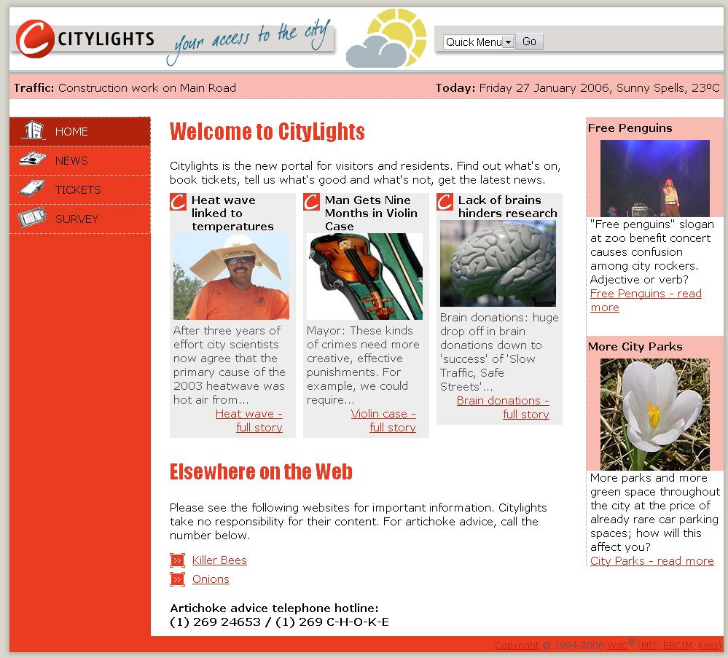
Questionable color contrast:
Notes:
Here is an example Web page. The main navigation down the left has black text on red background. Along the top are right is small black text and larger black text on light red background. In the middle is large red text on white background. There is small red text on a white background, gray background, and red background.
Do these areas meet WCAG 1.0 Checkpoint 2.2 for color contrast?
While the checkpoint provides important guidance, it is not specific enough to clearly determine whether all of the color contrast on this page meets WCAG 1.0 or not.
Let’s look at the similar WCAG 2.0 success criteria…
---
Note to presenters: Consider customizing this image. Find one with questionable color contrast from your organization or that would resonate with your audience.
Note to presenters: Remember to describe the pertinent parts of the image for people who are blind or otherwise cannot see it.

Slide 75
Testable Example
WCAG 1.0 Checkpoint
2.2 Ensure that foreground and background color combinations provide sufficient contrast when viewed by someone having color deficits…
WCAG 2.0 Success Criterion
1.4.3 Contrast (Minimum): The visual presentation of text and images of text has a contrast ratio of at least 4.5:1…
Notes:
The WCAG 2.0 success criterion is more specific and testable. It defines a precise contrast ratio, and there are tools that you can use to determine the contrast ratio.
That’s an example of how WCAG 2.0 is more precisely testable that WCAG 1.0 is. (Remember that some success criteria need human evaluation, and cannot be evaluated only with automated tools.)
UPDATE note: Check the latest WCAG 2.0 Draft at www.w3.org/TR/WCAG20/ to get the current wording of the relevant success criteria

Slide 76
What WCAG 2.0 gives you
Applies to more advanced technologies - current, future, non-W3C
Adaptable, flexible for different situations, and developing technologies and techniques
WCAG 2.0
Notes:
Applies to more advanced Web technologies - current, future, non-W3C
WCAG 2.0 has been developed to be applicable to current technologies and to future technologies. It is designed to apply to W3C technologies, as well as technologies developed outside of W3C.
WCAG 2.0 is designed to be more adaptable and flexible, through different types of documents.
Let’s look at how the different WCAG 2.0 documents provide that flexibility, as well as provide both general, technology-independent and specific guidance.
---
[decorative image description: hand holding silver platter with “WCAG 2.0” on it]

Slide 77
WCAG 2.0 Document
www.w3.org/TR/WCAG20/
Formal Web standard, a “W3C Recommendation”
“Normative”
Notes:
“Normative” formal standards, and “informative” supporting documents
An important clarification when looking at WCAG 2.0 information is to understand the difference between the “normative” standards and the “information” supporting documents.
WCAG 2.0 itself – the document at www.w3.org/TR/WCAG20 – is the formal Web standard draft, which is planned to become a “W3C Recommendation”. It is the only document that defines what is required. The other documents provide additional information, but are not part of the formal standard.
How WCAG 2.0 documents provide a stable basis as well as flexibility
WCAG 2.0 goes through the formal W3C process and once it is completed, it is intended to be stable and relevant as technology changes over time, and apply as we develop new techniques for making the Web accessible. In order to do that, WCAG 2.0 itself needs to be broadly applicable and technology-independent. (It can’t have details for specific technologies because things will change over time.)
WCAG 2.0 is not prescriptive about how to do things, but rather what functionality is needed for users. So WCAG 2.0 specifies what needs to be done for accessibility, and a related document tells how to do that. WCAG 2.0 Guidelines and Success Criteria are technology-independent, and specific guidance is provided in the Techniques.
Let’s look at how that provides flexibility.

Slide 78
Techniques document
Supporting document, “informative”
Examples for HTML, CSS, etc.
Can be updated
Notes:
Techniques tell you how to meet WCAG 2.0
The Techniques for WCAG 2.0 is a supporting document that tells you how to develop accessible Web content that meets WCAG 2.0. It provides specific details:
Description
Examples, such as HTML code
Browser (User Agent) and Assistive Technology Support Notes
Resources
Tests
It also shows you common “failures”, that is, some examples of how you can mess up and not meet the success criteria.
Where as WCAG 2.0 will be a stable document, the Techniques document can be updated as technologies and new techniques are developed. That’s how WCAG 2.0 can provide a stable basis, with flexibility to adapt over time – through the Techniques.
Currently there are: General techniques, HTML techniques, CSS techniques, Server-Side Techniques, and others. More Techniques will be developed in the future.
WAI encourages development of techniques for non-W3C technologies as well, so there may be techniques for Flash or PDF or XYZ technology. While W3C WAI will not directly develop techniques for these other technologies, it will encourage their development.
Techniques are “informative”
Again, the Techniques are not part of the WCAG 2.0 standard, and you don’t have to use them to meet WCAG 2.0. You could develop other ways to meet WCAG 2.0. This is another aspect of the flexibility of WCAG 2.0.
(By the way, if you develop new techniques to meet WCAG 2.0, you can submit them for review and inclusion in updates to the Techniques document.)

Slide 79
WCAG 2.0 requirements are more flexible
Notes:
Next, let’s look at examples of what WCAG 2.0 allows that WCAG 1.0 did not, that is, where WCAG 2.0 is less restrictive than 1.0.

Slide 80
Scripting allowed!
Notes:
Back in 1999, in the days of WCAG 1.0, there was very little support for scripting in common assistive technologies, such as screen readers. You pretty much couldn't design a site that relied on scripting and was accessible. That's changed now. All of the major browsers and assistive technologies support scripting. So now there are ways where you can use scripting, and even in some cases use it to enhance accessibility.
There are definitely some accessibility issues depending on what you do with scripting, but it's no longer something that always impairs accessibility; now it's actually encouraged in some cases.
There are several resources on the Web that provide additional guidance on accessibility and scripting.
---
Note to presenters: For some audiences, you might want to explain that scripting is an issue under the “Perceivable” principle. In the past, content provided through scripting was not always perceivable to uses with disabilities.

Slide 81
Scripting Techniques
Providing client-side validation and alert
Using functions of the Document Object Model (DOM) to add content to a page
Using Dynamic Web Content Accessibility to programmatically identify form fields as required
…
Notes:
In fact, there are specific scripting techniques for WCAG 2.0, including: [items listed on slide] And there will probably be more in the future.
---
Note to presenters: This is a particular area that you might want to cover in more or less detail depending on your audience. You can get more about scripting techniques from links in the Techniques document contents list: www.w3.org/TR/WCAG20-TECHS/#contents – as well as other (non-W3C WAI) resources on the Web (however, note that they may be out of date or incorrect).

Slide 82
Flexibility for rich Internet applications (Ajax, DHTML)
WAI-ARIA: Accessible Rich Internet Applications Suite
For example, accessible and highly usable expanding and collapsing menus/tree controls/nav bars
Techniques for meeting WCAG 2.0
Notes:
WCAG 2.0 was developed in coordination with related work on making accessible the more advanced features of dynamic content and rich Internet applications developed with Ajax, DHTML, and other Web technologies. That work is the Accessible Rich Internet Applications Suite, WAI-ARIA, which is developed by the W3C WAI Protocols and Formats Working Group.
A primary focus of ARIA is providing information about user interface controls to assistive technologies, e.g.:
Menus, tree controls, navigation bars
Role and state
Once ARIA is implemented, you’ll be able to make rich Internet applications much more accessible and usable by people with disabilities. For example, for a menu in a tree control, ARIA defines how to make the information about the nodes available to assistive technologies, so that users can to tell where they are in a tree, expand and collapse nodes, and get around and navigate a lot more effectively.
---
Note to presenters: This is a particular area that you might want to customize to cover in more or less detail depending on your audience. You might want to only mention it briefly and then delete the next couple of slides. You can learn more from the WAI-ARIA Overview at www.w3.org/WAI/intro/aria.php
Note to presenters: Please use ‘WAI-ARIA’ on first reference, especially in print. It’s OK to use just ‘ARIA’ when you’re using it repeatedly.

Slide 83
Flexibility through “accessibility-supported technologies”
(formerly “baseline”)
Notes:
Another way that WCAG 2.0 provides flexibility for different situations today and flexibility as technology changes over time is through what’s called “accessibility-supported technologies”.
First, let’s look at how WCAG 1.0 addressed the issue of accessibility support in browsers and other user agents, in order to understand one of the reasons for having the concept of accessibility-supported technologies in WCAG 2.0.
UPDATE Note: Make sure to check for updated information on accessibility-supported technologies. WAI may have new material that explains it in a different way. One place to check is the Overview of WCAG 2.0 Documents at http://www.w3.org/WAI/intro/wcag20 and the WCAG 2 FAQ at http://www.w3.org/WAI/WCAG20/wcag2faq.html
---
Note to presenters: Customize how much you cover accessibility-supported technologies (the following several slides) based on the audience. For audiences of policy makers, project managers, and others who might be defining what technologies are considered accessibility supported or defining what technologies are used to develop a Web site, it might be good to cover it in detail. For short presentations to usability/user experience professionals who are not involved in the decisions of which technologies to use, it might be best to cover it much less, and delete most of the slides.

Slide 84
Changes over time
10.2 Until user agents support explicit associations between labels and form controls, for all form controls with implicitly associated labels, ensure that the label is properly positioned
Notes:
WCAG 1.0 used the “until user agent” clause to address current limitations and future advances in user agents, such as with Checkpoint 10.2.
For WCAG 2.0, “accessibility-supported technologies” addresses that (the issue of current limitations and future advances).
Let’s look at what accessibility-supported technologies means from the authors’ point of view.

Slide 85
Accessibility Supported
A list of Web technologies (HTML, CSS, etc.) that an author can use to create accessible Web content
Notes:
From a developers/designers/authors perspective, one way to think about accessibility-supported technologies is: A list of Web technologies that an author can use to create accessible Web content

Slide 86
Accessibility Supported
A list of Web technologies (HTML, CSS, etc.) that an author can use to create accessible Web content
List may come from:
WAI, or
A governing body, or
An organization with accessibility expertise
or …
Notes:
WCAG 2.0 includes the criteria for a technology to be included on the list of accessibility-supported technologies.

Slide 87
Accessibility Supported
An established list of Web technologies (HTML, CSS, etc.) that an author can use to create accessible Web content
Can use non-accessibility-supported technologies, as long as content is usable without them
That is, used only for enhancement
Notes:
Note that you can use other technologies that are not on the list, as long as they are used only for enhancement, and all the information and functionality is fully available (perceivable, operable, and understandable) to people with disabilities then the non-accessibility-supported technology is not supported, or turned off (or on).
Now let’s look at how it’s described in WCAG 2.0, which covers other perspectives as well.

Slide 88
Accessibility Supported
Technologies that:
users’ assistive technologies support, and
the accessibility features in users’ browsers and other user agents support
Notes:
Let’s look at examples for each point.

Slide 89
Accessibility Supported
Technologies that:
HTML, CSS, GIF, SVG, PNG, PDF, Flash, JavaScript, MPEG, etc. if:
Notes:
“Technologies” here is Web content technologies, e.g., HTML, CSS, GIF, SVG, PNG, PDF, Flash, JavaScript, MPEG.
Note that these are examples of Web content technologies, but not all of those listed are necessarily accessibility supported.
Next, let’s look at what those “if”s are…
---
[layout description: There are two text boxes side-by-side, to show the description in the first, and examples in the second.
The first text box has: Technologies that:
The second text box has: HTML, CSS, GIF, SVG, PNG, PDF, Flash, JavaScript, MPEG, etc. if:
]

Slide 90
Accessibility Supported
Technologies that:
users' assistive technologies support, and
HTML, CSS, GIF, SVG, PNG, PDF, Flash, JavaScript, MPEG, etc. if:
the screen readers, screen magnifiers, etc. that the users use support it, and
Notes:
For the second phrase (“users' assistive technologies support”), you could say “the screen readers, screen magnifiers, etc. that the users use support it”.
---
[layout description: There are two text boxes side-by-side, to show the description in the first, and examples in the second. The old text is grayed out. The new text is below.
The first text box adds:
users' assistive technologies support, and
The second text box has:
the screen readers, screen magnifiers, etc. that the users use support it, and
]

Slide 91
Accessibility Supported
Technologies that:
users' assistive technologies support, and
the accessibility features in users’ browsers and other user agents support
HTML, CSS, GIF, SVG, PNG, PDF, Flash, JavaScript, MPEG, etc. if:
the screen readers, screen magnifiers, etc. that the users use support it, and
the accessibility features in the browsers, plug-ins, and such that the users use support it
Notes:
Where the second point says that assistive technologies have to support the technology, the third point says that common browsers and other user agents have to support the technology – because some people rely on the accessibility features of browsers and don’t use assistive technologies.
---
[layout description: There are two text boxes side-by-side, to show the description in the first, and examples in the second. The old text is grayed out. The new text is below:
The first text box adds:
the accessibility features in users’ browsers and other user agents support
The second text box has:
the accessibility features in the browsers, plug-ins, and such that the users use support it
]

Slide 92
Accessibility Supported
Technologies that:
users' assistive technologies support, and
the accessibility features in users’ browsers and other user agents support
HTML, CSS, GIF, SVG, PNG, PDF, Flash, JavaScript, MPEG, etc. if:
the screen readers, screen magnifiers, etc. that the users use support it, and
the accessibility features in the browsers, plug-ins, and such that the users use support it
Notes:
So if we put it together, is says [text on slide in the second box].
---
[layout description: There are two text boxes side-by-side, to show the description in the first, and examples in the second.
The first text box is grayed out and has:
Technologies that:
users' assistive technologies support, and
the accessibility features in users’ browsers and other user agents support
The second text box has:
HTML, CSS, GIF, SVG, PNG, PDF, Flash, JavaScript, MPEG, etc. if:
the screen readers, screen magnifiers, etc. that the users use support it, and
the accessibility features in the browsers, plug-ins, and such that the users use support it
]

Slide 93
Flexibility for different situations
Situation A
Situation B
Notes:
Next lets look at two very different situations for a Web site, and how the concept of the accessibility-supported technologies list provides flexibility.

Slide 94
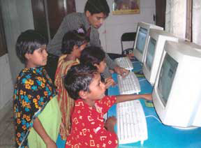
Flexibility for different situations
Situation A:
Internet for all
Notes:
Situation A is a Web application on the Internet that is intended to be used by everyone.
[image description: Photo of kids using computers.]
---
(Photo source: USAID Bangladesh http://commons.wikimedia.org/wiki/Image:Computerkids.jpg )

Slide 95

Flexibility for different situations
Situation A:
Internet for all
Situation B:
Internal for employees
Notes:
Situation B is a Web application inside an organization that is only for employees.
Now let’s say you are developing these Web applications and you are considering using SVG, scalable vector graphics. In situation A, you could not rely on SVG because many people don’t have user agents that support SVG.
However, if in situation B, the company provides all employees with accessible user agents that handle SVG and you have confirmed that it is fully accessible, then you could document that SVG is an accessibility-supported technology for that situation; therefore, you could use it for the application and meet (conform to) WCAG 2.0.
[image description: Photo of two kids looking at a computer, under Situation A (same as previous slide). Additionally, under Situation B, man in business clothes at a computer with others in the background.]
---
(Photo source: USAID Bangladesh http://commons.wikimedia.org/wiki/Image:Computerkids.jpg )
(Photo source: Microsoft clip art. See “Clip Art” section of “Use of Microsoft Copyrighted Content” at http://www.microsoft.com/about/legal/permissions/default.mspx#E4 )

Slide 96
Accessibility Supported
An established list of Web technologies (HTML, CSS, etc.) that an author can use to create accessible Web content, because the technologies are supported by users’ assisistive technologies and user agents’ accessibility features.
Notes:
Here’s what it looks like when we put it all together: [text on slide].
We just looked at how the concept of accessibility-supported technologies provides you flexibility for different situations and flexibility as technologies and user agents develop over time.
You can read more about accessibility-supported technologies in the WCAG 2.0 documents.
Speaking of the WCAG 2.0 documents, that’s one of the other things that WCAG 2.0 gives you…

Slide 97
What WCAG 2.0 gives you
Extensive supporting materials, practical implementation guidance
WCAG 2.0
Notes:
Let’s look at how this compares to WCAG 1.0…
---
[decorative image description: hand holding silver platter with “WCAG 2.0” on it]

Slide 98
WCAG 1.0 – WCAG 2.0
WCAG 1.0
Guidelines
Checkpoints Priority 1, 2, 3
1.0 Support
Techniques
WCAG 2.0
Principles: P-O-U-R
Guidelines
Success Criteria Level A, AA, AAA
2.0 Support
Techniques +
Understanding
Notes:
Techniques
With WCAG 1.0 there are some techniques. The WCAG 2.0 techniques are much more robust and comprehensive, and they include tests.
Understanding
In WCAG 1.0, brief descriptions are included in the main WCAG 1.0 document under each guideline. With WCAG 2.0, extensive guidance is provided for each guideline and success criteria in a new document, called Understanding WCAG 2.0: A guide to understanding and implementing WCAG 2.0.
---
[layout description: There are two text boxes side-by-side, to show a comparison.
The first text box has:
WCAG 1.0
Guidelines
Checkpoints Priority 1, 2, 3
1.0 Support
Techniques
The second text box has:
WCAG 2.0 WD
Principles
Guidelines
Success Criteria
Level A, AA, AAA
2.0 Support
Techniques +
Understanding
The first top of each section is grayed out, and the focus is on Support and the bullets underneath them.]

Slide 99
Understanding document
Supporting document, “informative”
Reference manual
Notes:
With WCAG 1.0, many people had questions on how to interpret it and implement it, such as: What does this checkpoint mean? How do we implement it? How does this help people with disabilities?
With WCAG 2.0, that information is provided in the Understanding document. It tells you the intent of each guideline and success criteria and how it helps people with disabilities; provides examples; and lists related resources, such as the tools to test for color contrast that we talked about earlier.
Note that the Understanding doc is not intended to be read cover to cover; instead, it's more like a reference manual. It’s the book on WCAG 2.0, from the Working Group itself.

Slide 100
WCAG 2.0 technical documents
WCAG 2.0
Understanding
Techniques
Notes:
Looking at those three documents together, now:
We have WCAG 2.0, the standards, that's normative;
We have the Techniques that are informative; and
We have the Understanding document that gives you all the that informative reference material.
That's a lot of information. We have something else that's been incredibly useful for getting around it all…
---
[image description: 3 boxes stacked vertically and labeled Understanding, WCAG 2.0, Techniques.]

Slide 101
How to Meet (Quick Reference)
Lists the WCAG 2.0 requirements
Provides summary information from the other documents
Links to details
Notes:
The WCAG 2.0 Quick Reference!
The Quick Reference lists the requirements for WCAG 2.0, provides summary information from the other documents, and links to details.
Most people will use the Quick Reference as the main tool for WCAG 2.0.
So let’s look at it in more detail.
---
Note to presenters: The Quick Reference is a key tool that should be mentioned in almost all presentations.

Slide 102
Quick Reference content
WCAG 2.0
Quick Reference
Guidelines
Success Criteria
Technique titles
Techniques
Notes:
The Quick References includes the guidelines and success criteria from the normative WCAG 2.0 document.
Under each success criteria, it lists the relevant techniques – just the title phrase of the techniques.
[image description: Box labeled Quick Reference that includes three bullets: Guidelines, Success Criteria, Techniques titles. Lines from Guidelines and Success Criteria go to another box labeled WCAG 2.0. A line from Techniques titles goes to another box labeled Techniques.]

Slide 103
Quick Reference links
Understanding
WCAG 2.0
Quick Reference
Guidelines
Success Criteria
Technique titles
Techniques
Notes:
The Quick Reference provides the basics, with links to the details.
For each guideline and each success criteria, there are links to the Understanding document.
Each of the techniques titles are linked to the details in the Techniques document.
Let's take a look at the actual Quick Reference.
---
Note to presenters: You might want to show a live demo. The screen captures on the following slides provide a backup for when a live demo is not feasible. The screen captures are from www.w3.org/WAI/WCAG20/quickref/#visual-audio-contrast-contrast
[image description: The same image as in the previous slide with additional arrows. Arrow from Guidelines and Success Criteria goes to box labeled Understanding. Arrow from Techniques titles goes to box labeled Techniques.]

Slide 104
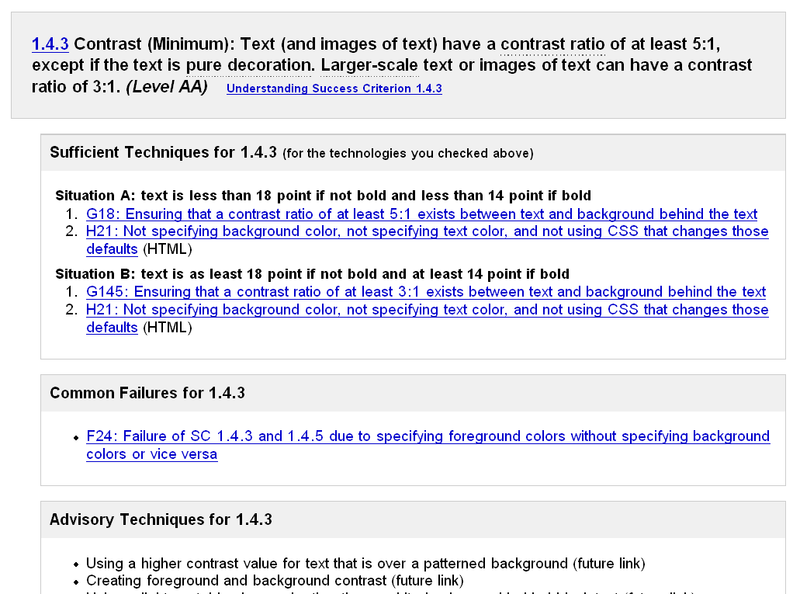
Quick Reference screen shot
Success Criteria
Notes:
Let’s look more at that color contrast success criteria. There's a short title: "Contrast (Minimum)" then the full text of the success criterion: “Text (and images of text) have a contrast ratio of at least 5 to 1 except if the text is pure decoration. Large-scale text or images of text can have a contrast ratio of 3 to 1”, and it includes the Level, which is Level AA for this one. Right after that is a link “Understanding Success Criterion 1.4.3”, so you can go directly to that topic in the Understanding document to get all that additional information if you want it.
The first section is Sufficient Techniques. These are the techniques that the Working Group has defined as being sufficient to meet the success criteria – that is, if you do the sufficient techniques, you meet the success criteria. These techniques are short sentences, so you can skim them. If you want to know more, you just click the link and it goes to the Techniques where you get the explanations, examples, etc.
The next section is Common Failures (which is new, we didn't have that with WCAG 1.0). They are examples of what not to do. For example, for this contrast one, a common failure is specifying a foreground color without specifying a background color, or vice versa.
The final section is Advisory Techniques. These will usually enhance accessibility, but are not sufficient techniques for various reasons.
(Remember that all techniques are informative, and you don’t have to use those particular techniques. They are there to define what you can do and to make it easy for you to know what will work, but there's flexibility to be able to define other techniques that will also meet the success criteria.)
UPDATE note: Check the success criteria designations (A, AA, AAA) in the latest draft; they might have changed to something else.
UPDATE note: The order of the sections and the text might have changed since this screen capture.
---
[image description: Screen shot from the Quick Reference at success criteria 1.4.3. The success criteria text is labeled Success Criteria. There are circles around Sufficient Techniques, Common Failures, Advisory Techniques.]

Slide 105
What WCAG 2.0 gives you
International standard, developed cooperatively
Applies to more advanced Web technologies
current, future, non-W3C
Clearer criteria, more precisely testable
Adaptable, flexible for different situations, and developing technologies and techniques
Extensive supporting materials, practical implementation guidance
WCAG 2.0
Notes:
To review what we just discussed: [text in slide]
---
[decorative image description: hand holding silver platter with “WCAG 2.0” on it]

Slide 106
Updating the Kansas Guidelines
The task before the Guidelines Working Group will require determining how WCAG 2.0 fits into our requirements, and how it impacts us and our partners.
I propose that all options for reflecting the improvements of WCAG 2.0 be considered, including not only rewriting our guidelines to do so, but also replacing our custom guidelines set with direct adoption of this industry standard.
Notes:
Section 508 must be considered as well, of course.

Slide 107
IT Policy 1210 and Annual Report
Notes:
Cole – 10 Min.

Slide 108
IT Policy 1210 and Annual Report
IT Policy 1210
Executive Order 08-12
“A report on the accessibility status of State of Kansas websites will be provided by the State ADA Coordinator with input from the WAS subcommittee. It will be distributed annually to the ITEC and copies sent to the individual entities.”
“The Partnership shall be a standing advisory committee to the Information Technology Executive Council, and other committees, boards and commissions as appropriate, and shall provide a copy of its annual report to the Council, as well as to the Governor and Legislature.”

Slide 109
Schedule of Future Meetings
Notes:
Duncan – 5 Min.

Slide 110
Meetings for the Remainder of 2009
Month | Date | Day | Time | Location
April | 15th | Wednesday | 1:30–3:30pm | Landon State Office Building, Room 106
July | 15th | Wednesday | 1:30–3:30pm | Curtis State Office Building, Room 530
October | 14th | Wednesday | 1:30–3:30pm | Landon State Office Building, Room 106

Slide 111
Open Discussion

