Slide 1
Kansas Partnership for Accessible Technology
April 15, 2009 Meeting

Slide 2
IT Policy 1210 Update

Slide 3
Web Accessibility Requirements Update Working Group
Jeff Coen Kansas Health Policy Authority
Bryan Dreiling Kansas Information Technology Office
Anthony Fadale State ADA Coordinator
Bradley Hook Kansas State School for the Blind
John Martello Kansas State School for the Blind
Libby Peters Kansas Department of Social and Rehabilitation Services
Sandy Sadowski Kansas Legislature
Eve Tracy Kansas Department of Agriculture
DiAnna Wages Kansas.gov
John Waldo Kansas Department of Revenue
Ivan Weichert Kansas Information Technology Office
Notes:
Met 4 times from March 9 to April 3.

Slide 4
IT Policy 1210 Update
Main goals were to account for:
WCAG 2.0
The Partnership
Also took opportunity to:
Omit obsolete details
Streamline and harmonize with other current IT policies

Slide 5
Core Requirement
IT Policy 1210, Revision 1
IT Policy 1210, Revision 2 (Proposed)
All web applications and web based services […] must, at a minimum, comply with
the W3C Web Accessibility Initiative, Web Content Accessibility Guidelines 1.0 Priority 1 and 2 Checkpoints;
and Federal Section 508 Guidelines, Subpart B - 1194.22 Web-based intranet and internet information and applications.
All Entity websites, web services, and web applications must, at a minimum, comply with:
W3C Web Content Accessibility Guidelines Level A and AA Success Criteria,
Section 508 Electronic and Information Technology Accessibility Standards, Web-based intranet and internet information and applications (36 CFR § 1194.22).
Notes:
9 New WCAG 2.0 requirements
7 Dropped WCAG 1.0 requirements

Slide 6
IT Policy 1210, Revision 2 (Proposed)

Slide 7
Supporting Material
A developer guidance document has been drafted, and will be published on the Partnership website.

Slide 8
ITEC Approval and Announcement
Proposed revision is on the April 23 ITEC meeting agenda.
Announcement possibilities:
Letter to agency heads, CIOs, & ADA coordinators
Existing IT networks (i.e., KITO & ITEC mailing lists)
KCDC mailing list
Your networks
Other?

Slide 9
Statewide Web Accessibility Assessment
Next Steps:

Slide 10
The Problem
The ability to monitor web accessibility status and effectiveness is critically needed.
A firm understanding of our accessibility status will not only provide feedback to state agencies on potential issues in need of remediation, but also help identify training needs and raise awareness of the state’s accessibility standards and efforts.

Slide 11
Challenges
The size and complexity of the state’s collective web properties makes this a big challenge.
To be effective, assessment needs to be:
Consistent
Able to be compared
Repeatable
Able to be aggregated
Quantified

Slide 12
Options
Manual, developer’s tools, etc.
Issues
Inconsistency
No reporting/aggregating
Awareness
Scale
Automated tool

Slide 13
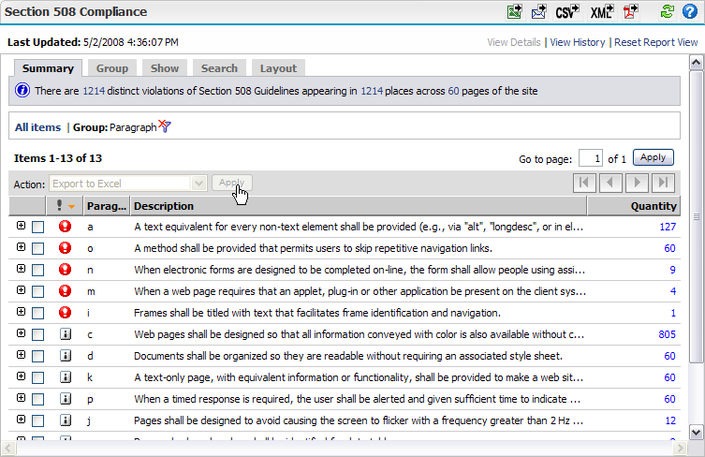
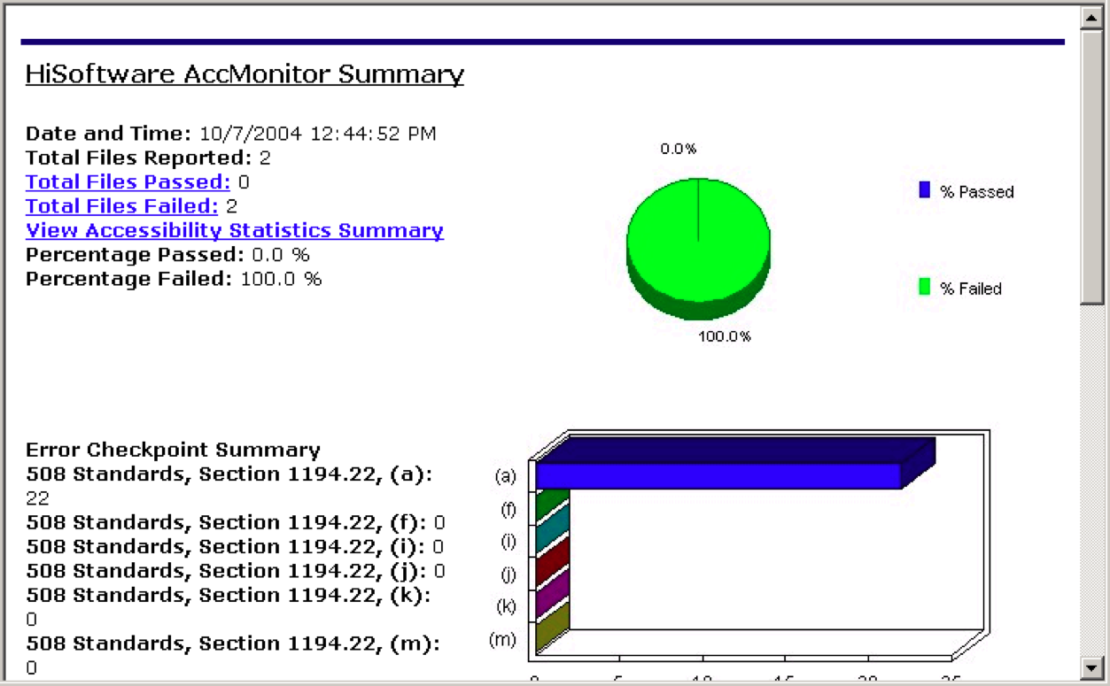
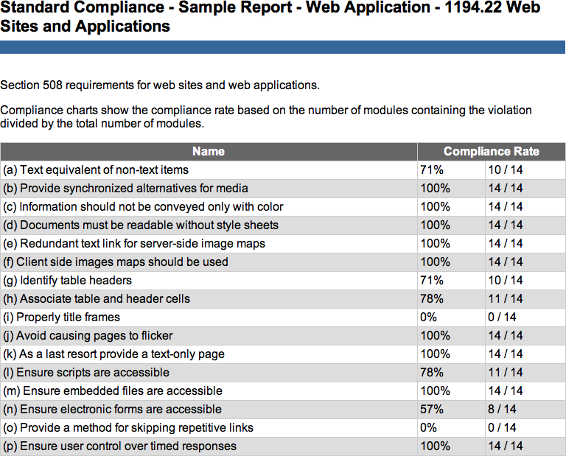
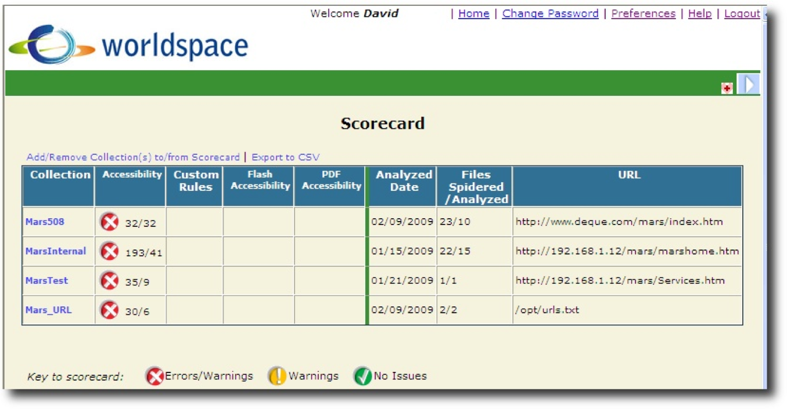
Automated Tool

Slide 14
Automated Tool
Pros
Cons
Consistent
Repeatable
Can measure progress
Saves time
Reduces risk of human error
Statewide coverage
Reporting
Identifies areas of need
Provides compliance management framework
Expedites remediation
Raises awareness
No panacea
Copious results could be overwhelming
Cost!

Slide 15
Pilot Program
One-time sample benchmark
Initial discovery/baseline
Low cost
Many pages don’t change often
Work load
Agency engagement
Ease into assessment
“Test drive” tool
Determine needs for future

Slide 16
Pilot Program
Issues
What to include?
High-profile / high-traffic sites
Tiers of content types (i.e., static HTML pages, dynamic web applications, PDF, RIA)
Honest representation
Good cross-sampling across all these dimensions

Slide 17
Pilot Program
Issues (continued)
Who?
Solicit
Cost/funding?
DISC
INK
Agencies?
Other?
Notes:
Indicate we did submit an INK grant application.

Slide 18
KPAT Direction

Slide 19
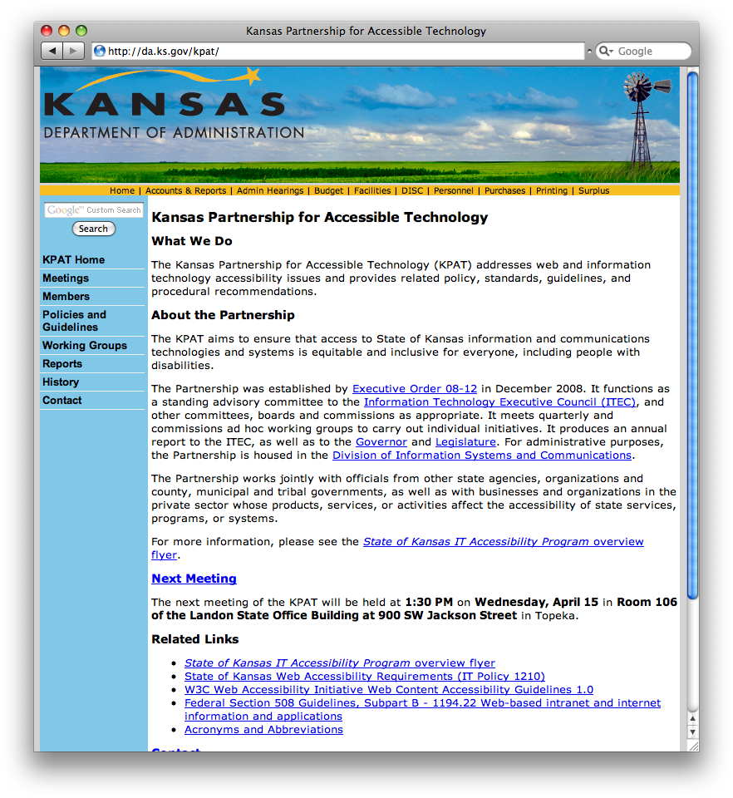
New KPAT Website
http://da.ks.gov/kpat/

Slide 20
2008 Annual Report

Slide 21
Summary re: Requests for KPAT Member Feedback
We attempted to gather feedback from everyone after the first meeting.
Responses:
Overall impressions positive
On the right track
Operational
We tried to squeeze too much into the first meeting.
Size of group
Meeting frequency
Resource constraints are a concern
Notes:
On the right track: Most answered “no” when asked about anything we ought to be doing differently.

Slide 22
Summary re: Requests for KPAT Member Feedback
Agency impact a common theme
What does is all mean to my agency?
What is expected of us?
Want information/materials to communicate back to organization
Specific projects
Other questions raised centered on support.
Technical expertise
Glossary of unfamiliar terms

Slide 23
Summary re: Requests for KPAT Member Feedback
Future direction/topic suggestions
Extending reach beyond state government
Strategies for website assessment/reporting
Examples of good accessibility, tools
Accessible remote meeting / web conference solutions
Stakeholder community outreach
Notes:
Stakeholder community outreach: We should both let them know what we’re planning and make overtures to get their input early on.

Slide 24
Summary re: Requests for KPAT Member Feedback
General remarks/advice
Constant communication is key.
We need to keep moving forward.

Slide 25
Goals – Next 90 Days
Assessment
Outreach
Procurement
Information Technology Architecture

Slide 26
Proposed Timeline
Notes:
(Slide from 2009-01-29 meeting presentation.)

Slide 27
Open Discussion

