Slide 1
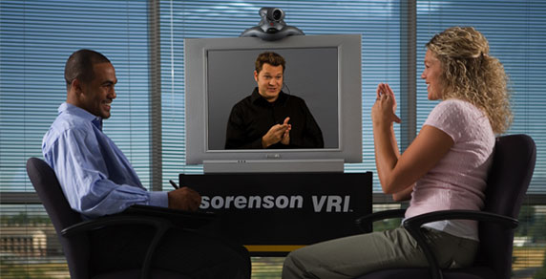
VRI
Video Remote Interpreting Services

Slide 2
WHAT IS THE DIFFERENCE BETWEEN VRS AND VRI?

Slide 3
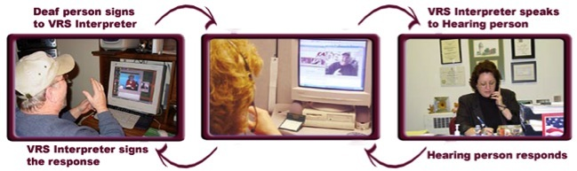
VIDEO RELAY SERVICE (VRS)
Notes:
VRS is free of charge to all telephone users, Deaf or hearing, as mandated by ADA. FCC regulations specifically forbid VRS to be used as a substitute for in-person interpreting services where both deaf and hearing consumers are in the same location; VRS may only be used when consumers are connecting with one another through a telephone location and at different locations.

Slide 4
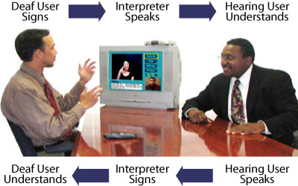
VIDEO REMOTE INTERPRETING (VRI)
Notes:
Americans with Disabilities Act of 1990 requires all companies providing services to the public, governmental agencies, and employers over a certain size be accessible to people with disabilities. Access to communications is one of the fundamental rights ensured by the ADA. VRI is not under FCC jurisdiction like VRS is, and is not free to all users. The set-up is in the room where the deaf and hearing persons are located (i.e. hospital emergency room). VRI is a means of providing qualified interpreter services to ensure effective communication with individuals who are deaf and who communicate using sign language.

Slide 5
MANDATES
The Americans with Disabilities Act (ADA) of 1990 mandates auxiliary aids/effective communications for persons with communications disabilities in Titles I, II & III
Title IV of the ADA requires telecommunications access by establishing Telecommunications Relay Services

Slide 6
MANDATES
The FCC regulates TRS and VRS as well as STS, IP Relay, Spanish TRS/STS and CapTel
VRI is not regulated by any Federal or state agency, but meets the fundamental rights ensured by ADA through provision of qualified sign language interpreters for persons who are deaf, deaf-blind, or hard of hearing

Slide 7
MANDATES
FCC regulations specifically forbid VRS to be used as a substitute for in-person interpreting services where both deaf and hearing consumers are in the same location

Slide 8
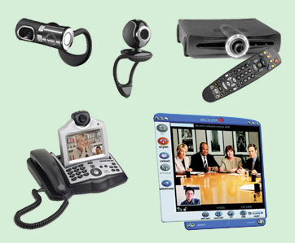
WHAT VIDEO EQUIPMENT IS NEEDED FOR VRI?
A computer system with a small camera mounted on the monitor, video conferencing software installed, and a microphone and speakers attached to it
A high-speed broadband connection (a minimum of 384 kbps symmetric bandwidth)
Notes:
You can use DSL, Cable, LAN or T1 broadband connections. There are a lot of videoconference equipment choices out there. Most, if not all, of the VRI vendors will work with you to ensure that video and audio quality meets their requirements for quality. A telephone connection may be required.

Slide 9
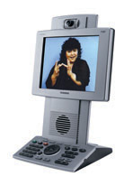
WHAT VIDEO EQUIPMENT IS NEEDED FOR VRI?
A videophone (H.323 or SIP/H.264 video coding standard, minimum 30 fps full motion video)
A publicly routable static IP address
A power outlet

Slide 10
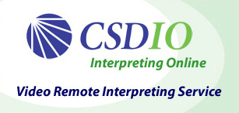




WHO DOES VRI SERVICES?
Notes:
There are a large number of VRI vendors available across the country. These are just some examples. A lot of sign language interpreter referral agencies are looking into providing this service online because it allows for more efficient resource planning.
This is also an example of the growth of video conferencing. The worldwide video conferencing segment is expected to grow from less than $100 million in 2006 to $164 million by 2012, with a compound annual growth rate of 8.5% (research published by AMI Partners, November 2008)

Slide 11
HOW DO I ACCESS VRI?
You may need to register with the VRI agency ahead of time and set up an account or user profile
You will need to provide the times you might need an interpreter, the projected length of time that the interpreter will be needed, some general information about the situation, and the best billing method for your situation
It is strongly recommended that an interpreter be scheduled at least 24 hours in advance

Slide 12
HOW DO I ACCESS VRI?
Requesting a specific interpreter may be allowed, and may require substantive advance notice (usually two weeks)
Cancellation policies may vary - usually 24 hours or more in advance results in no charge
If client fails to show up for the appointment, you will be billed for the entire scheduled time

Slide 13
HOW DO I ACCESS VRI?
Some VRI agencies provide 24/7 service, others during business hours (8a - 5p)
Some agencies accept on-demand (or last-minute) service requests but not all
Last minute scheduling requests may incur a service charge for some agencies

Slide 14
HOW DO I ACCESS VRI?
Cost for VRI is about $3 to $4 per minute
Some VRI agencies may require a minimum block of time (usually 10 minutes)
Some agencies may offer substantial discounts if you contract with them for a minimum number of hours per month

Slide 15
WHAT ARE THE ADVANTAGES OF VRI?
VRI has the potential to provide qualified interpreter services in areas where qualified interpreters are limited or not available (i.e. schools and/or rural areas)
VRI is useful for last-minute needs and emergencies
VRI can be available 24 hours a day depending on vendor
VRI works best for one-on-one meetings or small groups

Slide 16
WHAT ARE THE ADVANTAGES OF VRI?
VRI makes it easier for businesses or facilities to serve deaf customers
VRI may be accessed immediately without the user having to pay last-minute fees
Minimum time fees can be lower than for regular interpreting
Travel expenses are eliminated
Interpreter illness or weather considerations are minimized

Slide 17
WHAT ARE THE DISADVANTAGES OF VRI?
Benefits of in-person contact is lost - some people may understand interpreters better in person
Dependence on technology - if the equipment or connection is not working, interpreting cannot take place
Regional signs may be unfamiliar
On-site interpreter services are more likely to result in effective communication than VRI services

Slide 18
WHAT ARE THE DISADVANTAGES OF VRI?
On-site interpreters have more physical flexibility, have greater access to visual and auditory cues and information present in the environment
On-site interpreters do not encounter technology or equipment malfunctions
On-site interpreters can respond immediately to communication events as they arise

Slide 19
SPECIAL CONSIDERATIONS FOR VRI
Size, proximity, and position of the video screen relative to the deaf individual
Camera angles and focus
Audio quality
Privacy protocol (minimizing visual distractions)
Portability and size of equipment; ability of vendor to provide end solution to the customer

Slide 20
SPECIAL CONSIDERATIONS FOR VRI
Length of time to set up equipment and connection
Training on procedures to set up VRI
Technical issues - a need for IT staff capable of troubleshooting and resolving technical issues that may arise
Accommodation of video bandwidth
Monitoring of VRI effectiveness on an ongoing basis
Notes:
Video bandwidth, for example, a T1 switch can accommodate maybe four video calls. You will need to consider the impact of extra bandwidth needed to accommodate normal office internet/VOIP and maintain video quality if you do not use a T1.

Slide 21
QUESTIONS?

Slide 22
THANK YOU!

