Slide 1
Kansas Partnership for Accessible Technology
July 15, 2009 Meeting

Slide 2
Usability: Beyond Accessibility
Bill Griffiths The Rehabilitation Center for the Blind and Visually Impaired

Slide 3
Status Updates

Slide 4
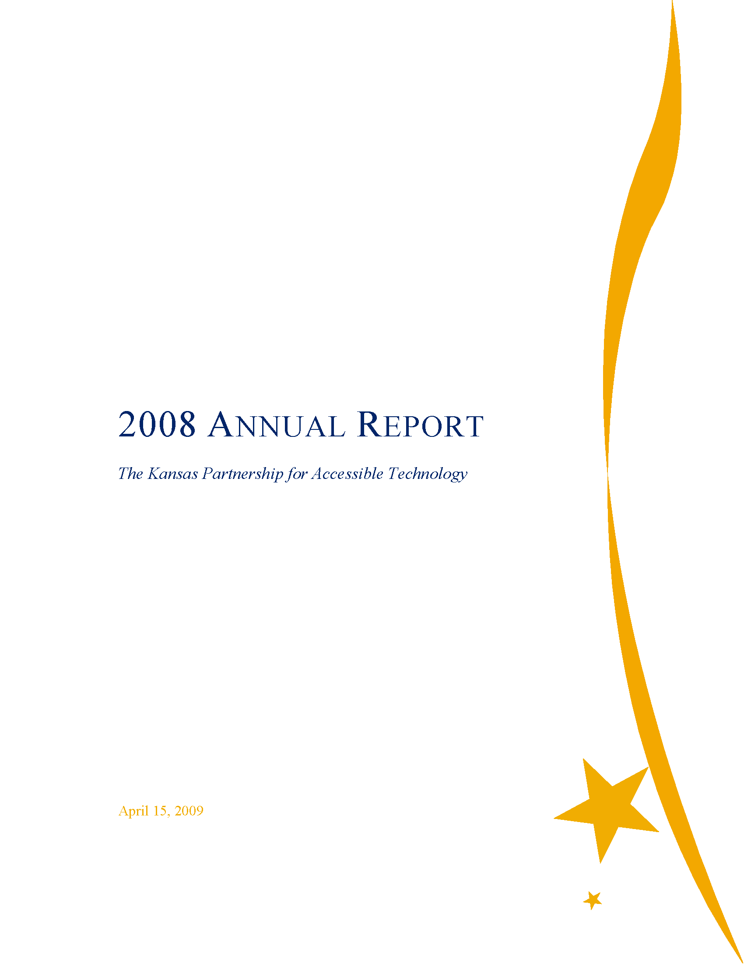
2008 Annual Report
Submitted to ITEC, the Legislature (JCIT Members), and the Governor
Online at da.ks.gov/kpat/ reports
Notes:
Cc’d: Senate President, House Speaker, Legislative Research Department personnel, Governor’s Office of Communications Director
(Full URL to report is http://da.ks.gov/kpat/reports/2008/kpat_annual_report_2008.pdf )

Slide 5
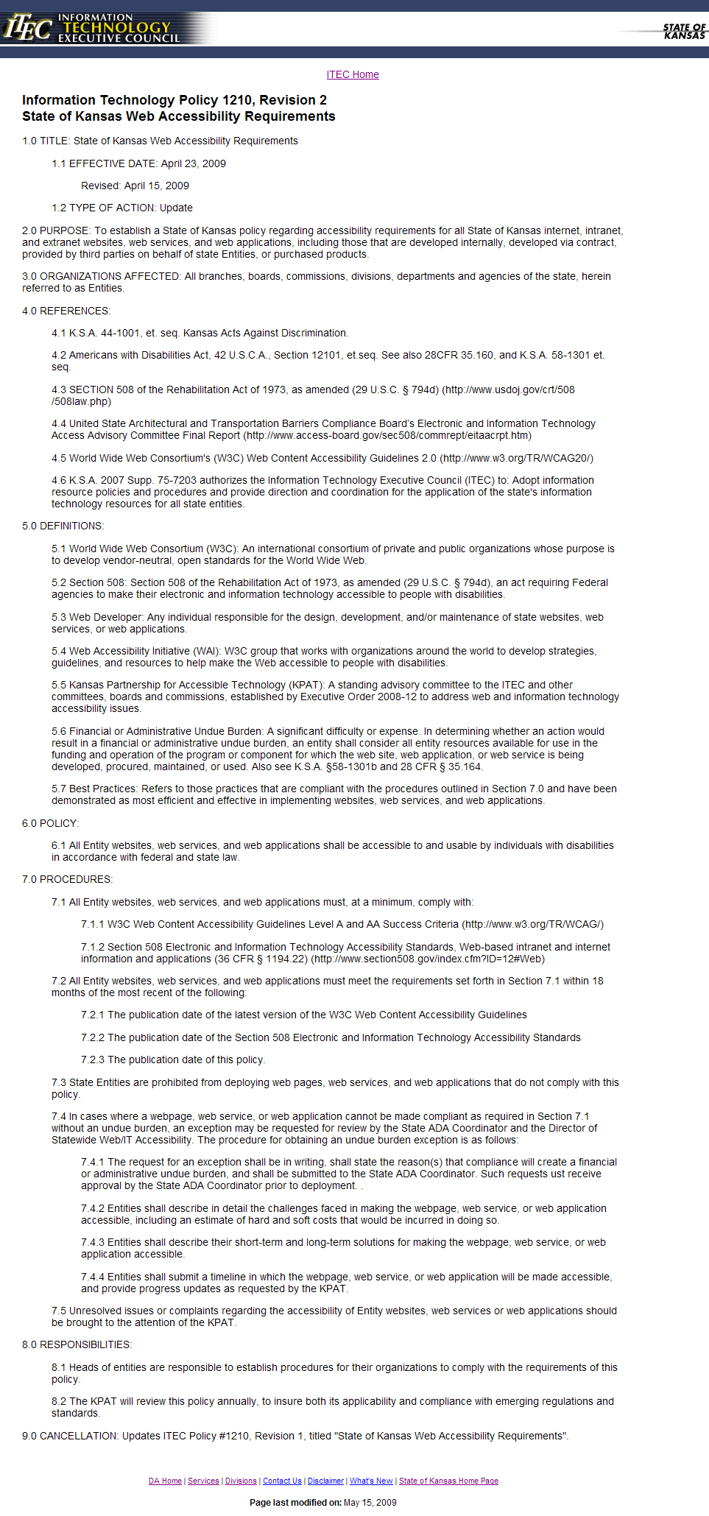
IT Policy 1210
Approved by ITEC in April.
Announced in email to agency heads, ADA coordinators, ITAB members, and KPAT members.
Online at da.ks.gov/itec/ documents/ itecitpolicy1210.htm
Guide for web developers at da.ks.gov/kpat/ resources
Notes:
(Full URL to web developers’ guide is: http://da.ks.gov/kpat/resources/1210guidance.htm )

Slide 6
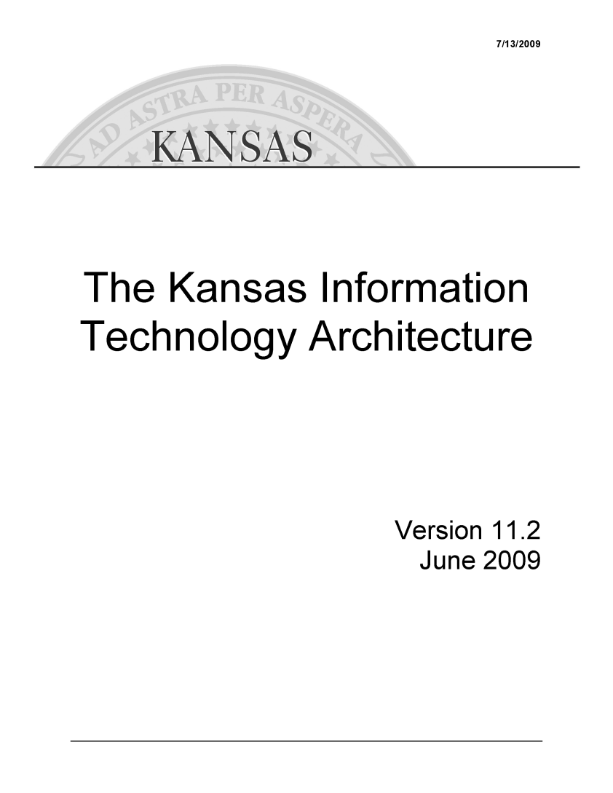
Kansas Information Technology Architecture
The KITA describes the information systems infrastructure that supports the applications used by the State. Its purpose is to guide the development of the information systems infrastructure.
IT Policy 4010 requires all IT initiatives and acquisitions, and all state contracts for IT products, to comply with the KITA.
Notes:
“For information technology projects with total cumulative cost greater than $250,000, project plan documents will include an Architectural Statement for review by the Chief Information Technology Officer of the appropriate branch and the CITA.… Agency Project Architectural Statements included with Project Plans for projects with cumulative cost greater than $250.000 for CITO review are to contain a description of the technology categories included in the project and an indication of the selected technical architecture elements to be employed.”
A Web Accessibility Compliance Statement is also required for IT projects (IT Policy 2400A).

Slide 7
Kansas Information Technology Architecture
Version 11.2 draft going to ITEC Thursday for approval
Worked with the Kansas Information Technology Office
Added several accessibility-related mentions
Awareness
Look for it to appear at da.ks.gov/itec/KITAMain.htm
Notes:
Added mentions: 15, by my count, plus a couple of slight revisions to existing mentions
This will hopefully be another platform to raise awareness

Slide 8
Statewide Web Accessibility Assessment
Recap:
Need to monitor web accessibility status and effectiveness
For feedback to agencies, to ensure conformance, to inform training, to raise awareness, etc.
Must be consistent, quantified, repeatable, able to be aggregated and compared across the State enterprise
Automated tool
Initial baseline pilot—representative sample
Notes:
Ensure conformance = meet our legal obligation

Slide 9
Web Accessibility Assessment Working Group
Mike Branam Kansas Department on Aging
Anthony Fadale State ADA Coordinator
Joe Oborny Kansas School for the Deaf
Libby Peters Kansas Department of Social and Rehabilitation Services
Anthony Schlinsog Kansas Department of Transportation
Matt Veatch State Historical Society
DiAnna Wages Kansas.gov
John Waldo Kansas Department of Revenue
Notes:
Met twice so far.

Slide 10


Automated Baseline Assessment
Up to 30 agencies
Up to 1,000 pages each
$5,000 total
Investigated and spoke repeatedly with five vendors
Negotiated from their standard—and much more costly—products and services to this approach
Two vendors remain under consideration
Notes:
Should have a selection and be ready to proceed soon.

Slide 11
Automated Baseline Assessment
Will your organization participate?
Notes:
KPAT involvement is the logical place to start.

Slide 12
Report from the Director of Statewide Web/IT Accessibility
PDF: H1N1 flu virus communications, HR memos
KanView search
Kansas Recovery
Broadband mapping contract
Kansas.gov accessibility statement
Shared Leave Request Form
State Performance Review Form
Notes:
PDF: Provided info to KDHE on making these accessible, and worked with them to provide accessible info to individuals who couldn’t read initial message; have meeting set up next week with DofA and Governor’s Office personnel to discuss changes that could be made to their workflow to produce accessible PDFs; also provided info to SRS recently. (Future training opportunity)
KanView: Confirmed accessibility of search pages
Kansas Recovery: Checked, worked with Janet on text alternatives
Broadband mapping contract: Duncan ensured web accessibility paragraph was included
Kansas.gov: Discussing options
Shared Leave & State Performance Review forms: Looking into accessibility issues & how to improve

Slide 13
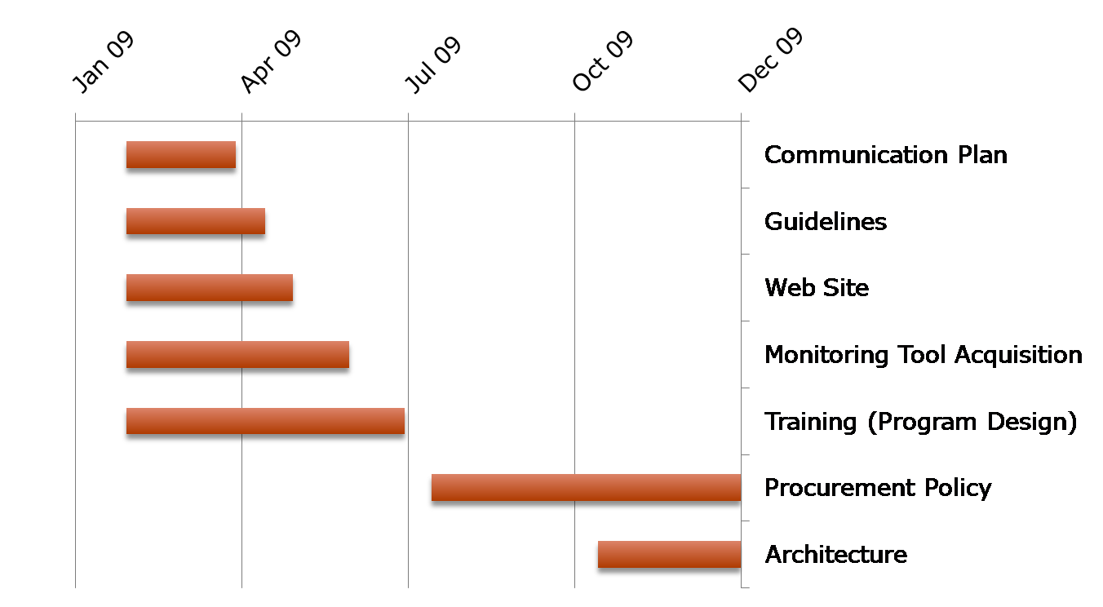
Proposed Timeline (Prior)

Slide 14
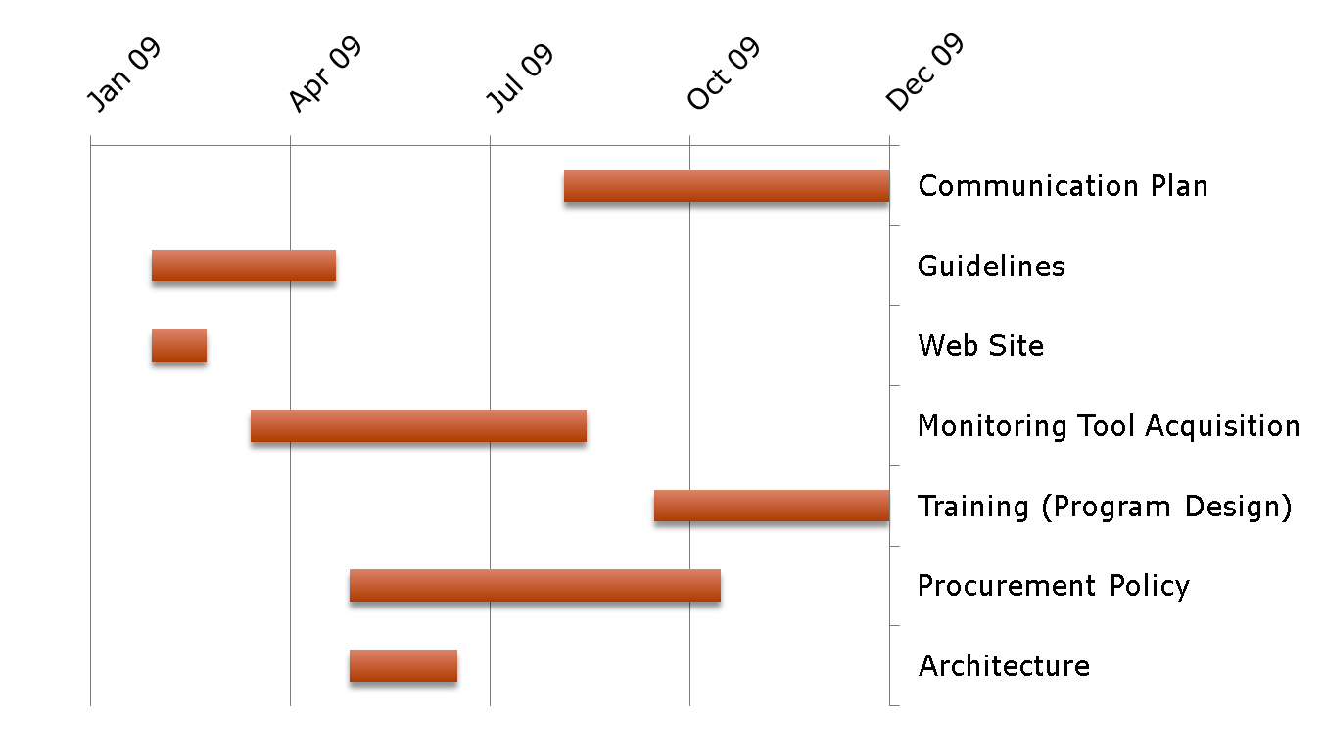
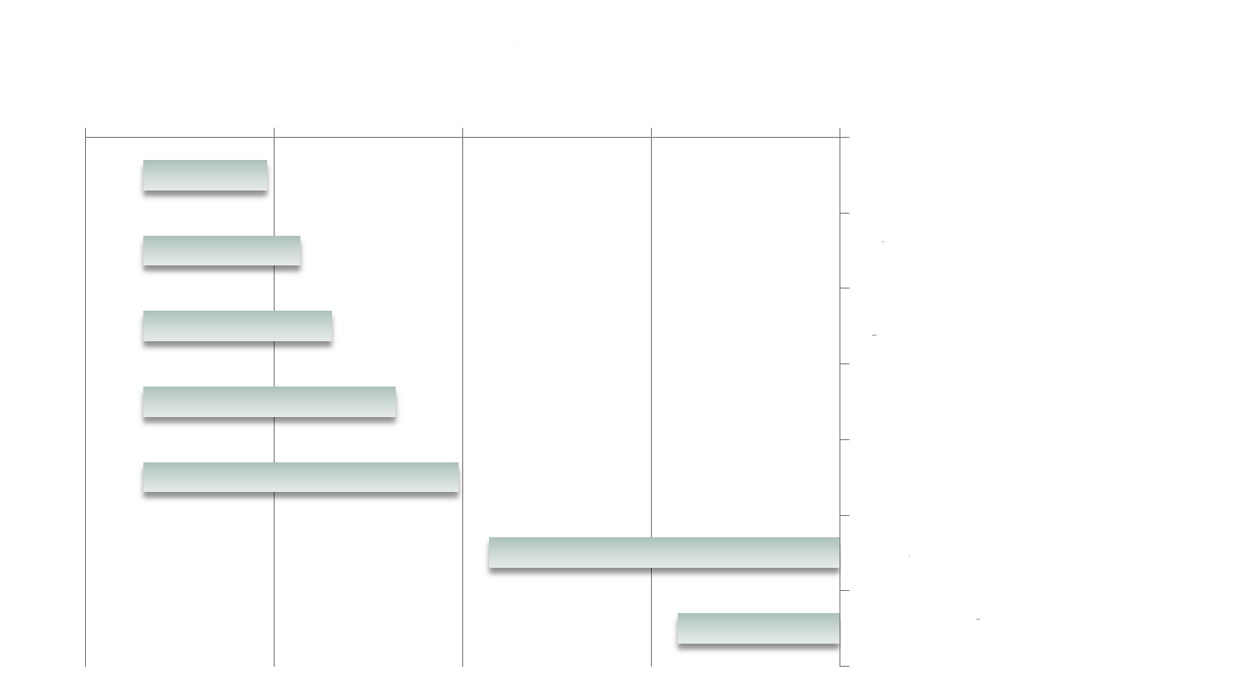
Proposed Timeline (Revised)

Slide 15
Procurement

Slide 16
Challenges
Third-party products (contracted development, SaaS, COTS, etc.)
It needs to be made clear that accessibility policy conformance is part of the requirements.
We need to try to be more “up front” in the procurement / project planning process.
Avoid rework, extended timelines, legal exposure, etc.
Notes:
As we’ve previously discussed…

Slide 17
Contract Language
One way to go about this is to restore specific IT accessibility language to contracts.
Consistent
Standardized language
In boilerplate templates (IFB, RFP, etc.)
Largely just spelling out ramifications of existing requirements (Not trying to “shock the system”)
Notes:
“Restore”: There used to be some.
“Consistent”: It’s in some (such as what Carey sees to); we want to make sure it’s in all (applicable). Also want to make sure it’s the same (standardized).

Slide 18

Proposed Language A
Computer Hardware, Software, Other Technologies. In accordance with the Anti-Discrimination Clause of Form DA-146a, paragraph number 5, all products and services provided or developed as part of fulfilling this contract shall conform to Section 508 of the Rehabilitation Act of 1973, as amended (29 U.S.C. & 794d), and its implementing Electronic and Information Technology Accessibility Standards (36 CFR § 1194). (Paragraph number 5 requires compliance with the ADA, Title II of which applies the regulations under the Rehabilitation Act of 1973, as amended.) Section 508 requires that electronic and information technology is accessible to people with disabilities, including employees and members of the public. Information regarding all aspects of accessibility under Section 508 is available at the federal government's official website, http://www.section508.gov/, and a technical assistance document can be found at http://www.access-board.gov/sec508/guide/.
Notes:
(All in new “Accessible Technology” section.)
This is the most general point. It attempts to draw the connection between the existing ADA compliance requirement and the IT-specific Section 508.
This is also our first real foray into broadening our scope to IT beyond web. (The EO says: “The Partnership shall address web and information technology accessibility issues…”, etc.)

Slide 19
Proposed Language B
Web Development. The State of Kansas requires that its websites, web services, and web applications be accessible to and usable by individuals with disabilities. This means that any websites, web services, and web applications developed in the fulfillment of this contract—including: (a) any to which this contract directly pertains; (b) any web-based training material, user documentation, reference material or other communications materials intended for public or internal use related to the work completed under this contract; and (c) any updates, new releases, versions, upgrades, improvements, bug fixes, patches, customizations, or other modifications to the above—shall comply with Kansas Information Technology Policy 1210: State of Kansas Web Accessibility Requirements (IT Policy 1210), which is consistent with applicable federal, state, and World Wide Web Consortium standards. IT Policy 1210 is located at http://www.da.ks.gov/itec/documents/itecitpolicy1210.htm. For additional reference, supporting information for implementing IT Policy 1210 can be found at http://da.ks.gov/kpat/resources/.
Notes:
Web-specific. References IT Policy 1210.

Slide 20
Proposed Language C
Affirmation of Conformance. The contractor shall provide a description of conformance with these specifications by means of a completed Voluntary Product Accessibility Template (VPAT) or other comparable document. (VPAT information is available at http://www.itic.org/index.php?src=gendocs&ref=vpat&category=resources&submenu=Resources.) This conformance claim becomes a contractual term between the contractor and the contracting state agency.
Notes:
This is new, but is simply an attempt to “get it in writing”. Mention Chris’ ideas about beefing this up to include it with the bid at the beginning, along with confirmation as a deliverable at the end.

Slide 21
About VPAT
VPAT documentation is an existing industry standard.
Many vendors already have standing VPATs available for their products.
For example: www.microsoft.com/industry/government/ products/section508.mspx
A VPAT is very simply a table with a row for each requirement and a column for whether/how the vendor meets that requirement, and another for remarks and explanations.

Slide 22
VPAT Sample
Criteria | Supporting Features | Remarks and explanations
(a) A text equivalent for every non-text element shall be provided (e.g., via "alt", "longdesc", or in element content). | Fully compliant: All <img> elements have appropriate alt attributes. Real text is used instead of images where possible. Transcripts are provided for audio and video content. | Illustrations are used throughout the content. In some cases the illustrations require alternative text. In other cases they are merely decorative, or enhance the "look and feel," in which case they are given null alt text or are included as CSS background images (to avoid providing screen reader users with useless information).
… etc.
(From http://www.webaim.org/products/training/vpat)

Slide 23
Proposed Language D
Issues/Complaints. The contractor shall promptly respond to any complaint brought to its attention regarding accessibility. The contractor shall resolve such complaints by bringing the product into compliance with the aforementioned requirements at no additional cost to the state. The contractor shall indemnify and hold harmless the State of Kansas and any agency thereof utilizing the contractor’s services from any claim arising out of the contractor’s failure to comply with the aforementioned requirements.
Notes:
We want the vendor to assume liability.

Slide 24
Rollout Approach
Looking for thoughts on this, too
Want to take a measured approach that would minimize barriers and raise awareness
Examples of outreach could include:
Speaking at a procurement officers meeting
Holding brief awareness sessions for purchasing staff
Introduce to community by talking to ITEC, ITAB, RITC, etc.
Add to templates for new contracts (including agency “toolkits”)
Amend base contracts for TPR
Address existing contracts when they come up for renewal
(If needed, some could be amended sooner)
Be available to help with RFPs or discussions with vendors, etc.

Slide 25
Feedback?
Notes:
We’ve discussed this with the Division of Purchases and the Office of Chief Counsel within the Department of Administration, and will collect further feedback (e.g., see what some vendors think). We certainly want to hear from KPAT members.
Possible barriers to implementation:
Barriers in the form of pushback on agencies including it in their RFPs
Potential pushback from the results—from vendors or agencies (re: cost or increased complexity of procurement, for example)
Other

Slide 26
Chair Nomination Process

Slide 27
Chair and Vice-Chair
Executive Order 08-12 states:
“The Governor shall select a Chairperson and Vice-Chairperson from among the members who shall serve for one year and thereafter be elected by the Partnership.”
Since our next meeting (October) will be our last before we begin our second year, we’ll need to handle this then.
So we should start thinking about it now.

Slide 28
Open Discussion

