Slide 1
Kansas Partnership for Accessible Technology
October 14, 2009 Meeting

Slide 2
Captioning
Joe Oborny and Jerod Prothe Kansas State School for the Deaf

Slide 3
Status Updates

Slide 4
JCIT Presentation
Joint Committee on Information Technology
Interim Committee of the Legislature
Duncan Friend presented on the KPAT September 23.
Presentation available at http://bit.ly/JCIT-KPAT
Notes:
JCIT charge: “The Committee is directed to study computers, telecommunications, and other information technologies
used by state government, and to review new acquisitions of information technology.”
http://bit.ly/JCIT-KPAT goes to http://skyways.lib.ks.us/ksleg/KLRD/Publications/JCIT_Resources/9-23-09/JCIT-KPAT.pdf

Slide 5
Statewide Web Accessibility Assessment
Recap:
Need to monitor web accessibility status and effectiveness
Automated baseline pilot
Up to 30 agencies, limited # pages — representative sample
$5,000 total budgeted
Investigated 5 vendors, got quotes from 4, narrowed to 2
Notes:
For feedback to agencies, to ensure conformance, to inform training, to raise awareness, etc.
Ensure conformance = meet our legal obligation
Must be consistent, quantified, repeatable, able to be aggregated and compared across the State enterprise

Slide 6
Statewide Web Accessibility Assessment
Working group got demos with sample reports from both vendors
Selected vendor
Working on refining scope of work in line with project plan
Notes:
Demos used http://da.ks.gov/.
Working group:
Mike Branam Kansas Department on Aging
Anthony Fadale State ADA Coordinator
Andrew Goodrick (was DiAnna Wages) Kansas.gov
Joe Oborny Kansas School for the Deaf
Libby Peters Kansas Department of Social and Rehabilitation Services
Anthony Schlinsog Kansas Department of Transportation
Matt Veatch State Historical Society
John Waldo Kansas Department of Revenue

Slide 7
Statewide Web Accessibility Assessment
Incremental rollout plan
Start with limited pilot
Identify and resolve any issues with the service
Get answers needed by agencies considering participation
Define/standardize most constructive approach to agency involvement
Estimate level of effort to manage remediation process
Define tracking and reporting methods
Etc.
Develop plan and identify participants for phased rollout to additional agencies
Notes:
Plan is still a work in progress

Slide 8
Statewide Web Accessibility Assessment
Incremental rollout plan (continued)
Lots of communication
Determine agency sponsors and stakeholders
Explain approach and define expectations
Identify resources
Work closely with agency to plan, execute, and track response
Ready to proceed

Slide 9
IT Procurement
Recap:
Needs to be made clear that accessibility policy conformance is part of the requirements in the procurement of third-party solutions
July:
Proposed language
Affirmation of conformance: VPAT
Tentative rollout approach
Notes:
Rollout Approach (as presented in July):
Looking for thoughts on this, too
Want to take a measured approach that would minimize barriers and raise awareness
Examples of outreach could include:
Speaking at a procurement officers meeting
Holding brief awareness sessions for purchasing staff
Introduce to community by talking to ITEC, ITAB, RITC, etc.
Add to templates for new contracts (including agency “toolkits”)
Amend base contracts for TPR
Address existing contracts when they come up for renewal
(If needed, some could be amended sooner)
Be available to help with RFPs or discussions with vendors, etc.

Slide 10
A Work in Progress…
Numerous discussions since we last met
Kansas Information Technology Office
Division of Purchases
Office of Chief Counsel
State ADA Coordinator
Illinois
Learned a lot
Adjustments

Slide 11
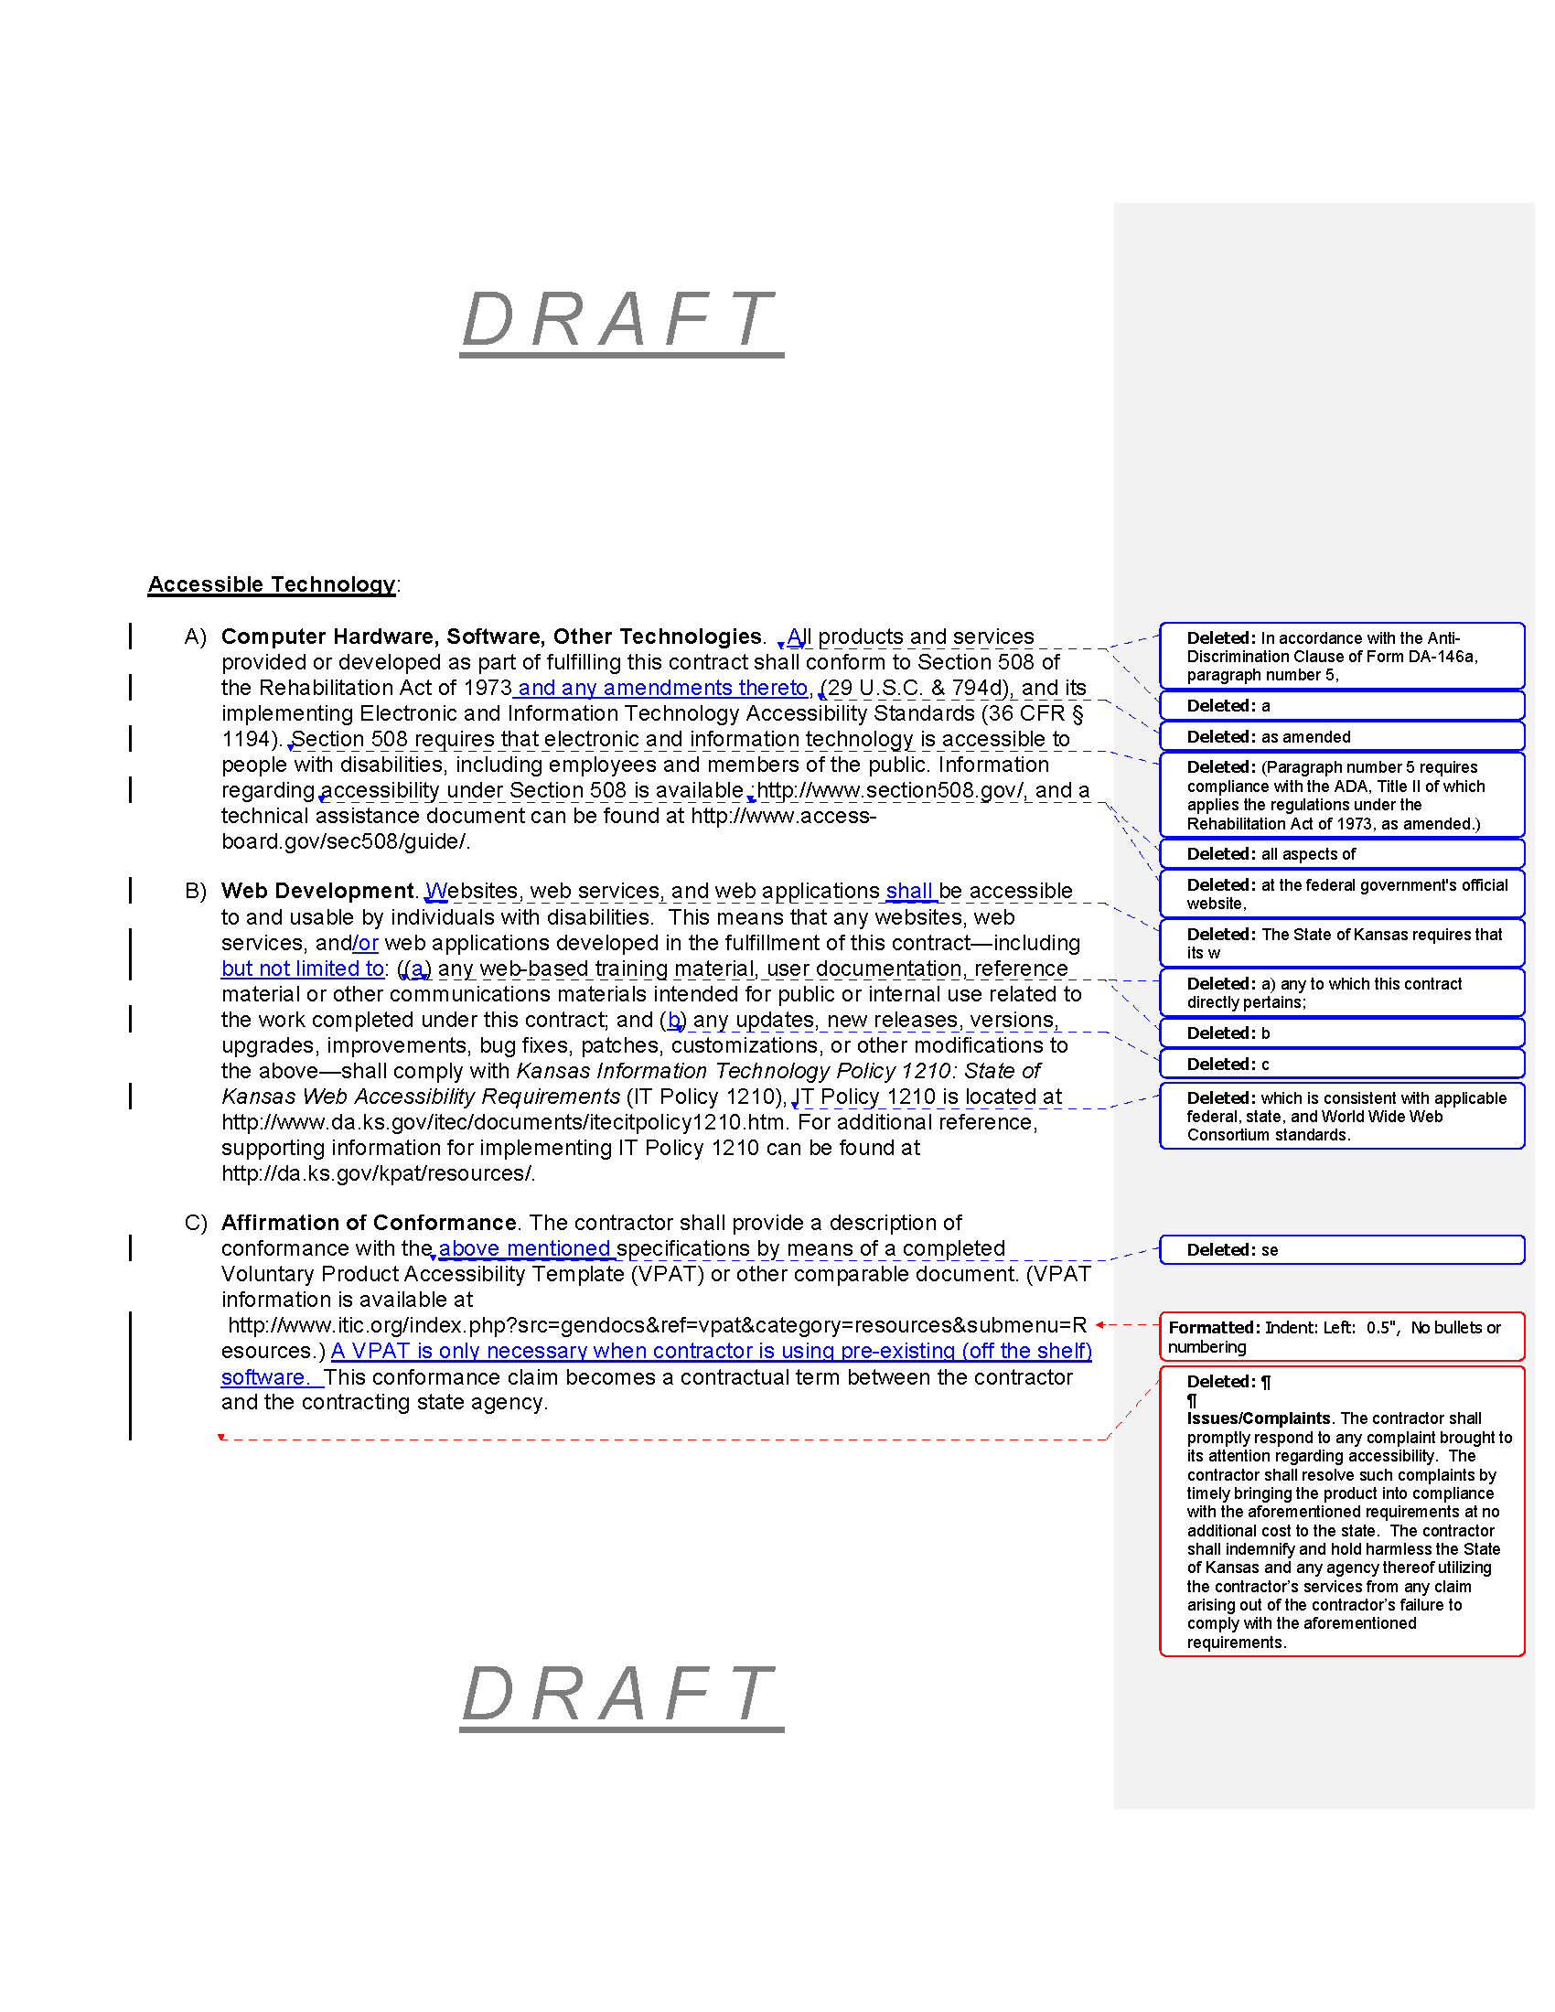
Language
Reached preliminary agreement on language, after some revisions

Slide 12
Many Aspects of Procurement
Task Orders
IT Projects
Statewide Contracts
Not Exactly
“One Size Fits All”…
Request for Proposal
Invitation for Bid
Delegated Purchasing Authority
Agency Contracts
Consortia (WSCA, MHEC, …)
Prior Authorizations
Fixed Price

Slide 13
IT Projects
Start with IT Projects
Defined in K.S.A. 75-7201(c):
"Information technology project" means a project for a major computer, telecommunications or other information technology improvement with an estimated cumulative cost of $250,000 or more and includes any such project that has proposed expenditures for: (1) New or replacement equipment or software; (2) upgrade improvements to existing equipment and any computer systems, programs or software upgrades therefor; or (3) data or consulting or other professional services for such a project.

Slide 14
IT Projects
Feasible starting point
Generally high impact
Existing governance framework
Much is already being done!
Similar language in RFPs
Architectural compliance
Web Accessibility Compliance Statement
Notes:
Feasible starting point
Generally high impact — we can make an appreciable difference even with a narrowed focus
Existing governance framework — Opportunity to make use of existing IT governance framework for policy and communication
ITEC Policies 2000 Series http://www.da.ks.gov/itec/ITPoliciesMain.htm
Policy 2400 - IT Project Approval
Policy 2400A - IT Project Plan Instructions
Policy 2500 - IT Project Status Reporting
Policy 2510 - IT Project Oversight
Policy 2530 - IT Project Management
Disruption of current process is minimal
For vendors as well
Much is already being done! — Again, disruption is minimal, both for us and for vendors
Similar language in RFPs
Architectural compliance
Web Accessibility Compliance Statement

Slide 15
IT Projects
Our aim:
Specify the VPAT as a way to document compliance
Increase focus on the issue, through outreach, etc.
Avail the Director of IT Accessibility to become involved, assist with compliance evaluation, etc.
Notes:
Groups to address include (but are not necessarily limited to):
ITAB
ITEC
Contract Development

Slide 16
Procurement
This will be a learning process.
First step: in time, we anticipate we’ll work our way through other levels of procurement
Applying what we’ve learned
Tailoring approach to each, while
Standardizing where we can

Slide 17
Challenges
Challenge | Resolution
Indemnity language may be too strong, could drive up cost | Not critical language; removed
Could increase exposure | Agreement that this is not an impediment to moving forward
When in the process is the VPAT required? | Will tailor to each procurement category. For projects, will follow process already in place.
References will need to be kept up-to-date. | By linking to external resources, tracking changes in those resources will not be required.
Notes:
On exposure: It’s there already. The good faith effort this represents will be a positive.

Slide 18
Challenges
Challenge | Resolution
How will we verify/enforce? | Use existing processes, rely on vendor, educate, assist; narrowed focus eases burden on resources
Could invite award complaints if process is not followed | Can ensure process is followed within narrowed scope
Should existing, internally built sites come first? | We are endeavoring to do both, and can do so in parallel. Important to address procured solutions given the increased reliance on them, their criticality, size of investments, etc.
Notes:
Procured/in-house: “stop the flow”

Slide 19
Report from the Director of Statewide Web/IT Accessibility
KDHE: reviewed H1N1 flu virus communications (PDFs) as follow-up
Connect Kansas: reviewed site, Speed Test (Flash), survey
Division of Personnel Services: provided info on how to make accessible PDFs for HR memos
SMART: Met to discuss requirements

Slide 20
Report from the Director of Statewide Web/IT Accessibility
Aging: Answered questions about social networking
Governor’s Office: Answered questions about web slideshows
Kansas Lottery: Answered questions about third-party content
Division of Facilities Management: produced Real Estate Lease Agreement as accessible PDF form

Slide 21
Communication Plan

Slide 22
Purposes/Themes of Communication Effort
Share information about:
KPAT mission, vision, and values
Agenda for accessibility, and what it means for you
Issues and risks
Available resources
Education (news, issues)
Others?
Notes:
KPAT mission, vision, and values
Increase awareness of KPAT; Demonstrate value; Sustain or expand membership; Demonstrate sponsorship
Agenda for accessibility, and what it means for you
Includes progress and achievements
Increase awareness of goals and objectives and stakeholders part in them; Demonstrate achievements and their relevance; Manage expectations; Gain feedback
Issues and risks
Increase awareness of issues and risks; Gain feedback on prevalence, concern; Identify emerging issues
Available resources
Increase awareness of tools, websites, other resources available to support AT
Education (news, issues)

Slide 23
Purposes/Themes of Communication Effort
Gather information about:
Accessible technology needs
Input into priorities/agenda of the KPAT
Measures of success / feedback
Available resources
News and issues
Others?

Slide 24
Communication Plan
Questions for discussion:
Are the preceding our purposes/themes?
How can we most effectively communicate
With each other?
With others in your organizations?
With other stakeholders?
Other approaches to information gathering?
With whom should we communicate
I.e., who are those other stakeholders?
Resources needed/available

Slide 25
Chair and Vice-Chair Election

Slide 26
Schedule of Future Meetings

Slide 27
2010 Meetings
Month | Date | Day | Time | Location
January | 13th | Wednesday | 1:30–3:30pm | TBD
April | 14th | Wednesday | 1:30–3:30pm | TBD
July | 14th | Wednesday | 1:30–3:30pm | Landon State Office Building, Room 106
October | 13th | Wednesday | 1:30–3:30pm | Landon State Office Building, Room 106

Slide 28
Open Discussion

