Slide 1
Kansas Partnership for
Accessible Technology
October 13, 2010 Meeting

Slide 2
Captioning Pilot Projects

Slide 3
Legislative Video
  Legislature’s Kansas Legislative Information Services System (KLISS) video plans moving ahead
  Met with representatives from Legislative Computer Services and the contracted vendors for KLISS and the Kansas Enterprise Electronic Preservation (KEEP) project, discussed technical aspects
  Still exploring how captioning information will be provided

Slide 4
Agency Opportunities
Opportunities for piloting both live and recorded captioning of state agency meetings

Slide 5
Web Accessibility Assessment Tool Procurement Status

Slide 6
Status
RFP draft is complete, and has been shared with Purchases
Putting working group together to review the RFP, see demos, etc.
Contacting vendors
Plan to have finalized for Purchases by the end of the month

Slide 7
RFP
Sets out to procure a tool for statewide use, as well as a vehicle for individual agency procurements
Highlights various usage scenarios
Details over 50 specific requirements for web accessibility assessment, in areas of architecture, remediation, assessment features, and reporting

Slide 8
RFP
Also provides for:
  Remediation tools
  Assessment and remediation tools for other (non-web) technologies
  Training
  Consulting assistance

Slide 9
IT Project Planning

Slide 10
Background
Improving accessibility in procurement has been a work in progress since the KPAT began.
In April, Don Heiman suggested ITEC Policy 2400A as a vehicle for doing so for IT projects.
Last meeting, he presented proposed accessibility additions to 2400A.
We’ve continued to revise, resulting in the drafts circulated by email last month.
Notes:
K.S.A. 75-7201(c):
"Information technology project" means a project for a major computer, telecommunications or other information technology improvement with an estimated cumulative cost of $250,000 or more and includes any such project that has proposed expenditures for: (1) New or replacement equipment or software; (2) upgrade improvements to existing equipment and any computer systems, programs or software upgrades therefor; or (3) data or consulting or other professional services for such a project.

Slide 11
ITEC Policy 2400A Currently Says:
Web Accessibility Compliance Statement - ITEC Policy 1210
  http://da.ks.gov/kito/itec/ITPoliciesMain.htm
This element in the information project plan is a written statement of compliance with web accessibility compliance features in accordance with ITEC Policy 1210. If different, explain why or attach your written State ADA Coordinator waiver from the ITEC Policies or if no web accessibility compliance features are included in this project, explain why.

Slide 12
ITEC Policy 1210, In Turn, Says:
7.1 All Entity websites, web services, and web applications must, at a minimum, comply with:
  7.1.1 W3C Web Content Accessibility Guidelines Level A and AA Success Criteria (http://www.w3.org/TR/WCAG/)
  7.1.2 Section 508 Electronic and Information Technology Accessibility Standards, Web-based intranet and internet information and applications (36 CFR § 1194.22) (http://section508.gov/index.cfm?fuseAction=stdsdoc#Web)

Slide 13
These Are:
(a) A text equivalent for every non-text element shall be provided (e.g., via "alt", "longdesc", or in element content).
(b) Equivalent alternatives for any multimedia presentation shall be synchronized with the presentation.
(c) Web pages shall be designed so that all information conveyed with color is also available without color, for example from context or markup.
Etc.…
Notes:
The provisions of Section 508 § 1194.22

Slide 14
… And:
1.1.1 Non-text Content: All non-text content that is presented to the user has a text alternative that serves the equivalent purpose…. (Level A)…
1.2.1 Audio-only and Video-only (Prerecorded): For prerecorded audio-only and prerecorded video-only media, the following are true, except when the audio or video is a media alternative for text and is clearly labeled as such: (Level A)
  Prerecorded Audio-only: An alternative for time-based media is provided that presents equivalent information for prerecorded audio-only content.
  Prerecorded Video-only: Either an alternative for time-based media or an audio track is provided that presents equivalent information for prerecorded video-only content.
1.2.2 Captions (Prerecorded): Captions are provided for all prerecorded audio content in synchronized media, except when the media is a media alternative for text and is clearly labeled as such. (Level A)
Etc.…
Notes:
The Level A and AA success criteria of WCAG 2.0
These are the requirements. They have been for 18 months in the current version. Including earlier versions, they have been the requirements for about a decade.

Slide 15
Checklist
Having the requirement details two steps away in two separate documents obscures them.
Providing a single listing of the requirements should improve their visibility and clarity, to make following them easier.
Notes:
Again, these are the current requirements.

Slide 16
Web Accessibility Compliance Statement
The current compliance statement requirement is too general to be useful.
Casting it in terms of the individual requirements listing gives it needed specificity.
  Makes meaningful evaluation possible.
  Hopefully more effective

Slide 17
Web Content Accessibility Template
Adding columns to the requirements list, in which to document compliance status for each, produces a template that does exactly that.

Slide 18
Web Content Accessibility Template
Criteria | Supporting Features | Remarks and explanations
(a) A text equivalent for every non-text element shall be provided (e.g., via "alt", "longdesc", or in element content).
(b) Equivalent alternatives for any multimedia presentation shall be synchronized with the presentation.
(c) Web pages shall be designed so that all information conveyed with color is also available without color, for example from context or markup.
(d) Documents shall be organized so they are readable without requiring an associated style sheet.
…

Slide 19
Web Content Accessibility Template
In fact, this is exactly what the Federal government does with the VPAT, which makes it a familiar format.
  Many vendors already have VPAT documents prepared for their products.

Slide 20
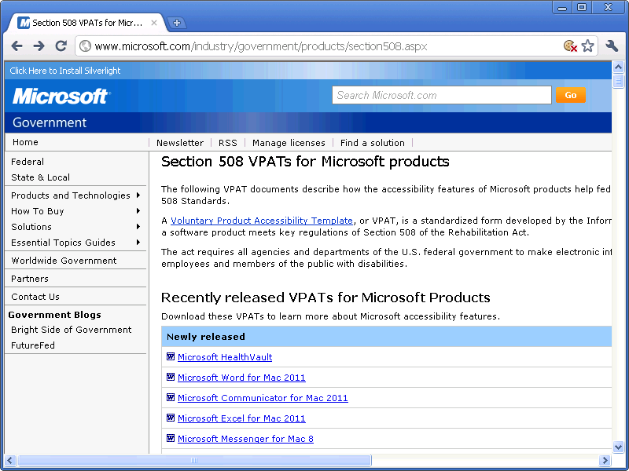
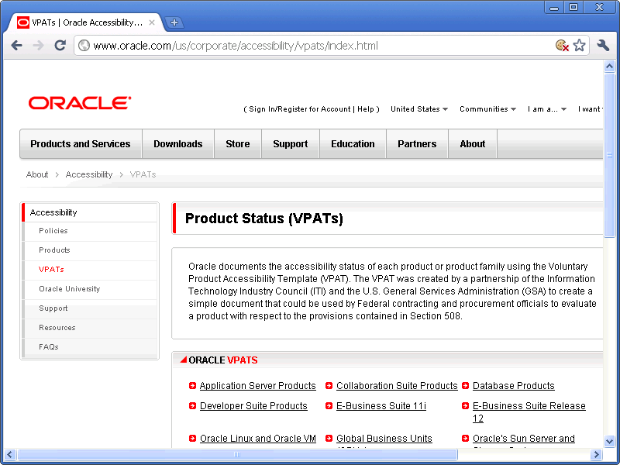
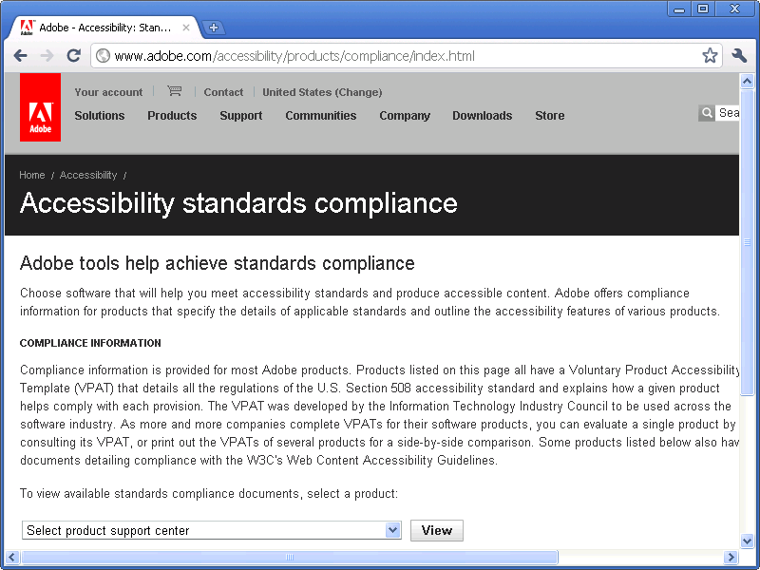
Examples

Slide 21
Ready for the Future
1210-derived template does differ from VPAT, by its inclusion of WCAG 2.0 Level AA.
But with this being the direction of 508, this difference will soon disappear.

Slide 22
Alignment with Existing Process
Including the template listing of requirements with the bid specification puts them right alongside other functional and technical requirements.

Slide 23
Compliance Deliverables
As with other requirements, the completed accessibility compliance template included with the detailed project plan would indicate how the requirements will be met, with associated work items, cost estimates, etc.

Slide 24
Verification
We also propose requiring verification of compliance.
  Again, this treats these much like any other requirements, which would typically include testing in the work breakdown.
  Minimizes the need for “expert” evaluation.
  Hopefully more effective

Slide 25
KPAT Review
Since the July presentation, we’ve adjusted the KPAT’s review role:
  To name just one person, rather than a subcommittee
    Streamline logistically
  To occur once, instead of twice
    Less burdensome
    Eliminates high-level review, where there wouldn’t yet be much to evaluate anyway
  To coincide with other reviews
    So as not to add any delay

Slide 26
Proposed Changes: ITEC 2400A
CITO approval is to include:
  “Review of the detailed project plan and Web Accessibility Statement by the Director of IT Accessibility.”
  (p. 4)

Slide 27
Proposed Changes: ITEC 2400A
Cost Avoidance:
  “Accessibility Factors - the cost avoidance achieved by initial compliance with accessibility requirements, including the decreased potential for high legal expenses, and forestalling the need for more difficult and expensive post-deployment retrofitting.”
  (p. 9)

Slide 28
Proposed Changes: ITEC 2400A
Cost Savings (Hard Savings), Examples of Savings
  “Accessibility (decreases need for multiple implementations when accessibility enables interoperability with different devices; reduces demand for alternate formats of content, saving production and distribution costs)”
  (p. 9)

Slide 29
Proposed Changes: ITEC 2400A
Work Breakdown Structure (WBS) @ 8/80 duration level, Defining Tasks or Activities:
  “Note that the WBS must specifically include all relevant tasks for achieving accessibility compliance, including any remediation, development, and testing/verification activities.”
  (p. 10)

Slide 30
Proposed Changes: ITEC 2400A
Web Accessibility Compliance Statement - ITEC Policy 1210
  “This element in the information project plan is a written statement confirming compliance with the web accessibility requirements outlined in ITEC Policy 1210. A completed Web Content Accessibility Template (WCAT) must be provided as part of the statement for all products that are procured, provided as a service, or custom built as part of the project. If the WCAT indicates full compliance on all items, the statement should include the identification of the task numbers on the WBS that verify this compliance. For any WCAT item where full compliance is not indicated, the statement should identify task numbers in WBS that perform remediation of compliance issues along with task numbers that will verify compliance. If the product is not anticipated to be compliant upon initial implementation, please attach an exception from the State ADA Coordinator. If no web accessibility compliance features are included in this project, explain why.”
  (pp. 13–14)

Slide 31
Proposed Additions:
Feasibility Study Report Process
Proposed Solution Analysis
  “Will the proposed solution comply with Information Technology Executive Council Policy 1210 State of Kansas Web Accessibility Requirements?”
  (p. 6)

Slide 32
Proposed Additions:
Feasibility Study Report Process
Solution Description
  “Accessibility: What steps will be taken to ensure the compliance of the proposed solution with Information Technology Executive Council Policy 1210 Web Accessibility Requirements (requirement in bid specifications, testing, etc.)?”
  (p. 20)

Slide 33
Proposed Addition: Entity Checklist for High Level Project Plans
Web Accessibility Statement (ITEC Policy 1210)
http://www.da.ks.gov/kito/itec/
ITPoliciesMain.htm
  Provide confirmation of intent to use Web Content Accessibility Template (WCAT) to assess compliance with ITEC 1210 as part of the procurement/development and testing process.

Slide 34
Proposed Change: Entity Checklist for Detailed Project Plans
Current:
  Web Accessibility Statement (ITEC Policy 1210)
  http://www.da.ks.gov/kito/itec/ITPoliciesMain.htm
    Description of web accessibility compliance features
    If none, attach ADA Coordinator waiver

Slide 35
Proposed Change: Entity Checklist for Detailed Project Plans
Proposed:
  Web Accessibility Statement (ITEC Policy 1210)
  http://www.da.ks.gov/kito/itec/ITPoliciesMain.htm
    Confirm compliance with ITEC Policy 1210 requirements by attaching a completed Web Content Accessibility Template (WCAT) for the product(s) procured, provided as a service, or custom-built.
    If WCAT indicates compliance on all items, provide statement identifying task numbers in WBS that will verify compliance.
    For any WCAT item where full compliance is not indicated, identify task numbers in WBS that perform remediation of compliance issues along with task numbers that will test compliance.
    If product is not anticipated to be compliant upon initial implementation, please attach State ADA Coordinator exception. If accessibility standards do not apply, please provide explanation.

Slide 36
Kansas Broadband Summit

Slide 37

Kansas Broadband Summit
October 24–25
Wichita Marriott
connectkansas.org/broadband_summit

Slide 38
State ADA Coordinator Report

Slide 39
Approach to Administration Transition

Slide 40
Open Discussion

