Slide 1
Kansas Partnership for
Accessible Technology
January 12, 2011 Meeting

Slide 2
Annual Report

Slide 3
Accomplishments
Governance
  ITEC Guideline 2400A
  Kansas Broadband Advisory Task Force “digital inclusion” member
  Federal ICT Standards and Guidelines draft comments
Assistance
  ITEC Policy 1210 implementation guidance
  Support

Slide 4
Accomplishments
Communication
  FCC Accessibility and Innovation Initiative participation in the Kansas Broadband Conference
  Legislature, ITAB, ITEC, RITC
  Webmasters meetings
  Website
Assessment
  Tool RFP

Slide 5
Planned Initiatives
Governance
  Kansas Information Technology Architecture update
  Federal updates
  Procurement
Assistance
  Captioning pilots

Slide 6
Planned Initiatives
Communication
  Assessment tool rollout
  Communication plan
  Webmasters list
Assessment
  Statewide, automated web accessibility assessment

Slide 7
IT Project Planning

Slide 8
IT Project Planning
  ITEC Guideline 2400A, Web Content Accessibility Template posted
  KITO sent announcement to ITAB Monday.
  Will be included in CITO Reporting Requirements training.
Notes:
(Recap what’s involved: review and approval prior to plan submission, statement in high-level plan, WCAT use in detailed plan)

Slide 9
Kansas Broadband Summit

Slide 10
Captioning Pilot Projects

Slide 11

Board of Education Meeting
Kala J. Patterson
1-877-674-5800
admincs@captionsolutions.com
Closed Caption Pilot - 1/11/2011 - 10:00–12:00 Kansas State Board of Education
CART services (Communications Access Real-time Translation)
StreamText – http://streamtext.net
Demo (Issues)
Integration
Event Transcripts

Slide 12
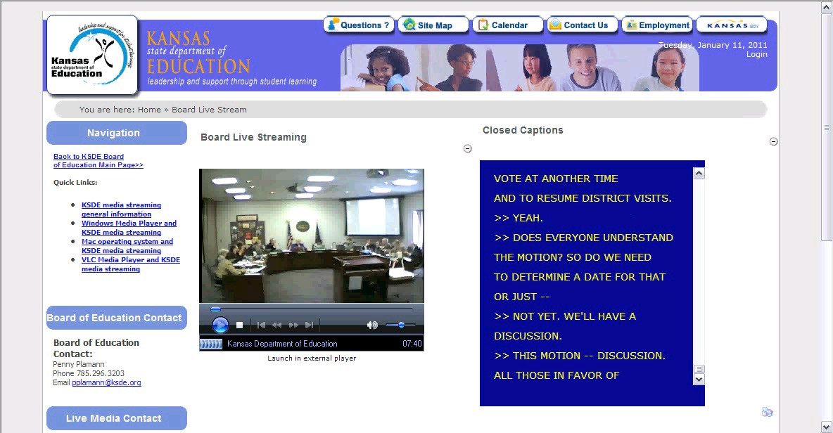
Board of Education Meeting

Slide 13
Legislative Committee Meetings
Two rooms
  Old Supreme Court room
  Committee room 548
Video application in place
  Storage format will include robust caption support
Grant request for video hardware
Captioning by “re-talking”
  Re-talkers identified
Up in March

Slide 14
State of the State Address
Confirmed that telecast will be captioned by KPTS, as has been done in the past
KPTS will forward caption file for web use.

Slide 15
Web Accessibility Assessment Tool Procurement Status

Slide 16
Request for Proposal
Bid event EVT0000261 mailed November 5, closed December 3
Received and have been reviewing a small number of bids
Questions to vendors sent Monday, responses due Friday

Slide 17
Evaluation Team
Mike Branam
Department on Aging
Anthony Fadale
State ADA Coordinator
Michael Fienen
Pittsburg State University
Duncan Friend
DISC
Libby Peters / Phil White
Department of Social and Rehabilitation Services
Cole Robison
DISC
Anthony Schlinsog
Department of Transportation
John Waldo
Department of Revenue

Slide 18
Evaluation Team
Met 3 times to date
Reviewed proposals, came up with questions
Experimenting with trial access
Crafting scenario & sample content for demos

Slide 19
State ADA Coordinator Report

Slide 20
Chair and Vice-Chair Election

Slide 21
Schedule of Future Meetings

Slide 22
2011 Meetings Schedule
Wednesday, April 6
Wednesday, July 6
Wednesday, October 5

Slide 23
Open Discussion

Slide 24
Next Meeting:
Wednesday, April 6, 2011
Time:
1:30–3:30 PM
Location:
Landon State Office Building
Room 106
900 SW Jackson Street

