Slide 1
Kansas Partnership for Accessible Technology
April 3, 2012 Meeting

Slide 2
Section 508 Refresh Comment

Slide 3
Second Refresh Draft
Second draft of the update to the federal Information and Communication Technology (ICT) Standards and Guidelines
  Notice: http://www.access-board.gov/sec508/
  refresh/notice.htm
  Draft text: http://www.access-board.gov/sec508/
  refresh/draft-rule.htm
Public comment period ended March 7, 2012.

Slide 4
Our Comment
Our comment viewable at http://go.usa.gov/PIW
Besides addressing specific questions posed in the notice, comment emphasized:
  Strong support of WCAG 2.0 incorporation
  Encouragement of prompt adoption
Notes:
Shortened URL redirects to http://www.regulations.gov/#!documentDetail;D=ATBCB-2011-0007-0042
Oracle Accessibility Program Director has remarked to me, in a separate email conversation, that he noticed our comment. —CDR

Slide 5
Other Comments
Also provided input on NASCIO comment, through participation in Section 508 Working Group.
  http://go.usa.gov/mOz
74 comments submitted, including from SSB BART Group, NetCentric, PDF Association, Adobe, Microsoft, Oracle, etc.
  http://go.usa.gov/mOu
Notes:
NASCIO: National Association of State Chief Information Officers
http://go.usa.gov/mOz → http://www.regulations.gov/#!documentDetail;D=ATBCB-2011-0007-0052
http://go.usa.gov/mOu → http://www.regulations.gov/#!docketDetail;dct=PS;rpp=250;po=0;D=ATBCB-2011-0007

Slide 6
AMP Rollout Update

Slide 7
AMP Rollout
Met with personnel from all cabinet agencies to introduce AMP and its implementation
Moving forward with other agencies
104 users from 25 agencies to date.
SSB training being scheduled; likely to begin toward end of April

Slide 8
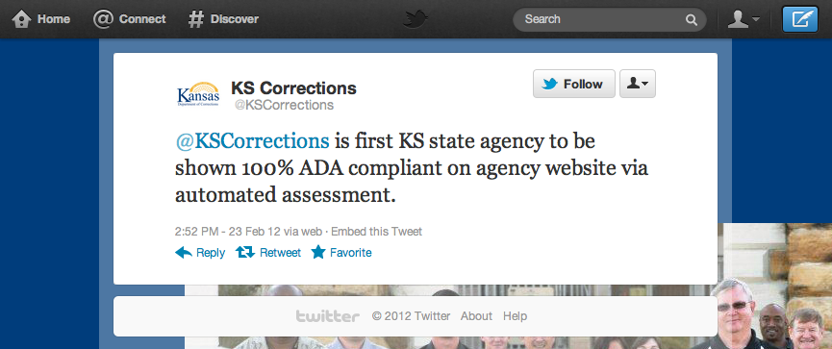
Notes:
Also received similar email from Kansas Highway Patrol.

Slide 9
KPAT Annual Report

Slide 10
Annual Report Draft
Accomplishments and Planned Initiatives as outlined last meeting
A number of tentative possibilities for reporting AMP results for the Accessibility Status of State Websites last time.
Refined and came up with some new ideas based on your feedback

Slide 11
Assessment Sample
63 agency home page domains, as represented in the Agency Contact Listing page of the Communication Directory on the Department of Administration website (with corrections and a few additions)
Spidered each site up to 250 pages
Automated testing
Notes:
Agency Contact Listing at http://da.ks.gov/Phonebook/agencyprint.asp
Additions were public universities from http://www.kansasregents.org/interactive_map_listing missing from the list, and the Legislature.

Slide 12
Assessment Sample
This is the same sample as presented last time.
There was some discussion then of reporting from a different, more comprehensive, dataset, but another run would be too far removed from calendar year.
The next, and subsequent, reports will feature more comprehensive datasets.

Slide 13
Pages
11,084 pages scanned
9,292 pages had one or more violations (83.8%)

Slide 14
Numbers of Violations
High Severity Violations | 55,210 | (48%)
Medium Severity Violations | 11,533 | (10%)
Low Severity Violations | 48,248 | (42%)
Total violations | 114,991

Slide 15
Most Frequent Violations
(by Pages Affected)
Best Practice | Violations | Percentage of Pages with Violation | Severity | Noticeability | Tractability
Ensure the language of a document is set | 5,918 | 52% | 1 | 6 | 2
Provide explicit labels for form fields | 12,301 | 42% | 10 | 6 | 2
Ensure headers and cells are properly associated | 4,043 | 24% | 10 | 7 | 4
Ensure table headers are used in a valid fashion | 3,131 | 19% | 10 | 4 | 4
Provide alternative text for images | 7,171 | 18% | 10 | 10 | 2

Slide 16
Most Frequent Violations
(by Violation Count)
Best Practice | Violations | Percentage of Pages with Violation | Severity | Noticeability | Tractability
Ensure heading elements are properly ordered | 38,957 | 18% | 3 | 6 | 4
Ensure the sole use of device dependent event handlers is avoided | 25,363 | 17% | 8 | 7 | 2
Provide explicit labels for form fields | 12,301 | 42% | 10 | 6 | 2
Ensure keyboard focus is only assigned to elements that are defined as keyboard focusable without setting a tabindex | 8,347 | 8% | 6 | 5 | 4
Provide alternative text for images | 7,171 | 18% | 10 | 10 | 2

Slide 17
Most Severe Violations
Best Practice | Violations | Percentage of Pages with Violation | Severity | Noticeability | Tractability
Provide alternative text for images | 7,171 | 18% | 10 | 10 | 2
Provide explicit labels for form fields | 12,301 | 42% | 10 | 6 | 2
Ensure headers and cells are properly associated | 4,043 | 24% | 10 | 7 | 4
Ensure table headers are used in a valid fashion | 3,131 | 19% | 10 | 4 | 4
Avoid utilizing sub-tables in header elements | 15 | 0% | 9 | 3 | 5

Slide 18
Most Tractable Violations
Best Practice | Violations | Percentage of Pages with Violation | Severity | Noticeability | Tractability
Provide alternative text for images | 7,171 | 18% | 10 | 10 | 2
Provide explicit labels for form fields | 12,301 | 42% | 10 | 6 | 2
Ensure the sole use of device dependent event handlers is avoided | 25,363 | 17% | 8 | 7 | 2
Ensure frame titles are meaningful | 1,530 | 6% | 7 | 6 | 2
Provide valid, concise, and meaningful alternative text for image buttons | 311 | 2% | 6 | 8 | 2
Ensure the language of a document is set | 5,918 | 52% | 1 | 6 | 2
Provide summary attributes for tables when appropriate | 255 | 1% | 3 | 7 | 2
Ensure hr elements utilize relative sizing | 630 | 0% | 4 | 2 | 2
Ensure option elements in large lists are grouped | 821 | 6% | 1 | 2 | 2

Slide 19
Agency Appraisal / Recognition

Slide 20
Ideas?
Letter grades
  Sought be Executive Branch CITO
  Need to develop algorithm, accompany results with explanation
  Agency would have opportunity to attach explanation
“Honor roll”
  Badges for sites, collection of links, etc.
  Carrot instead of stick
  Risk: Potentially makes sites targets

Slide 21
PDF Accessibility

Slide 22
PDF Accessibility Resources
Documentation
Training
Assessment tools for individuals
Enterprise assessment tools
Authoring and remediation tools
Remediation services

Slide 23
Originating Documents
PDF files are often produced by conversion from originating documents of another type, e.g., Microsoft Word. The accessibility of the result is directly affected by the accessibility of the original in its native format, so accessibility resources for the originating documents come into play as well.

Slide 24
Documentation
Adobe Acrobat Pro Accessibility Guide: Best Practices for Accessibility
  http://www.adobe.com/accessibility/products/acrobat/pdf/
  A9-access-best-practices.pdf
PDF Techniques for WCAG 2.0
  http://www.w3.org/TR/
  WCAG20-TECHS/pdf.html
AMP Learning Center
  Adobe Acrobat PDF – Technology Platform
  Adobe Acrobat PDF – Best Practices
U.S. Department of Health & Human Services (HHS)
  http://www.hhs.gov/web/508/pdfs/
Etc.
Notes:
(This slide was skipped in the meeting due to time constraints.)

Slide 25
Documentation
(Originating Documents)
Creating Accessible Word Documents
  http://j.mp/HMFJDh
Creating Accessible Excel Files
  http://j.mp/hwgvTD
Creating Accessible PowerPoint Presentations
  http://j.mp/HMH50N
Create Accessible PDFs
  http://j.mp/idYMkx
AMP Learning Center
  Microsoft Word – Best Practices
  Microsoft PowerPoint – Best Practices
Notes:
http://j.mp/HMFJDh → http://office.microsoft.com/en-us/word-help/creating-accessible-word-documents-HA101999993.aspx
http://j.mp/hwgvTD → http://office.microsoft.com/en-us/excel-help/creating-accessible-excel-files-HA102013545.aspx
http://j.mp/HMH50N → http://office.microsoft.com/en-us/powerpoint-help/creating-accessible-powerpoint-presentations-HA102013555.aspx
http://j.mp/idYMkx → http://office.microsoft.com/en-us/excel-help/create-accessible-pdfs-HA102478227.aspx
(This slide was skipped in the meeting due to time constraints.)

Slide 26
PDF/UA
International standard for accessible PDF
ISO 14289
Supported by PDF/UA Competence Center of the PDF Association
  http://www.pdfa.org/competence-centers/pdfua-competence-center/
Expected for publication in the first half of 2012
Also coming soon: “Achieving WCAG 2.0 with PDF/UA” document
Notes:
Thanks to Bill Griffiths for passing along this information.
(This slide was skipped in the meeting due to time constraints.)

Slide 27
Training
AMP Learning Center
  Adobe Acrobat Accessibility Overview
  Adobe Acrobat – Basics
  Adobe Acrobat – Advanced
Forthcoming state training
SSB BART Group
  State contract at http://go.usa.gov/jGK
  Web-based or onsite instructor-led training
Other training providers
Notes:
(This slide was skipped in the meeting due to time constraints.)

Slide 28
Assessment Tools for Individuals
Manual checklists
  Ersatz checklist from documentation
  AMP
  HHS PDF File 508 Checklist
    http://www.hhs.gov/web/policies/checklistpdf.html
Notes:
(This slide was skipped in the meeting due to time constraints.)

Slide 29
Assessment Tools for Individuals
Automated
  Acrobat Pro
    Advanced ▶ Accessibility ▶ Full Check
    http://www.adobe.com/products/acrobatpro.html
  PAC – the PDF Accessibility Checker
    Free
    http://www.access-for-all.ch/en/pdf-lab/pdf-accessibility-checker-pac.html
  CommonLook PDF
    http://www.commonlook.com/CommonLook-PDF
Notes:
There’s also a “Quick Check” in Acrobat Pro.
(This slide was skipped in the meeting due to time constraints.)

Slide 30
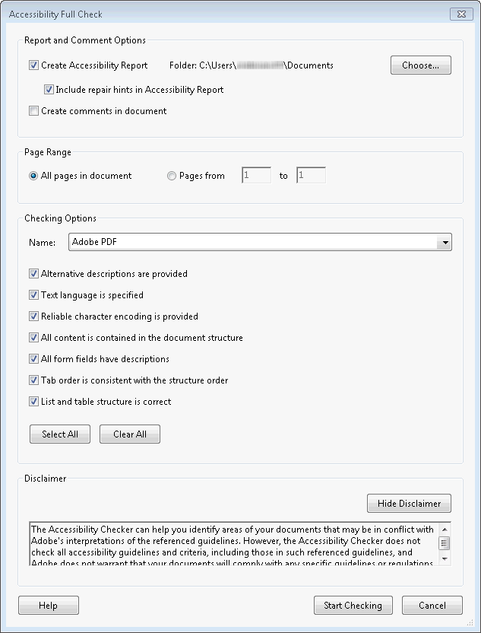
Acrobat Pro
Accessibility Full Check
Notes:
(This slide was skipped in the meeting due to time constraints.)

Slide 31
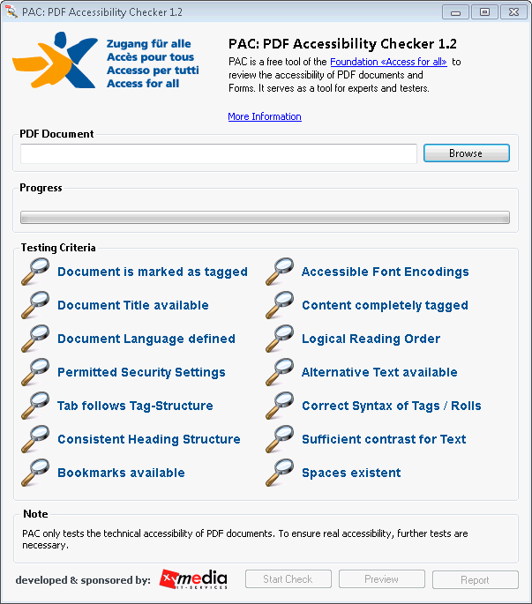
PAC
Notes:
(This slide was skipped in the meeting due to time constraints.)

Slide 32
Assessment Tools for Individuals
(Originating Documents)
Manual checklists
  AMP (Word, PowerPoint)
  HHS checklists (Word, Excel, PowerPoint)
    http://www.hhs.gov/web/508/checklists/
Notes:
(This slide was skipped in the meeting due to time constraints.)

Slide 33
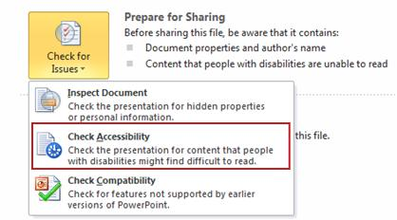
Assessment Tools for Individuals
(Originating Documents)
Automated
  Accessibility Checker (Word, Excel, PowerPoint)
    http://j.mp/szZkKC
Notes:
http://j.mp/szZkKC → http://office.microsoft.com/en-us/excel-help/accessibility-checker-HA010369192.aspx
(This slide was skipped in the meeting due to time constraints.)

Slide 34
Enterprise Assessment Tools
CommonLook Clarity
  http://www.commonlook.com/CommonLook-Clarity
Notes:
(This slide was skipped in the meeting due to time constraints.)

Slide 35
Authoring and Remediation Tools
Acrobat Pro
  http://www.adobe.com/products/
  acrobatpro.html
CommonLook PDF
  http://www.commonlook.com/CommonLook-PDF
  Works with (and requires) Acrobat
Notes:
(This slide was skipped in the meeting due to time constraints.)

Slide 36
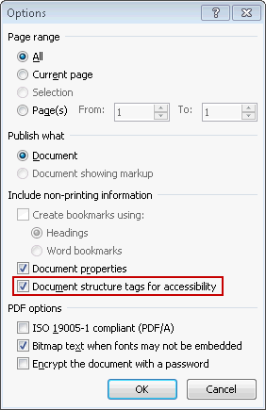
Authoring and Remediation Tools
(Originating Documents)
Aforementioned Create Accessible PDFs instructions (Word, Excel, PowerPoint)
  http://j.mp/idYMkx
CommonLook Office
  http://www.commonlook.com/CommonLook-office
Notes:
http://j.mp/idYMkx → http://office.microsoft.com/en-us/excel-help/create-accessible-pdfs-HA102478227.aspx
(This slide was skipped in the meeting due to time constraints.)

Slide 37
Remediation Services
CommonLook Service
  http://www.commonlook.com/verification-and-remediation
Notes:
(This slide was skipped in the meeting due to time constraints.)

Slide 38
Summary
Plentiful information resources available
Producing accessible PDF files starts in the originating document’s native application (i.e., Office)!
PAC represents a good freeware option for individual assessment.

Slide 39
Summary
However, authoring/remediation tools are costly.
  Also require considerably more effort and expertise.
NetCentric CommonLook seems to be only major player in PDF accessibility space.

Slide 40
What Might a CommonLook Solution Look Like?
CommonLook Clarity appears to be analogous to AMP for PDF.
A big difference is that with HTML, the remediation side can generally be handled with whatever tools folks are already using to produce HTML content. With PDF, new tools need to be provided here as well.
CommonLook Office is much less expensive (and has much less of a learning curve) than Acrobat Pro, but would still require significant investment.

Slide 41
Feedback
What do you think?
Notes:
Interest in a demo at the next meeting?
(This slide was skipped in the meeting due to time constraints.)

Slide 42
State ADA Coordinator Report

Slide 43

July Meeting Schedule

Slide 44
Open Discussion

