Slide 1
Kansas Partnership for Accessible Technology
August 29, 2012 Meeting

Slide 2
AMP Update

Slide 3
AMP Rollout
As noted last time, we’ve met with personnel from all cabinet agencies to introduce AMP and its implementation
Moving forward with other agencies
153 users from 29 agencies to date
Had first two sessions of SSB training in May
Put up mini-site at http://oits.ks.gov/kpat/tool/
License renewal assured

Slide 4
Progress
Since the audit detailed in the KPAT Annual Report, 77% of agencies have reduced their number of violations.
Overall and average numbers of violations dropped 59%, due to an overall elimination of over 66,000 violations.
Average violations per page is also down 34%.
Two agencies, the Office of the Kansas State Treasurer and the Kansas Department of Corrections, brought their violations down to zero.
  (Based on automated testing)
Notes:
Assessment sample: 63 agency home page domains, as represented in the Agency Contact Listing page of the Communication Directory on the Department of Administration website at http://da.ks.gov/Phonebook/agencyprint.asp (with corrections and a few additions, namely public universities from http://www.kansasregents.org/interactive_map_listing missing from the list, and the Legislature), each spidered up to 250 pages

Slide 5
Agency Self-Assessments
Martha Gabehart

Slide 6
State ADA Coordinator Report
Anthony Fadale

Slide 7
Procurement

Slide 8
Procurement
Over the last two years, we’ve successfully integrated accessibility requirements into IT projects as defined in K.S.A. 75-7201(c).
From early on, that was determined to be the best starting point, with additional approaches appropriate to other levels of procurement to be sought in time.

Slide 9
Procurement
We’ve begun discussions with Procurement and Contracts
Will try to identify agency and statewide contracts to which requirements apply
Procurement officer can ensure desired requirements language is included
Engage when contracts come up for renewal or rebidding, as well as new contracts

Slide 10
Procurement
Any such steps must be preceded by discussion with interested parties for awareness, feedback, and buy-in
  CITO
  Secretary of Administration
  ITAB
  Administrative services
  Procurement officers
  Etc.

Slide 11
PDF Accessibility

Slide 12
Overview
In order for a PDF document to be accessible, it must satisfy many of the same functional requirements as a traditional HTML web page (or any other form of ICT), such as:
  Alternative text for images
  Identification of document structure (headings)
  Programmatically identifiable table relationships
  Programmatically identifiable labels for form controls
  Adaptability to multiple modalities
  Etc.
Remember, indeed, that ITEC Policy 1210, Section 508, and WCAG all apply regardless of the technology.

Slide 13
Overview
As HTML is a markup language, the notion of marking up the necessary semantics is fairly natural (the hurdle has traditionally been to mark up the semantics adequately).
As visual fidelity was the sole original intent of PDF, it has no intrinsic semantics. Tags were added to the technology to address this very issue, but it is possible (and all too common) to create PDF documents that have no tags.

Slide 14
Untagged PDF
Without tags, it is impossible for all but the very simplest of documents to be accessible.
Without tags, there is no mechanism to do things like:
  define alternative text for an image
  identify headings, navigation, structure, or ordering
  mark up tables or forms
  distinguish “artifacts” from “real” content
  etc.

Slide 15
Scanned PDF
Worse, a PDF document may not only be untagged, but contain no text whatsoever.
This is often the outcome when the PDF is the product of a scanned document.
Such a PDF is nothing more than an image. It’s an image of a text document, but there it contains no textual data.

Slide 16
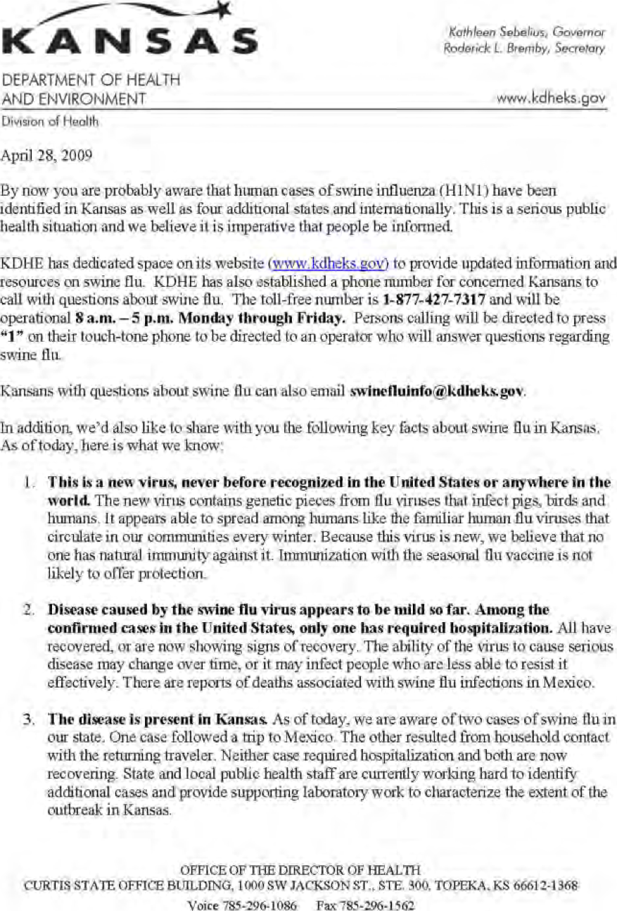
Example
In 2009 KDHE circulated this PDF document.
The accessible text content (that available to, e.g., a screen reader) is empty.
A screen reader user who could not read it raised the issue. The State ADA Coordinator worked with the IT Accessibility Director, KDHE, and DPS to implement methods to produce a more accessible version.

Slide 17
PDF Accessibility Prerequisites
In order for a PDF to be accessible, then, it must first actually include text data.
  This is generally accomplished by producing PDFs directly from software, i.e., PDFs that are “born digital”.
  Even with scanned documents, it is possible using OCR.
Second, the PDF must be tagged.
Then, and only then, can specific accessibility enhancements be applied to satisfy the functional requirements.

Slide 18
Scope
Using AMP’s Document Inventory report, I attempted to get a rough idea of the number of PDF documents on state websites.
Out of 61 domains surveyed, 230,915 PDFs were found (compared to 361,288 HTML files).
The average number of PDFs per agency was 3,785.49.
More than half of the agencies (36) had more PDFs than HTML files!

Slide 19
Scope
As an initial product evaluation, a vendor of an enterprise PDF accessibility assessment tool (more on this later) scanned a small sample of state websites.
The scan was limited to the first 50 PDF files found on each of 6 agency websites, for a total of 300 PDF files evaluated.
Of these, 268 (89%) failed accessibility requirements.
150 (50%) were untagged.
Notes:
The number of pages in the PDF documents evaluated ranged from 1 to 248, with an average of 15.61.

Slide 20
PDF Accessibility Resources
Standards: PDF/UA
Documentation
Training
Assessment tools for individuals
Enterprise assessment tools
Authoring and remediation tools
Remediation services

Slide 21
Originating Documents
PDF files are often produced by conversion from originating documents of another type, e.g., Microsoft Word. The accessibility of the result is directly affected by the accessibility of the original in its native format, so accessibility resources for the originating documents come into play as well.

Slide 22
Standards: PDF/UA
International standard for accessible PDF
ISO 14289-1
Supported by PDF/UA Competence Center of the PDF Association
  http://www.pdfa.org/competence-centers/pdfua-competence-center/
Published August 7, 2012.
Also coming soon: “Achieving WCAG 2.0 with PDF/UA” document
Notes:
Thanks to Bill Griffiths for passing along this information.

Slide 23
PDF/UA
More information:
  ISO 14289-1:2012 (PDF/UA) is here!
    http://www.commonlook.com/ISO-14289-12012-PDF-UA
  A New Standard for PDF Accessibility: PDF/UA
    http://blogs.adobe.com/accessibility/2012/08
  What is PDF/UA? 5 reasons why it matters
    http://www.commonlook.com/what-is-pdfua

Slide 24
PDF/UA and WCAG 2.0
WCAG 2.0 and PDF/UA - Your Questions Answered
  http://www.commonlook.com/WCAG-20-and-PDF-UA-Your-Questions-Answered
WCAG 2.0 and PDF/UA
  http://blogs.adobe.com/accessibility/2012/05/wcag-2-0-and-pdfua.html

Slide 25
Documentation
Adobe Acrobat Pro Accessibility Guide: Best Practices for Accessibility
  http://www.adobe.com/accessibility/products/acrobat/pdf/
  A9-access-best-practices.pdf
PDF Techniques for WCAG 2.0
  http://www.w3.org/TR/
  WCAG20-TECHS/pdf.html
AMP Learning Center
  Adobe Acrobat PDF – Technology Platform
  Adobe Acrobat PDF – Best Practices
U.S. Department of Health & Human Services (HHS)
  http://www.hhs.gov/web/508/pdfs/
Etc.

Slide 26
Documentation
(Originating Documents)
Creating Accessible Word Documents
  http://j.mp/HMFJDh
Creating Accessible Excel Files
  http://j.mp/hwgvTD
Creating Accessible PowerPoint Presentations
  http://j.mp/HMH50N
Create Accessible PDFs
  http://j.mp/idYMkx
AMP Learning Center
  Microsoft Word – Best Practices
  Microsoft PowerPoint – Best Practices
Notes:
http://j.mp/HMFJDh → http://office.microsoft.com/en-us/word-help/creating-accessible-word-documents-HA101999993.aspx
http://j.mp/hwgvTD → http://office.microsoft.com/en-us/excel-help/creating-accessible-excel-files-HA102013545.aspx
http://j.mp/HMH50N → http://office.microsoft.com/en-us/powerpoint-help/creating-accessible-powerpoint-presentations-HA102013555.aspx
http://j.mp/idYMkx → http://office.microsoft.com/en-us/excel-help/create-accessible-pdfs-HA102478227.aspx

Slide 27
Training
AMP Learning Center
  Adobe Acrobat Accessibility Overview
  Adobe Acrobat – Basics
  Adobe Acrobat – Advanced
Forthcoming state training
SSB BART Group
  State contract at http://go.usa.gov/jGK
  Web-based or onsite instructor-led training
Other training providers

Slide 28
Assessment Tools for Individuals
Manual checklists
  Ersatz checklist from documentation
  AMP
  HHS PDF File 508 Checklist
    http://www.hhs.gov/web/policies/checklistpdf.html

Slide 29
Assessment Tools for Individuals
Automated
  Acrobat Pro
    Advanced ▶ Accessibility ▶ Full Check
    http://www.adobe.com/products/acrobatpro.html
  PAC – the PDF Accessibility Checker
    Free
    http://www.access-for-all.ch/en/pdf-lab/pdf-accessibility-checker-pac.html
  CommonLook PDF
    http://www.commonlook.com/CommonLook-PDF
Notes:
There’s also a “Quick Check” in Acrobat Pro.

Slide 30
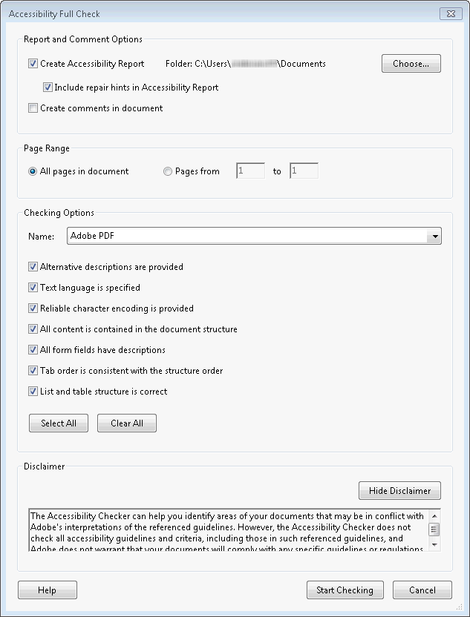
Acrobat Pro
Accessibility Full Check

Slide 31
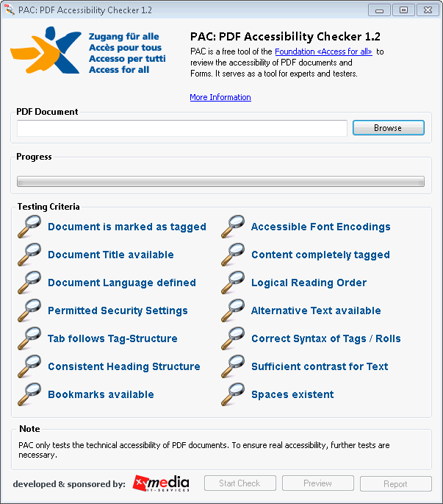
PAC

Slide 32
Assessment Tools for Individuals
(Originating Documents)
Manual checklists
  AMP (Word, PowerPoint)
  HHS checklists (Word, Excel, PowerPoint)
    http://www.hhs.gov/web/508/checklists/

Slide 33
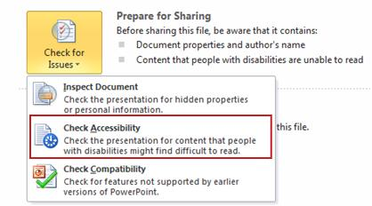
Assessment Tools for Individuals
(Originating Documents)
Automated
  Accessibility Checker (Word, Excel, PowerPoint)
    http://j.mp/szZkKC
Notes:
http://j.mp/szZkKC → http://office.microsoft.com/en-us/excel-help/accessibility-checker-HA010369192.aspx

Slide 34
Enterprise Assessment Tools
CommonLook Clarity
  http://www.commonlook.com/CommonLook-Clarity
  (This is what provided the aforementioned sample.)

Slide 35
Authoring and Remediation Tools
Acrobat Pro
  http://www.adobe.com/products/
  acrobatpro.html
CommonLook PDF
  http://www.commonlook.com/CommonLook-PDF
  Works with (and requires) Acrobat

Slide 36
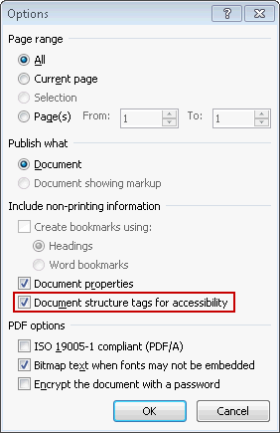
Authoring and Remediation Tools
(Originating Documents)
Aforementioned Create Accessible PDFs instructions (Word, Excel, PowerPoint)
  http://j.mp/idYMkx
CommonLook Office
  http://www.commonlook.com/CommonLook-office
Notes:
http://j.mp/idYMkx → http://office.microsoft.com/en-us/excel-help/create-accessible-pdfs-HA102478227.aspx
I have done some simple comparative testing of the many various tools/methods of creating PDFs. In general, methods for producing a PDF from a Word document fared better than those that start with a scan. While no automatic method is perfect, using CommonLook Office to produce a PDF from a Word document was best, with Word’s built-in PDF export functionality a fairly close second. Other tools, including the Adobe PDF Print Driver, Acrobat Pro, and ABBYY PDF Transformer (recently recommended by KCDC) failed to produce tagged PDF.

Slide 37
Remediation Services
CommonLook Service
  http://www.commonlook.com/verification-and-remediation

Slide 38
Summary
Plentiful information resources available
Producing accessible PDF files starts in the originating document’s native application (i.e., Office)!
PAC represents a good freeware option for individual assessment.

Slide 39
Summary
However, authoring/remediation tools are costly.
  (This is in contrast to HTML, where the tools are generally the same as those being used anyway.)
  Also require considerably more effort and expertise.
    (This is in contrast to the way PDF documents are generally created—when accessibility is not taken into account.)
NetCentric CommonLook seems to be only major player in PDF accessibility space.
  NetCentric has a partnership with SSB BART Group.

Slide 40
What Might a CommonLook Solution Look Like?
CommonLook Clarity appears to be analogous to AMP for PDF.
A big difference is that with HTML, the remediation side can generally be handled with whatever tools folks are already using to produce HTML content. With PDF, new tools need to be provided here as well.
CommonLook Office is much less expensive (and has much less of a learning curve) than Acrobat Pro, but would still require significant investment.

Slide 41
Feedback
What do you think?
Notes:
Interest in a demo at the next meeting?

Slide 42
Open Discussion

