Slide 1
Kansas Partnership for Accessible Technology
October 3, 2012 Meeting

Slide 2
Achieving Web Accessibility at the Department of Corrections
David Cook

Slide 3
State ADA Coordinator Report
Anthony Fadale

Slide 4
AMP Update

Slide 5
Progress (Updated)
Last time, I presented new AMP findings compared to the results of the audit detailed in the KPAT Annual Report last January—but I neglected to correlate the performance to the usage of AMP.
Here, then, are the results when considering only those agencies with AMP accounts:

Slide 6
Progress (Updated)
All tested agencies, as presented last time
Only AMP-using agencies
Since the audit detailed in the KPAT Annual Report, 77% of agencies have reduced their number of violations.
Overall and average numbers of violations dropped 59%, due to an overall elimination of over 66,000 violations.
Average violations per page is also down 34%.
Since the audit detailed in the KPAT Annual Report, 83% of agencies have reduced their number of violations.
Overall and average numbers of violations dropped 76%, due to an overall elimination of almost 57,000 violations.
Average violations per page is also down 68%.
Notes:
AMP-using agencies accounted for 86% of the total violations eliminated.
Original assessment sample: 63 agency home page domains, as represented in the Agency Contact Listing page of the Communication Directory on the Department of Administration website at http://da.ks.gov/Phonebook/agencyprint.asp (with corrections and a few additions, namely public universities from http://www.kansasregents.org/interactive_map_listing missing from the list, and the Legislature), each spidered up to 250 pages; automated testing only. AMP-using agencies consisted of 24 of those 63 agencies.

Slide 7
AMP Rollout Notes
All agencies (for which contact information was available) have been notified of AMP’s availability and offered access
Two more AMP user training webinars have been scheduled:
Tuesday, October 23, 2:00–3:30
Thursday, October 25, 10:00–11:30
Notes:
Training conducted by SSB BART Group’s Matt Baillargeon, with an introduction and program overview by Cole Robison.

Slide 8
Training

Slide 9
Training
It’s finally happening!
I’m developing an introductory workshop to cover:
Introduction to web accessibility and ITEC Policy 1210
Assessment with AMP
Accessible development/remediation techniques, with specific examples for top issues

Slide 10
Training
In person, instructor-led
Will investigate webinar option
First session will be held before the end of the year, with more to come.
Still in development, so suggestions are welcome

Slide 11
Telephone Captioning Services

Slide 12
Telephone Captioning Services
OITS is working with a provider of free, secure captioning services for office phones.
Captions display directly on phone screen.
Available to any qualifying employee with a new Cisco phone, on a self-selecting basis.
Coming soon!
Notes:
Pending due diligence

Slide 13
2013 Meeting Schedule

Slide 14
2013 Meeting Schedule
I’ve received a request to change the meeting schedule to avoid Wednesdays.
Suggestions for other days/times?
Online poll
Notes:
Mondays and Fridays are often open, but are traditionally not considered good days for meetings.
What about the 1st, 2nd, or 4th Tuesday or Thursday of the month, at 2:30?
Are there other quarterly conflicts? Is there any advantage to offsetting the schedule by a month to avoid them? (I.e., March, June, September, December instead of January, April, July, October—would rather shift earlier instead of later for lead time prior to ITEC, etc.)

Slide 15
PDF Accessibility

Slide 16
Recap
Last meeting, an extensive overview of the PDF accessibility landscape was presented. To briefly recap, here are some of the highlights:

Slide 17
Existing Requirements
PDF is already covered by ITEC Policy 1210, Section 508, and WCAG.
The same functional requirements apply.

Slide 18
PDF Accessibility Prerequisites : Text and Tags
For PDF specifically, two fundamental requirements—machine-recoverable text and tagging—must be in place before any other accessibility features are even possible.

Slide 19
Scope
Prevalence of PDF documents on state websites is significant—comparable to HTML!
Out of 61 domains surveyed, 230,915 PDFs were found (compared to 361,288 HTML files).
The average number of PDFs per agency was 3,785.49.
More than half of the agencies (36) had more PDFs than HTML files.

Slide 20
Scope
One rough estimate (based on a small sample) suggests about half of the PDFs on state websites are untagged, and about 90% are non-compliant.
Notes:
The scan was limited to the first 50 PDF files found on each of 6 agency websites, for a total of 300 PDF files evaluated.
The number of pages in the PDF documents evaluated ranged from 1 to 248, with an average of 15.61.

Slide 21
Originating Documents
PDF accessibility must be addressed both in PDF itself and, in many cases, in the format of the originating document from which the PDF is created (e.g., Word).

Slide 22
PDF Accessibility Resources
A variety of resources exist, in similar categories to those for HTML, i.e.:
Documentation
Training
Assessment tools for individuals
Enterprise assessment tools
Authoring and remediation tools
Remediation services
This suggests a parallel approach to that taken for HTML.
Notes:
See the August presentation for details.

Slide 23
Commercial Authoring Software
Unlike HTML, accessible development and remediation of PDF requires additional software tools that are not freely available.

Slide 24
PDF/UA
International standard for accessible PDF (ISO 14289-1) published August 7, 2012
Notes:
Here ends the recap.

Slide 25
PDF/UA Observations
Compact: 24 pages (including a few pages of front and back matter)
Not just for authors; specifications for developers of authoring tools, readers, and assistive technology
File format requirements in Part 7, which is 9 pages

Slide 26
PDF/UA Observations
Consistent with WCAG 2.0
Cites it as “indispensable for the application of this document”
Lists it as one of two normative references (the other being the PDF spec itself)
Refers to it directly where appropriate throughout

Slide 27
PDF/UA Observations
Very straightforward in some cases, codifying application of WCAG as expected
Quite technical in others, referring to such things as specific values for keys in the PDF file structure and properties of font file character maps
Dedicated software tools would likely be required for evaluation of the more technical aspects

Slide 28
“Achieving WCAG 2.0 with PDF/UA”
Accompanying article
http://bit.ly/OzUAIV
Thoroughly explains relationship between WCAG 2.0 and PDF/UA
Includes full mapping table correlating WCAG 2.0 Success Criteria and PDF/UA subsections.
Notes:
This was mentioned as forthcoming at the last meeting, though it actually came out August 16. I missed it because I hadn’t seen it announced at that point.
http://bit.ly/OzUAIV → http://www.aiim.org/Research-and-Publications/standards/committees/PDFUA/WCAG20-Mapping

Slide 29
“Achieving WCAG 2.0 with PDF/UA”
“PDF/UA and WCAG 2.0 are complementary with no conflicts. Conformance with one, however, does not guarantee conformance with the other.”
“Violating PDF/UA… should be considered a violation of WCAG 2.0.”

Slide 30
NetCentric
It was mentioned last time that NetCentric, with its CommonLook line of products and services, seems to be only major player in PDF accessibility space.
NetCentric preliminary recommendation:

Slide 31
Example Kansas Agency Remediation Plan
Discovery - Scan agency URL using CommonLook Clarity.
Access the remediation needs based on the Clarity reports and recommendations.
Remediation - CommonLook Services for bulk remediation of all PDF files found to not be meeting accessibility standards.
Each PDF will be properly tagged and will come with a CommonLook 508 Compliance report accepted by HHS.
Tools and Services - Ongoing PDF Remediation using tools such as CommonLook Office and CommonLook PDF, Kansas agencies can create accessible PDF files quickly and easily.
Maintain Compliance – Via annual Scans – CommonLook Clarity scans on an annual basis will help assure KPAT is meeting the goals of accessibility for all.
Notes:
Note: This slide originated with NetCentric as part of a presentation given by David Herr to me, and is reproduced here in the interest of reporting to the KPAT on that conversation. —Cole Robison

Slide 32
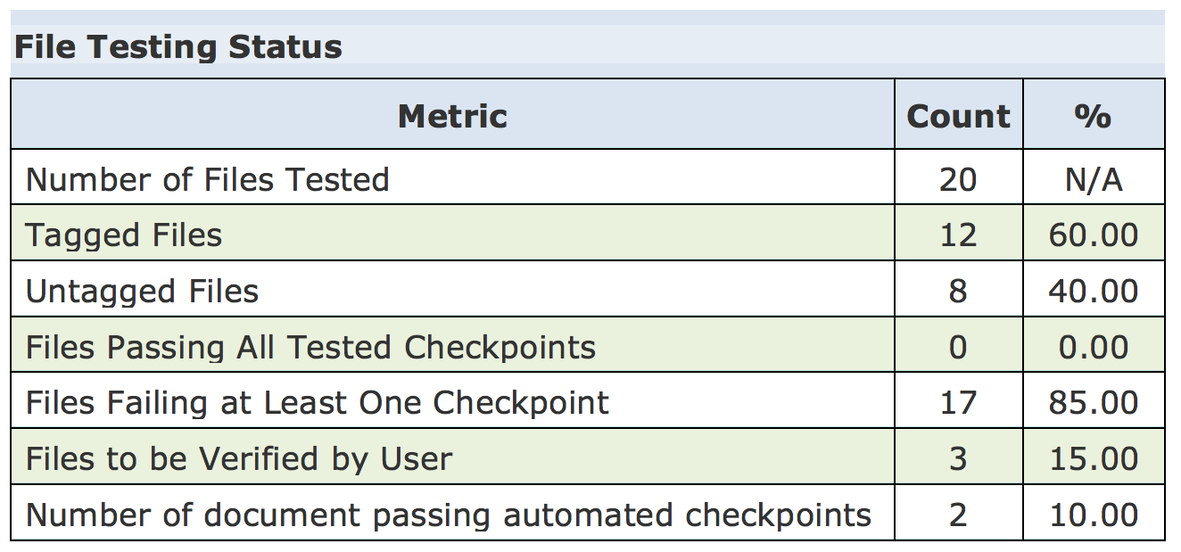
Example Kansas Agency Remediation Plan
CommonLook Clarity Scan
Scans are run on a specific URL (http://www.da.ks.gov).
Reports are generated to show the status of the web site and which PDF files need to remediated for Accessibility.
CommonLook Clarity Scans are $695 per URL.
Notes:
Note: This slide originated with NetCentric as part of a presentation given by David Herr to me, and is reproduced here in the interest of reporting to the KPAT on that conversation. —Cole Robison

Slide 33
Example Kansas Agency Remediation Plan
CommonLook Services Remediation
Sample Agency identified has 82 PDF files that need remediation.
The documents on the site vary from as little as 1 page to as many as 163 pages, for a total page count of 847.
After a CommonLook Clarity scan or if a customer submits their PDF files for remediation, CommonLook Services provides a fixed price quote for the remediation services.
Customers are provided with a Section 508 Certificate for each document that is accepted by HHS.
CommonLook Service is quoted based on your documents and averages $10 - $50 per page. For the purposes of this example, the remediation could range from $8,470 to $42,350 depending upon the complexity of the documents.
Notes:
Note: This slide originated with NetCentric as part of a presentation given by David Herr to me, and is reproduced here in the interest of reporting to the KPAT on that conversation. —Cole Robison

Slide 34
Example Kansas Agency Remediation Plan
Ongoing PDF Remediation
CommonLook PDF is used as an Adobe Acrobat Pro add-on to create fully accessible PDF and to remediate existing PDF files. This tool is more appropriate for webmasters and accessibility specialists in your state agencies.
CommonLook Office is used to create accessible PDF content directly in Microsoft Word and PowerPoint. This tool is appropriate for end users and can be deployed across your entire agency using our volume site licensing.
CommonLook Services can continue to be used for agencies that do not want to invest in software or do not have the staff available to do the accessibility remediation work for ongoing files published to their web sites.
CommonLook PDF is $1299 per user, CommonLook Office Professional is $599 per user. We will be providing special pricing for the State of Kansas for bulk licensing
Notes:
Note: This slide originated with NetCentric as part of a presentation given by David Herr to me, and is reproduced here in the interest of reporting to the KPAT on that conversation. —Cole Robison

Slide 35
Example Kansas Agency Remediation Plan
Annual CommonLook Clarity Scan
Run annual scans on your web sites to ensure compliance.
Reports can be used to identify any files that need remediation.
Remediation can be done in-house or sent to CommonLook for remediation.
CommonLook Clarity Annual scans are $695 per URL
Notes:
Note: This slide originated with NetCentric as part of a presentation given by David Herr to me, and is reproduced here in the interest of reporting to the KPAT on that conversation. —Cole Robison

Slide 36
Open Discussion

