Slide 1
Kansas Partnership for Accessible Technology
April 9, 2013 Meeting

Slide 2
State ADA Coordinator Report

Slide 3
CommonLook Trial Update

Slide 4
CommonLook Trial
Review: Evaluating CommonLook Office and CommonLook PDF
60-day trial
23 people on evaluation team, from 12 agencies
Software distributed last week
Kickoff webinar meeting tomorrow

Slide 5
KPAT Annual Report

Slide 6
Accomplishments
Governance
  Review of 10 IT Project Plans under ITEC Guideline 2400A
  Federal ICT Standards and Guidelines second draft comments
  NASCIO Section 508 Working Group
  KEES accessibility
Assistance
  Support
  AMP administration
Notes:
KEES = Kansas Eligibility Enforcement System

Slide 7
Accomplishments
Communication
  ITAB
  PIOs
  Regents CIOs at CHECK
  Website
Assessment
  AMP rollout completion and license renewal
  PDF scope assessment
  3 Year IT Plans
Notes:
ITAB = Information Technology Advisory Board

Slide 8
Accessibility Status of State of Kansas Websites
Accessibility Status of State of Kansas Websites as outlined last meeting

Slide 9
Planned Initiatives
Governance
  Federal updates
  Section 508 Strategic Plan
  Procurement (non-ITPP)
Assistance
  Training
  PDF accessibility resources

Slide 10
Planned Initiatives
Communication
  Webmasters outreach / user group
  Establish dialogue with accessibility personnel for major software vendors
Assessment
  Continued use of AMP
  More comprehensive AMP evaluation
  Possible PDF accessibility assessment

Slide 11
Feedback
Please provide any comments, suggestions, revisions, etc., by April 23.
cole.robison@ks.gov
(785) 291-3016

Slide 12
Strategic Plan for Improving Management of Section 508 of the Rehabilitation Act

Slide 13
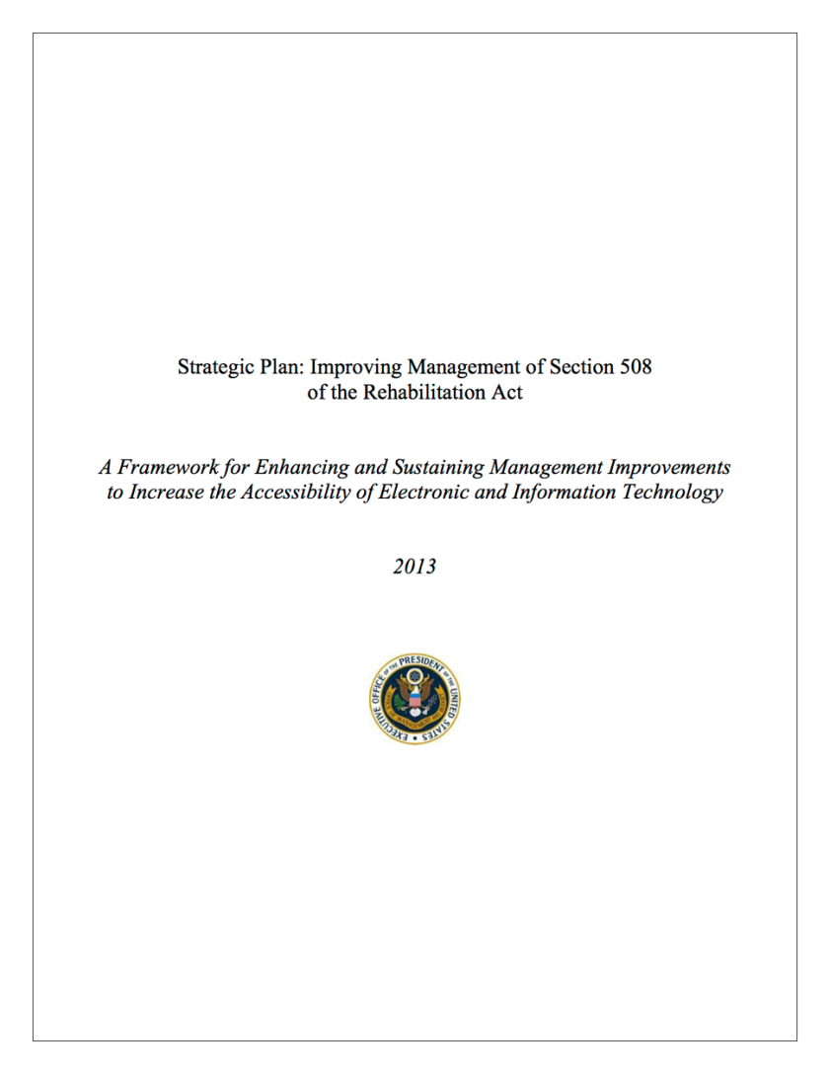
Section 508 Strategic Plan
Issued January 24 by OMB
http://go.usa.gov/TqUR
for Federal agencies
Are there measures we might want to adopt?
Notes:
http://go.usa.gov/TqUR → http://www.whitehouse.gov/sites/default/files/omb/procurement/memo/strategic-plan-508-compliance.pdf

Slide 14
Increasing Transparency
Make website one-stop source of info
Accessibility statement on all agency websites, to include:
  Contact info for Section 508 program
  Date of last update
  Method for feedback on Section 508 program

Slide 15
Strengthening Accountability
Name agency coordinators (and provide notice on turnover)
Standard measurement template
Baseline assessment
Report plans/progress
Assessment measures both website compliance and procurement processes.

Slide 16
Improving Collaboration
Update coordinators’ Reference Manual
Update and extend Buy Accessible Wizard (www.buyaccessible.gov)
Courses for acquisition personnel
Section 508 Refresh rollout

Slide 17
Appendices
Roles and Responsibilities
Action Plan
Resources and Additional Guidance

Slide 18
Open Discussion

Slide 19
Next Meeting
Tuesday, July 9, 2013
Time:
2:30–4:30 PM
Location:
Curtis State Office Building
Room 530
1000 SW Jackson Street

