Slide 1
Kansas Partnership for Accessible Technology
October 15, 2013 Meeting

Slide 2
Chair and Vice-Chair Election

Slide 3
PDF Accessibility / CommonLook

Slide 4
CommonLook Office & CommonLook PDF
Recap:
PDF accessibility tools
CommonLook Office is for non-technical content creators using Microsoft Office (specifically, Word and PowerPoint)
CommonLook PDF is for more technical users who need to tag existing PDFs using Adobe Acrobat Professional
After trial evaluation, we decided to ask agencies to estimate the number of potential users to determine available pricing.

Slide 5
CommonLook Office & CommonLook PDF
Presented at July ITAB meeting
Emailed ~95 agency contacts, received responses from 30.
Estimated potential users:
CommonLook Office: 495
CommonLook PDF: 215

Slide 6
CommonLook Clarity Scan
INK Board approved grant funding for CommonLook Clarity baseline scan PDF accessibility
Order in process
Will assess all PDFs on 182 agency public-facing websites (homepage domains)

Slide 7
IT Project Planning for COTS Items

Slide 8
Last Meeting
Brought up that the otherwise-successful process for web accessibility review of IT Project Plans under ITEC Guideline 2400A is a bit awkward to apply to procurements of commercial off-the-shelf (COTS) items.
Solicited ideas for how this might be improved.
As part of the ensuing discussion, Martha asked how other states handle these.
Notes:
Review

Slide 9
Massachusetts
I looked at a few other states, and found a couple that offered something relevant.
Massachusetts has standard contract language that includes the following text.
It seems directed at COTS delivered as part of a custom-developed solution, though.

Slide 10
“[Vendor] shall not deliver COTS or ASP Software under this Agreement that fails to meet the ITD Standards unless it has documented (1) that it has performed due diligence in seeking accessible alternative COTS or ASP Software, offering equivalent features and functionality to the inaccessible COTS or ASP Software, for which [Vendor] is or can readily become a licensed distributor; and (2) the cost of developing substitute accessible software under this Agreement. (Such documentation need not include reference to any specific competing COTS or ASP Software and its level of accessibility).
Notes:
ASP = application service provider
ITD = Massachusetts’ Information Technology Division

Slide 11
“COTS or ASP Software delivered under this Agreement or under another contract with a state agency in connection with a system delivered under this Agreement that does not meet the ITD Standards shall be acceptable if either (1) the software vendor provides a roadmap for meeting such standards and interoperating with such AT or (2) the agency seeks and obtains a waiver from ITD that it would be an undue hardship on the agency to eschew use of such COTS or ASP Software.”

Slide 12
California
More interesting, though, was California, which directly adopts Federal regulations/standards for commercial nonavailability that I hadn’t noticed before.

Slide 13
Federal Acquisition Regulations
http://go.usa.gov/De4Q
39.203(c)
(c)(1) When acquiring commercial items, an agency must comply with those accessibility standards that can be met with supplies or services that are available in the commercial marketplace in time to meet the agency’s delivery requirements.
(2) The requiring official must document in writing the nonavailability, including a description of market research performed and which standards cannot be met, and provide documentation to the contracting officer for inclusion in the contract file.
Notes:
This section is titled “Applicability”
http://go.usa.gov/De4Q → https://acquisition.gov/far/current/html/Subpart%2039_2.html

Slide 14
Federal Acquisition Regulations
39.204(e)(2)(ii)
(ii) When acquiring commercial items, an undue burden determination is not required to address individual standards that cannot be met with supplies or service available in the commercial marketplace in time to meet the agency delivery requirements (see 39.203(c)(2) regarding documentation of nonavailability).
Notes:
“Exceptions, Documentation”

Slide 15
Section 508 Standards
http://go.usa.gov/De4w
26 CFR 1194.2(b)
(b) When procuring a product, each agency shall procure products which comply with the provisions in this part when such products are available in the commercial marketplace or when such products are developed in response to a Government solicitation. Agencies cannot claim a product as a whole is not commercially available because no product in the marketplace meets all the standards. If products are commercially available that meet some but not all of the standards, the agency must procure the product that best meets the standards.
Notes:
“Application”
http://go.usa.gov/De4w → http://section508.gov/index.cfm?fuseAction=stdsdoc#Application

Slide 16
Revised 508 Coordinators Reference Manual
http://go.usa.gov/De4e
1.4 Nonavailability
An agency may conclude that EIT meeting the applicable technical provisions of the Access Board's standards is not available (and purchase EIT that does not meet those provisions) when it cannot find a commercial item that both meets applicable Access Board's technical provisions and can be furnished in time to satisfy the agency's delivery requirements. If products are available that meet some, but not all, applicable provisions, agencies cannot claim a product as a whole in nonavailable just because it does not meet all of the applicable provisions. Agency acquisitions must comply with those applicable technical provisions that can be met with supplies or services that are available in the commercial marketplace in time to meet the agency's delivery requirements. Nonavailability determinations must be documented.
Notes:
http://go.usa.gov/De4e → http://www.section508.gov/docs/RefManual_Sec1.pdf

Slide 17
Acquisition of E & IT Under Section 508 of the Rehabilitation Act
http://section508.gov/index.cfm?FuseAction=faqall
F.1. - Under what circumstances may an agency conclude that no EIT is available that meets the Access Board’s technical provisions?”
[Verbatim text from Revised 508 Coordinators Reference Manual 1.4]
“The concept of nonavailability is recognized in the Access Board’s standards (at 36 CFR 1194.2(b)) and the FAR (at 39.203(c)) because agencies may find that some their needs cannot be satisfied with EIT that meets all the applicable technical provisions. However, as manufacturer offerings of products that meet the applicable technical provisions increase over time, incidents of nonavailability will decrease.

Slide 18
Acquisition of E & IT Under Section 508 of the Rehabilitation Act
F.2. - What should be included in a nonavailability determination?
The requiring official must document in writing the nonavailability and provide a copy of this documentation to the contracting officer for inclusion in the contract file. FAR 39.203(c)(2) requires that the documentation must include a description of market research performed and identification of the applicable technical provisions that cannot be met with products or services available from the marketplace. Agency procedures (if any) must be followed.

Slide 19
Acquisition of E & IT Under Section 508 of the Rehabilitation Act
F.4 - If an agency has appropriately determined and documented that commercial items are not available that meet applicable technical provisions, must it also determine that an exception applies?
No. Nonavailability is an independent basis for acquiring EIT that does not meet the applicable Access Board's technical provisions. See FAR 39.204(e)(2) (ii). Undue burden documentation would be required if products meeting all (or some) of the standards are commercially available but would create an undue burden on the agency to acquire. (In other words, when a product meeting the standards is commercially available, it is treated no differently than a non- commercial item with respect to application of the undue burden justification). Agencies should document commercial nonavailability in accordance with agency procedures to assist in defending the agency's decision in the event of a complaint. (see section F.2., above).

Slide 20
Department of Health and Human Services Policy for Section 508 Electronic and Information Technology (EIT)
http://go.usa.gov/Degm
4.3.1 Commercial Nonavailability Exception Determination and Certification
In order for an acquisition to qualify for this exception, the definition given in FAR Subpart 2.101 for the term “commercial item” should be followed. The requesting official should document individual Section 508 standards that the product does not meet. If products are commercially available that meet some but not all of the standards, the agency must procure the product that best meets the standards. Each agency will use the standards established in 36 CFR Part 1194 and FAR 10.001(a)(3)(vii) to conduct its market research. See Section 11.2 of this document for more information.
Notes:
http://go.usa.gov/Degm → http://www.hhs.gov/web/508/contracting/hhs508policy.html#431CommercialNonavailabilityExceptionDeterminationandCertification

Slide 21
Department of Health and Human Services Policy for Section 508 Electronic and Information Technology (EIT)
The certification statement should contain the following language:
I have determined and hereby certify that the procurement of the applicable EIT product(s) or services required by my organization that are subject to Section 508 of the Rehabilitation Act of 1973, as amended, in accordance with 36 CFR Part 1194, is 'commercially not available', nor expected to become available in a compliant version in time to satisfy agency delivery requirements (36 CFR 1194.2(b) and FAR 39.203(c)). I have conducted the required market research and have not found an accessible product.

Slide 22
Department of Health and Human Services Policy for Section 508 Electronic and Information Technology (EIT)
At a minimum, the documentation should discuss the following information:
The products or services required to meet the agency’s needs and the estimated timeframe of acquiring the products or services.
Identification of the applicable technical provisions (Appendix B) that cannot be met with products or services available from the marketplace, which concluded in the determination that a compliant product or service was not available.
A description of the extent and how market research was performed and details of the subsequent findings to locate a commercially available item, which concluded in the determination that a compliant product or service was not available.
Plan for providing information to persons with disabilities in an alternate format if proposed noncompliant products or services are purchased.
Each entity is still responsible for addressing how it will accommodate persons with disabilities.

Slide 23
Thoughts?

Slide 24
SSB BART Group Recommendations

Slide 25
Recommendations
SSB BART Group process audit recommendations discussed last time:
Implement a Best Practices-Driven Approach to Meeting ITEC 1210 Compliance
Implement a Vendor Certification Process
Require Vendor Submissions of Due Diligence
While the second is not something we’re prepared to pursue at this time, more information was requested on the other two.

Slide 26
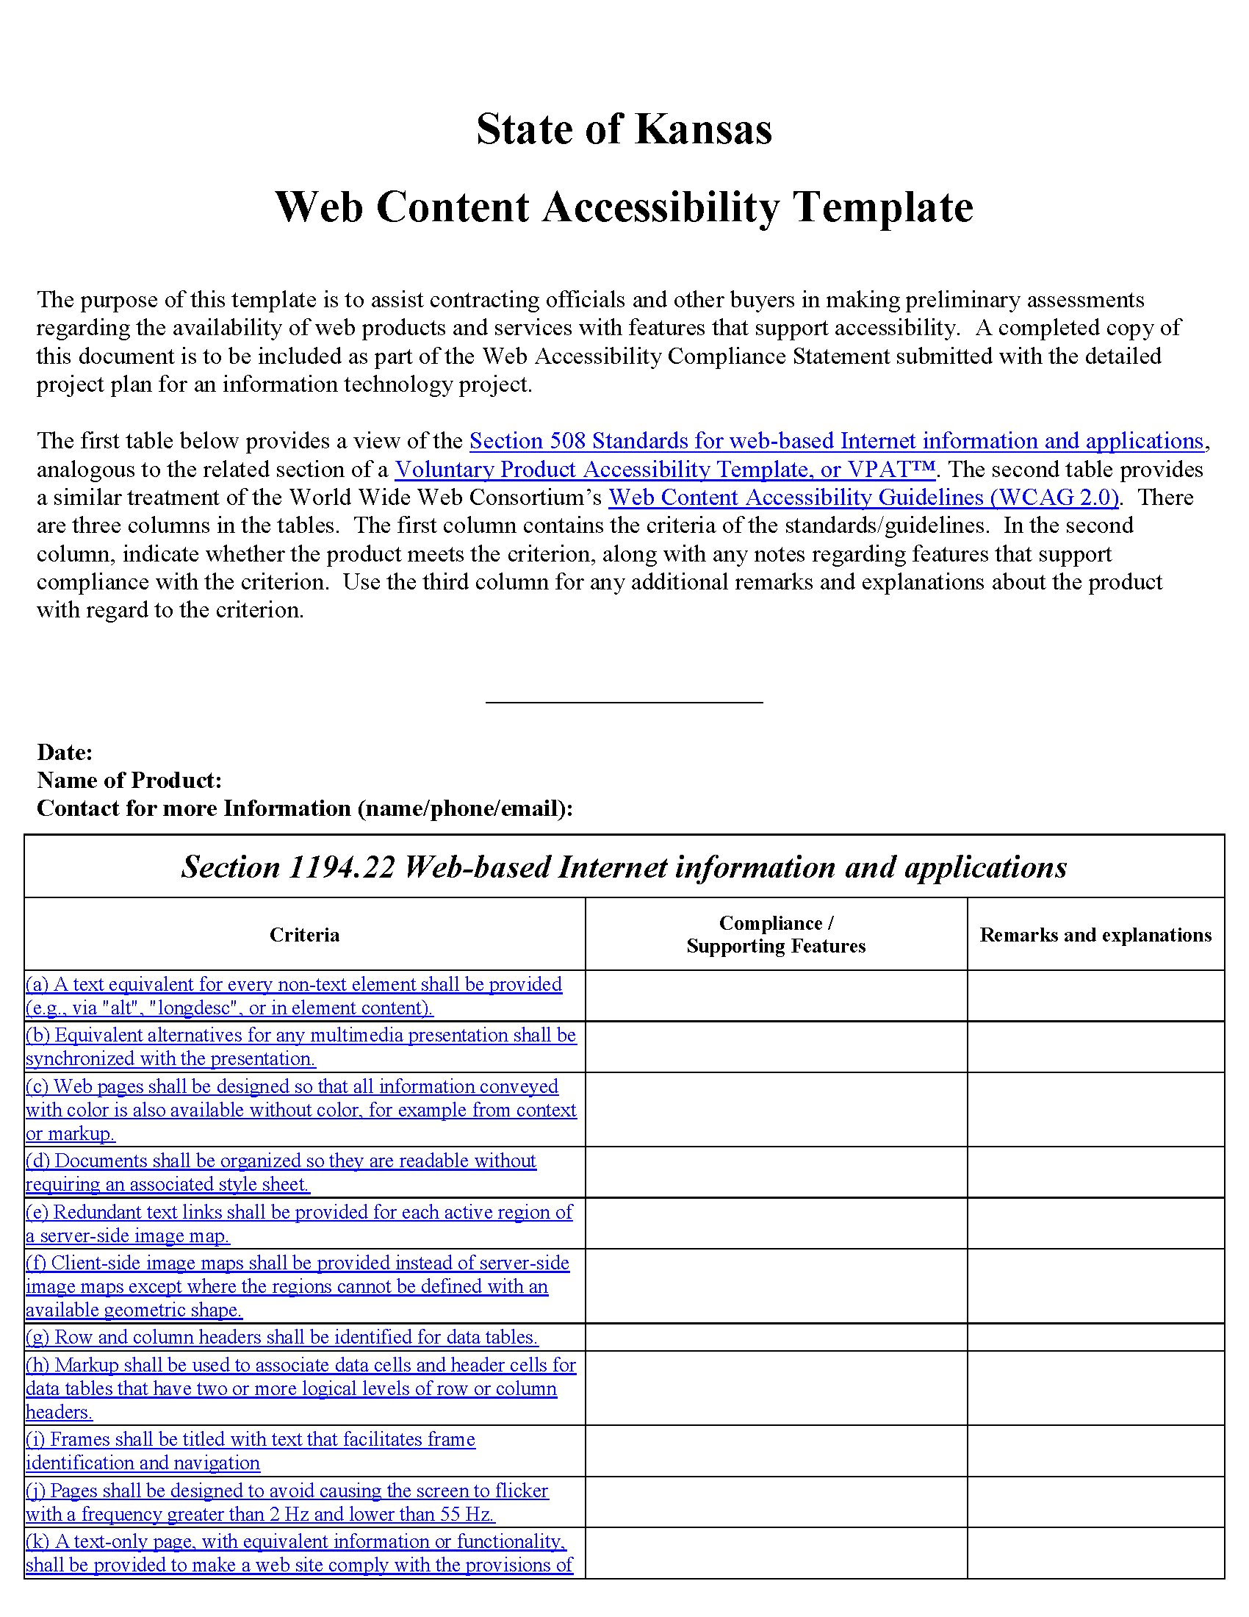
Best Practices-Driven Approach to Compliance
WCAT mockup

Slide 27
Vendor Due Diligence
SSB BART Group is preparing a written response with more detail.

Slide 28
State ADA Coordinator Report

Slide 29
Status Updates

Slide 30
AMP Summer 2013 Release
AMP was updated to the Summer 2013 Release September 11.
New UI
Introductory presentation – http://bit.ly/17i24Vk
“What’s New” page – http://bit.ly/GRNvkn
Early issue resolved
Notes:
Issue was resolved in 4 days.
http://bit.ly/17i24Vk → https://sas.elluminate.com/site/external/jwsdetect/playback.jnlp?psid=2013-07-23.1439.M.08F2529979568F835CC308FE8A2EC1.vcr&sid=2013017
http://bit.ly/GRNvkn → https://www.ssbbartgroup.com/reference/index.php/AMP_Summer_2013_What%27s_New

Slide 31
Section 508 Refresh
Federal ICT Standards and Guidelines
Spring 2013 agenda on Reginfo.gov lists it as due for an NPRM on an unspecified date in November.
http://go.usa.gov/De4B
Notes:
http://go.usa.gov/De4B → http://www.reginfo.gov/public/do/eAgendaViewRule?pubId=201304&RIN=3014-AA37

Slide 32
Accessibility of Web and Information Services
DOJ ANPRM published in July 2010 to consider establishing specific requirements for entities covered by the ADA to make their websites accessible.
http://go.usa.gov/De2x
Listed as a “Long Term” item in 2011, seemed dormant.
The Title II and Title III rulemakings have been divided.
The Title II rulemaking (the State and Local Government one) is listed in the Spring 2013 Reginfo.gov agenda with an unspecified November date for NPRM.
http://go.usa.gov/De25
Notes:
The Title III rulemaking (the Public Accommodations one) is listed with an unspecified March 2014 date for NPRM.
http://go.usa.gov/De2x → http://www.ada.gov/anprm2010/web%20anprm_2010.htm
http://go.usa.gov/De25 → http://www.reginfo.gov/public/do/eAgendaViewRule?pubId=201304&RIN=1190-AA65
(Title II/III mix-up corrected after meeting presentation)

Slide 33
The ICT Opportunity for a Disability-Inclusive Development Framework
Report on how ICT can enable and accelerate the social and economic inclusion of persons with disabilities.
Based on work carried out in support of the High-Level Meeting on Disability and Development of the UN General Assembly session in New York last month.
Prepared by the UN Broadband Commission for Digital Development, the Global Initiative for Inclusive ICTs (G3ICT), the International Disability Alliance (IDA), the International Telecommunication Union (ITU), Microsoft, the Telecentre.org Foundation and the UN Educational, Scientific and Cultural Organization (UNESCO).
Lists challenges that are still to be addressed while outlining concrete actions to be undertaken and a set of indicators to help measure progress.

Slide 34
The ICT Opportunity for a Disability-Inclusive Development Framework
Press release – http://bit.ly/19w7g9D
Executive summary – http://bit.ly/17ruHyh
Full report – http://bit.ly/16EoqzX
Notes:
http://bit.ly/19w7g9D → http://www.itu.int/net/pressoffice/press_releases/2013/39.aspx
http://bit.ly/17ruHyh → http://www.itu.int/en/action/accessibility/Documents/Executive%20Summary_ICT%20Opportunity%20for%20a%20Disability_Inclusive%20Development%20Framework.pdf
http://bit.ly/16EoqzX → http://www.itu.int/en/action/accessibility/Documents/The%20ICT%20Opportunity%20for%20a%20Disability_Inclusive%20Development%20Framework.pdf

Slide 35
The ICT Opportunity for a Disability-Inclusive Development Framework
Web services were found to be the ICT with the greatest impact, closely followed by mobile devices and services. TV ranked third.
The definition and implementation of accessibility guidelines was seen as one of the most important developments. The fact that investments in accessibility also introduce benefits for wider groups of the population was cited as a “hugely significant finding.”

Slide 36
The ICT Opportunity for a Disability-Inclusive Development Framework
Challenges listed include the cost/availability of AT/ICT and inadequate accessibility policy.
Priority actions for government:
Strengthening R&D to develop new ICT-enabled solutions for persons with disabilities
Incorporating accessibility requirements in procurement policies
Updating disability legislation to include ICTs in the legal definition of accessibility

Slide 37
WCAG2ICT
W3C WCAG WG Guidance on Applying WCAG 2.0 to Non-Web Information and Communications Technologies
This informative document is intended to help clarify how to use WCAG 2.0 to make non-web documents and software more accessible to people with disabilities. It includes complete guidance for all Levels A and AA Success Criteria, guidance on all glossary terms plus new Key Terms, comments on conformance, and additional background information on some topics.
Overview – http://www.w3.org/WAI/intro/wcag2ict
Full Document – http://www.w3.org/TR/wcag2ict/
Notes:
Published September 5

Slide 38
OITS Web Development IT Forum
The IT Forums, part of OITS’ 25 IT initiatives, have been created as a way to enable collaboration and knowledge sharing among IT staff in all executive branch agencies.
Web Development forum is due to launch this month.
http://oitsforums.ks.gov/

Slide 39
Disability Employment Awareness Month
President’s proclamation – http://go.usa.gov/DedH
Governor’s proclamation
Notes:
http://go.usa.gov/DedH → http://www.whitehouse.gov/the-press-office/2013/09/30/proclamation-national-disability-employment-awareness-month-2013

Slide 40
Texas Accessibility Coffee Breaks

Slide 41
Texas Accessibility Coffee Breaks
The Accessibility Coffee Break features short accessible video learning opportunities about an aspect of accessible technology and documents. The videos are meant to be consumed in the same time it would take to enjoy a cup of coffee. The videos were created by a multidisciplinary group of Texas state employees dedicated to accessibility over a year’s time and hosted by the Texas Governor’s Committee on People with Disabilities on its website. The purpose of the Accessibility Coffee Break is to increase and enhance communications with people with disabilities across a wide variety of civic, emergency and employment perspectives. The Accessibility Coffee Breaks will be featured twice monthly through 2013 and early 2014.

Slide 42
Texas Accessibility Coffee Breaks
Focused on Microsoft Office accessibility
Each is offered as:
YouTube video
Audio MP3 file
Instructional Word document
Instructional PDF
http://go.usa.gov/Dewd
Notes:
http://go.usa.gov/Dewd → http://governor.state.tx.us/disabilities/accessibledocs/

Slide 43
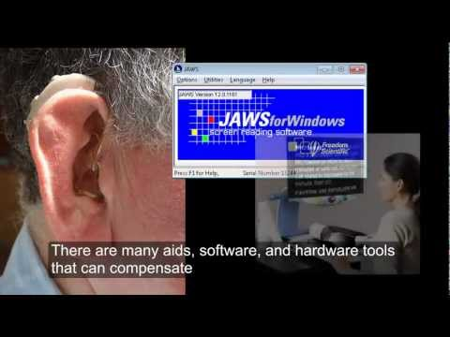
Understanding Assistive Technology

Slide 44
Open Discussion

Slide 45
Next Meeting
Tuesday, January 14, 2014
Time:
2:30–4:30 PM
Location:
Curtis State Office Building
Room 530 1000 SW Jackson Street

