Slide 1
Kansas Partnership for Accessible Technology
October 13, 2015 Meeting

Slide 2
Status Updates and Announcements

Slide 3
U.S. Web Design Standards
The U.S. government has released open source UI components and a visual style guide to create consistent and accessible user experiences across federal government websites.
In alpha
https://playbook.cio.gov/designstandards/
Blog post introducing the standards: http://go.usa.gov/3JXDV
Notes:
http://go.usa.gov/3JXDV → https://18f.gsa.gov/2015/09/28/web-design-standards/

Slide 4
ATAG 2.0
On September 24 Authoring Tool Accessibility Guidelines (ATAG) 2.0 was published as a W3C Recommendation.
ATAG provides guidelines for designing web content authoring tools that are both:
more accessible to authors with disabilities
designed to enable, support, and promote the production of more accessible web content by all authors.

Slide 5
ATAG 2.0 Links
W3C blog post “More Accessible Web Authoring with ATAG 2.0”
http://bit.ly/1WkTTCy
ATAG Overview
http://www.w3.org/WAI/intro/atag.php
ATAG
http://www.w3.org/TR/ATAG20/
Notes:
http://bit.ly/1WkTTCy → https://www.w3.org/blog/2015/09/more-accessible-web-authoring-with-atag-2-0/

Slide 6
Upcoming Training
Using AMP for Web Accessibility
Tuesday, December 8—FULL
Info: http://oits.ks.gov/kpat/tool/training
ADA National Network Accessible Technology series webinar: “Social Media, Accessibility and Disability Inclusion”
Thursday, November 19
Registration: https://adagreat.powweb.com/Webinar/ AccessibleTechnology/register.php
Notes:
“Document Accessibility” was this morning.

Slide 7
AMP Release
AMP has been updated to the Summer 2015 Release since we last met.
Introduces Alchemy in beta
Adds fixing functionality to the testing process
Info on what’s new at http://bit.ly/1VJ41CQ
Notes:
http://bit.ly/1VJ41CQ → https://helpdesk.ssbbartgroup.com/hc/en-us/articles/203840879-AMP-Summer-2015-What-s-New

Slide 8

NDEAM
October is National Disability Employment Awareness Month.
This year marks 70 years since the first observance
The theme for this year is “My Disability Is One Part of Who I Am.”
Department of Labor Office of Disability Employment Policy site: http://www.dol.gov/odep/topics/ndeam/
Presidential proclamation: http://go.usa.gov/3J9Sw
Notes:
http://go.usa.gov/3J9Sw → https://www.whitehouse.gov/the-press-office/2015/10/01/presidential-proclamation-national-disability-employment-awareness-month

Slide 9
Invisible Disabilities Week
The Invisible Disabilities Association has declared October 18 through 24 Invisible Disabilities Week, with open online events highlighting disabilities that are not always obvious to the onlooker, such as debilitating pain, fatigue, dizziness, cognitive dysfunctions, brain injuries, learning differences and mental health disorders, as well as hearing and vision impairments.
http://invisibledisabilitiesweek.org/

Slide 10
Adopting ICT Standards and Guidelines in State Policy

Slide 11
Review: ICT Standards and Guidelines
Proposed Information and Communication Technology (ICT) Standards and Guidelines
Latest stage in the rulemaking process for the update, or “refresh”, of the federal Section 508 standards and Section 255 guidelines
http://go.usa.gov/3WcfA
Notes:
Section 508 of the Rehabilitation Act
Section 255 of the Telecommunications Act
http://go.usa.gov/3WcfA → http://www.access-board.gov/guidelines-and-standards/communications-and-it/about-the-ict-refresh

Slide 12
Review: Expanding Beyond Web Technologies
Section 508 has always covered all IT, not just the web.
ITEC 1210 applies only to web technologies; we do not have state policy for the accessibility of other IT.
We have often mentioned in the past that we might want to consider addressing non-web IT accessibility.
Adoption of the new ICT Standards and Guidelines might be a good time to do so, if we desire.
Consensus was expressed at the last meeting to pursue expanding state policy to cover all IT and fully harmonize with the new ICT Standards and Guidelines.

Slide 13
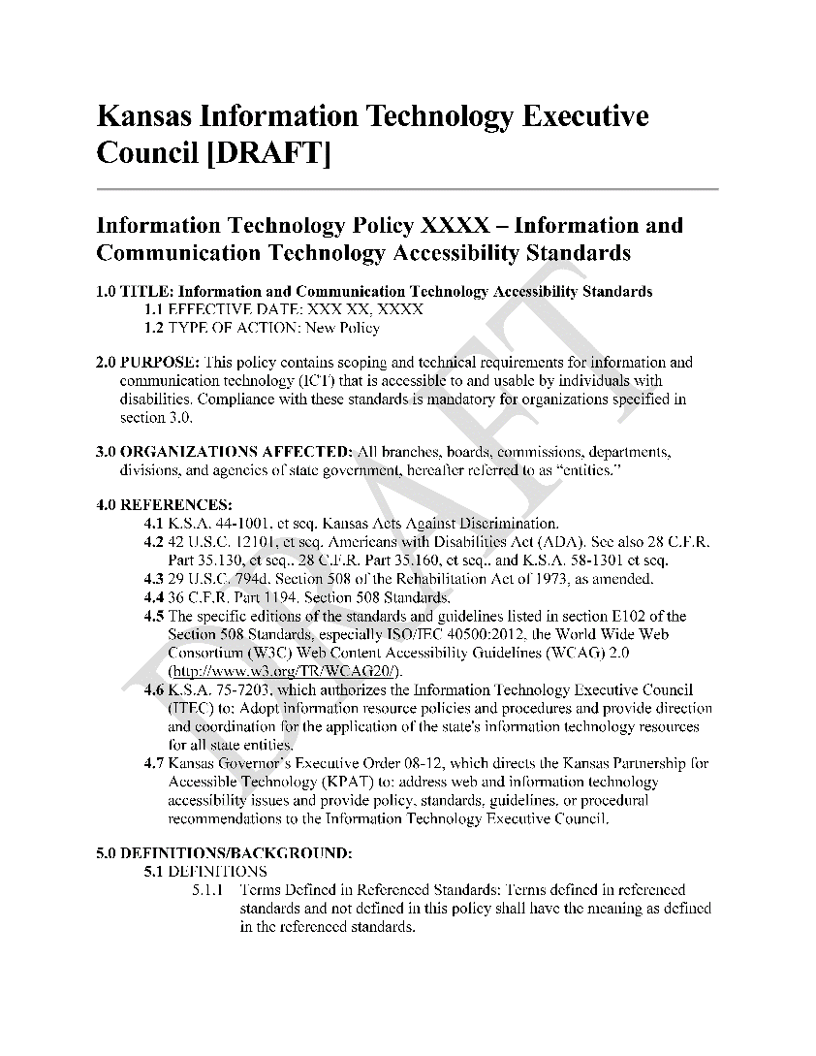
Proposed Policy Draft

Slide 14
Assessing Impacts
Ideas?

Slide 15
Video Communications Platforms Update
Robert Cooper Executive Director, Commission for the Deaf and Hard of Hearing

Slide 16
Open Discussion

Slide 17
Next Meeting
Tuesday, January 12, 2016
Time:
2:30–4:30 PM
Location:
Landon State Office Building
Room 560 900 SW Jackson Street

