Slide 1
Capitol Visitors Center Kiosks Project
Presentation to
Kansas Partnership for Accessible Technology
Mary Madden, Director, Kansas Museum of History
Matt Veatch, State Archivist
Jesse DeGarmo, IT Project Manager
April 14, 2015

Slide 2
Overview
Capitol Visitors Center
Why Interactive Kiosks?
INK Grant
Project Team
Deliverables
Hardware
Software
Accessibility
Assessment

Slide 3
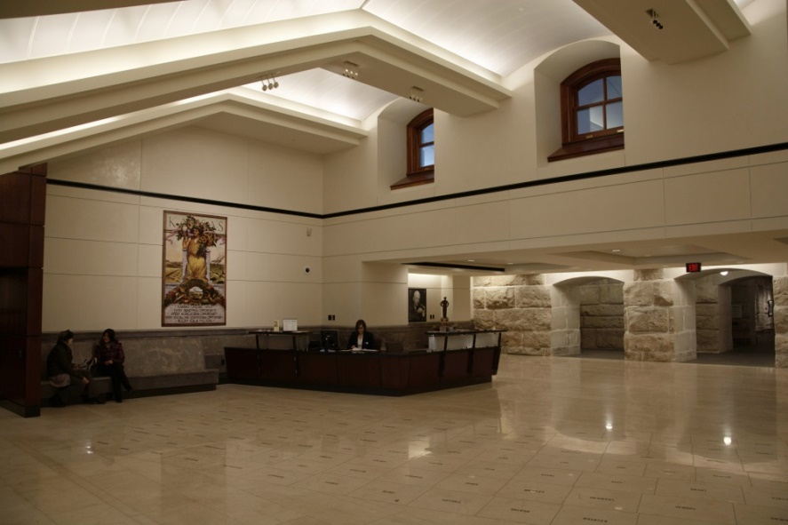
Capitol Visitors Center
Final phase of Capitol restoration project
Opened January 2014
Operated and staffed by Kansas Historical Society
Exhibits
Auditorium
Classroom
Capitol Store

Slide 4
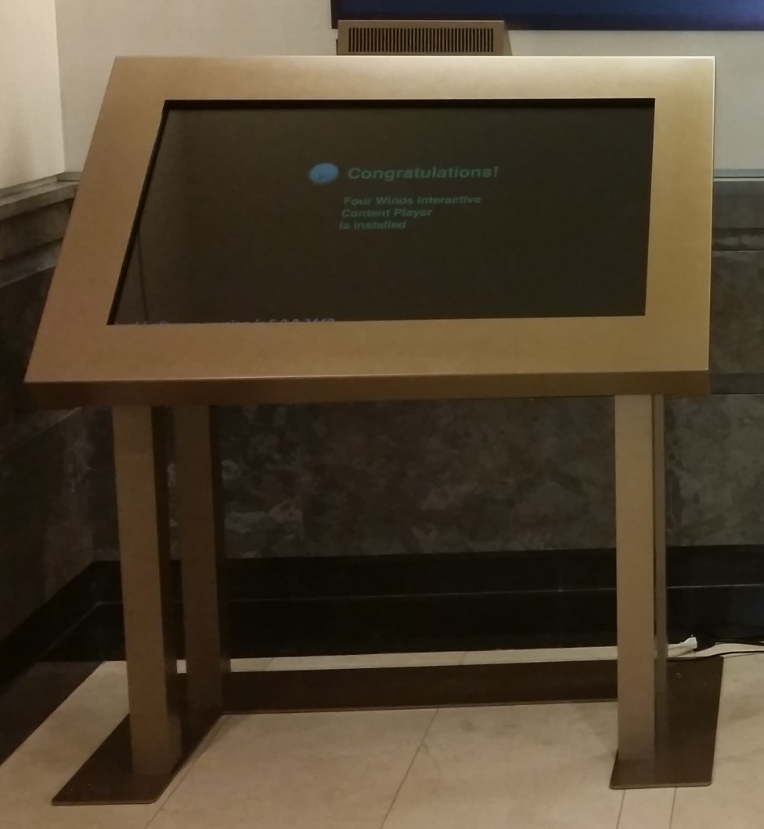
Why Interactive Kiosks?
Provide Capitol visitors with user-friendly, self-service access to building directory and wayfinding information.
Supplement KSHS staff

Slide 5
INK Grant
Information Network of Kansas grant to support Capitol kiosks project in May 2014
$60,000
Thank you INK Board!

Slide 6
Project Team Vendor
Four Winds Interactive (FWi)
Denver-based
Started in 2005
4700 clients, 300 employees
Interactive signage in hotels, retail stores, airports, cruise ships, casinos, museums, and government buildings around the world.

Slide 7
Project Team Interagency Kansas Team
KSHS
Mary Madden
Matt Veatch
Jesse DeGarmo
Jennie Chinn
Craig Dannenberg
Bobbie Athon
Linda Park
Andrea Burton
Barry Greis, Statehouse Architect
Terri Clark, Legislative Computing Services
Roderick Patton, Legislature
Todd Fertig, DoA
Consultants
Cole Robison, OITS
Anthony Fadale, DCF

Slide 8
Deliverables: Hardware
Two free-standing 48-inch multi-touch displays
Two Nuc Mini PCs
SonicBeam speakers (12”)
Custom-designed, wheelchair accessible enclosure

Slide 9
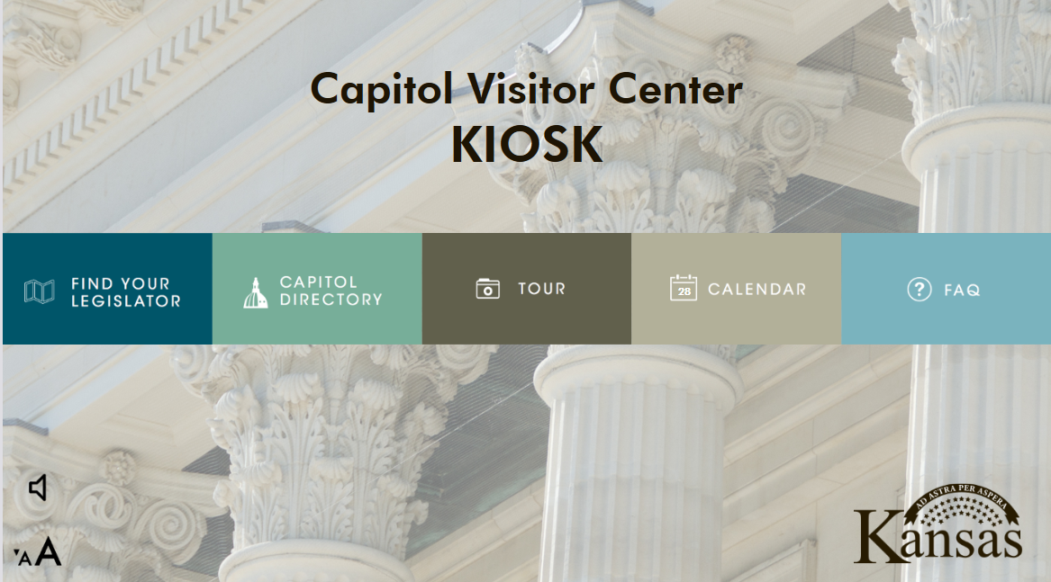
Deliverables: Software

Slide 10
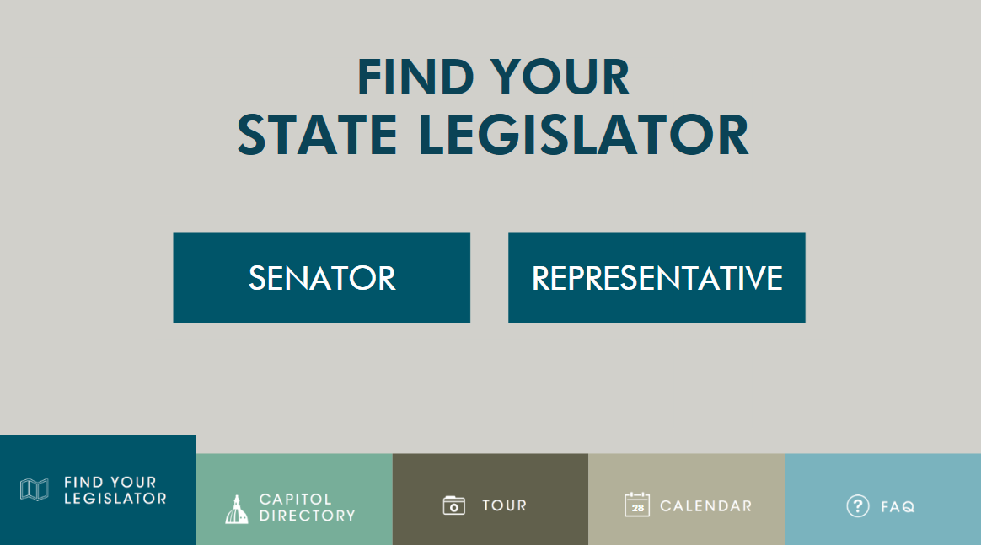
Find Your Legislator

Slide 11
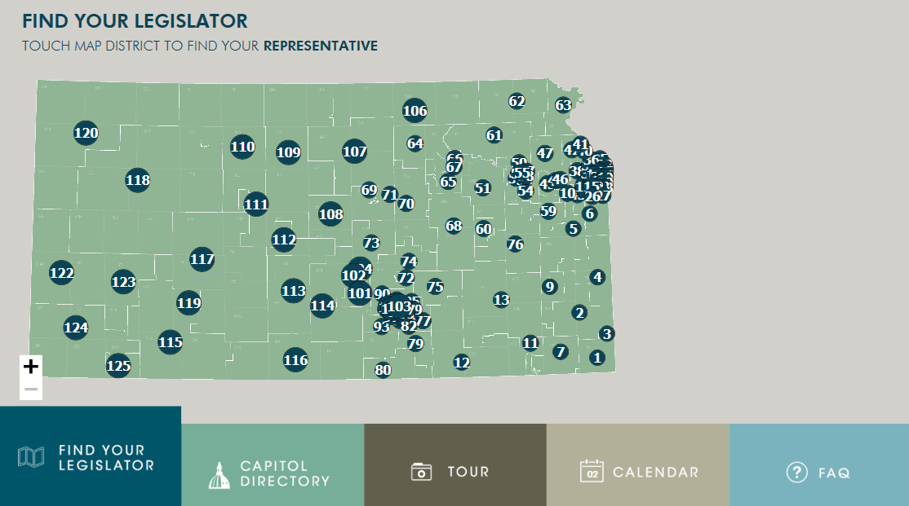
Find Your Legislator
Notes:
Visitors can find their state senator or representative by navigating an interactive state map depicting legislative district.

Slide 12
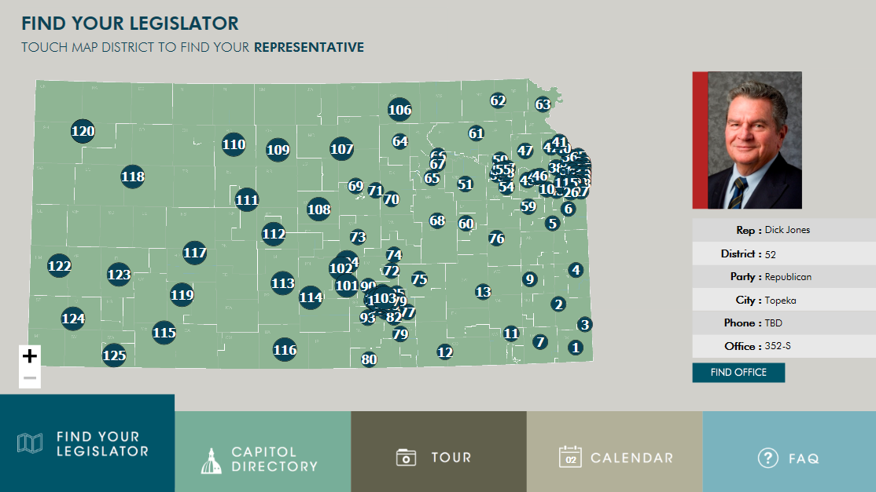
Find Your Legislator
Notes:
By touching their home district a visitor can display summary information about their legislator.

Slide 13
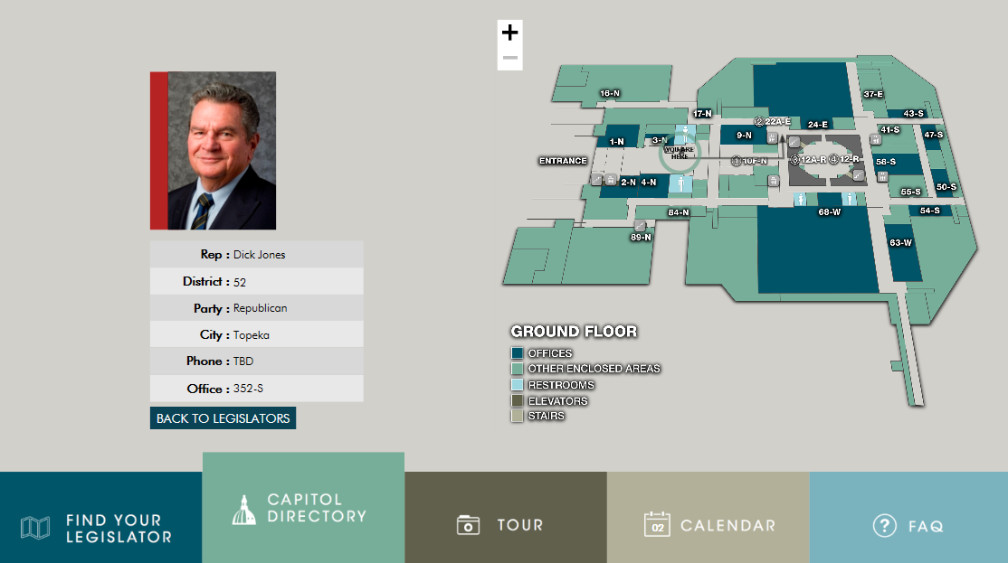
Find Your Legislator
Notes:
This application also links back to the wayfinding map should a user require directions to their legislator’s Capitol office

Slide 14
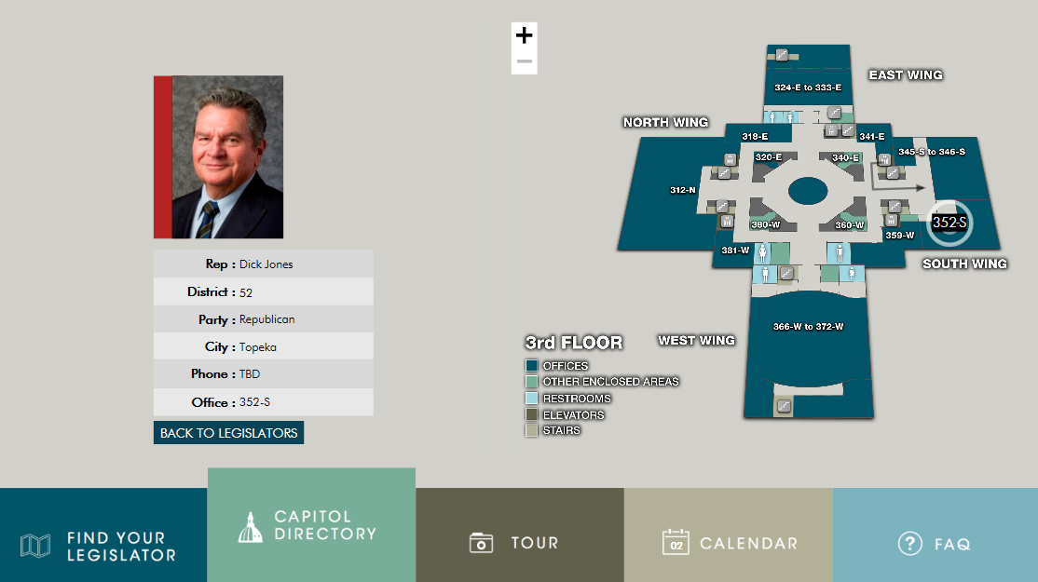
Find Your Legislator
Notes:
Challenges
Faulty assumption = we assumed they would use Bing maps for this app: wrong!
Bing API not robust enough for what we needed
Developed a solid workaround – not perfect but functional.
Some usability issues have emerged – users occasionally have trouble with the touchscreen zoom feature when trying to identify their House or Senate district.

Slide 15
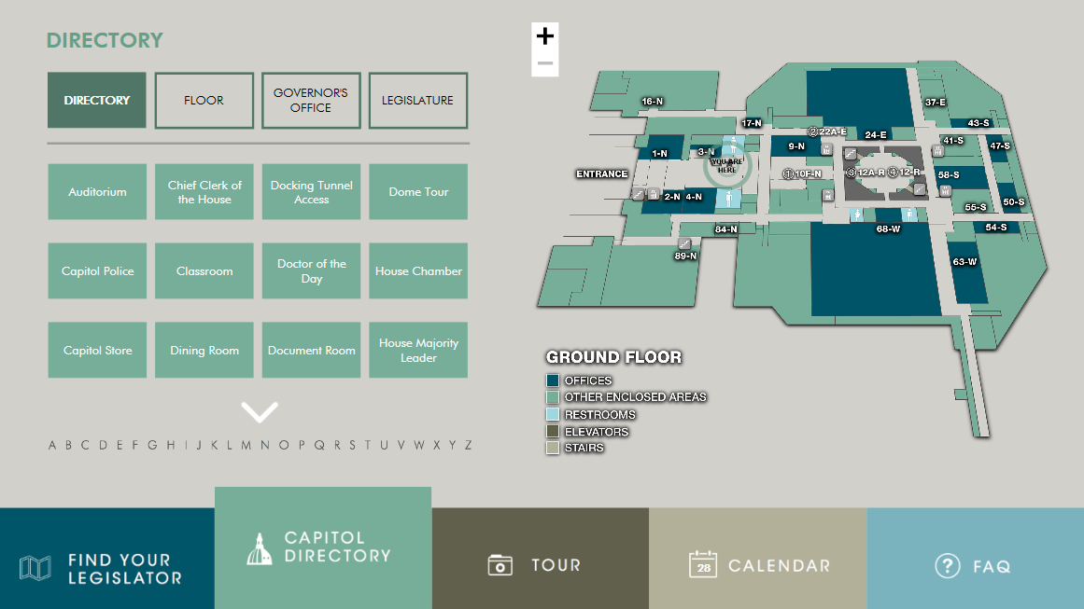
Capitol Directory
Notes:
The Capitol Directory enables visitors to browse for offices or individual legislators.
Selecting a specific location triggers a wayfinding map that provides visual directions to the general area of the office or other point of interest. Visitors with a smartphone can access text directions to the desired location by scanning a QR code.
Challenges
Accurate, updated directory data
Some from KLISS
Some manually compiled
Start of session – data revised frequently (new members, new offices)
Accurate directions to each location

Slide 16
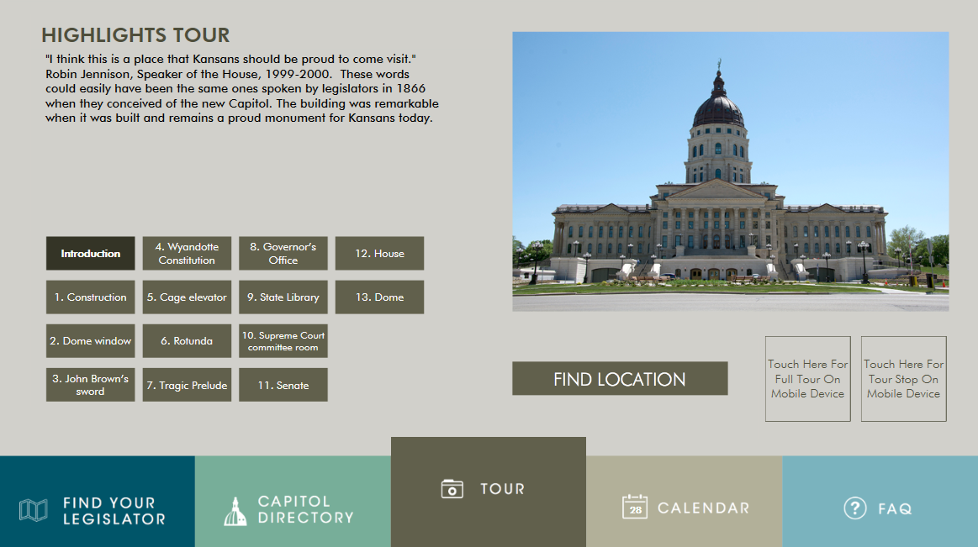
Highlights Tour
Notes:
Visitors can view images and learn about thirteen points of interest in the Capitol including John Brown’s sword, the Wyandotte Constitution, John Steuart Curry's "Tragic Prelude," and the Senate and House Chamber galleries. Visitors with a smartphone can access textual descriptions of each tour stop by scanning a QR code.
Challenges
Not as multimedia-rich as anticipated – no audio or video clips.
Not as mobile-friendly as desired
QR code delivers descriptive text but no navigation directions.
KSHS may explore mobile app development in the future.

Slide 17
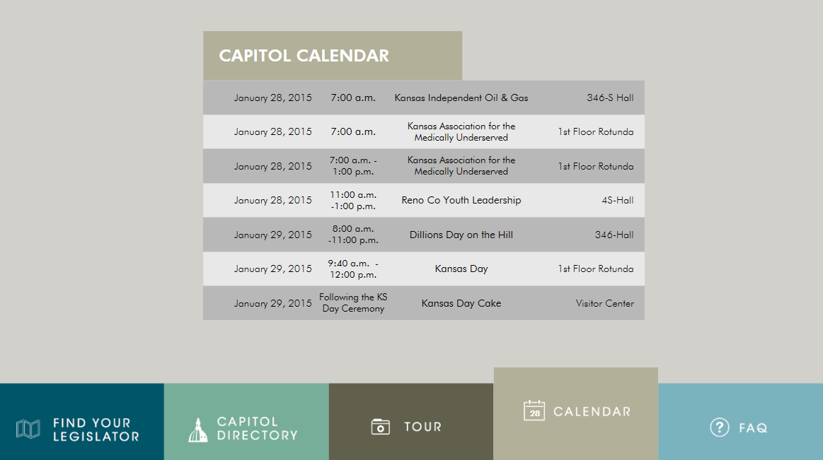
Calendar
Notes:
A simple calendar lists public events scheduled at the Capitol.
Challenges
Source data – multiple, disparate sources
Decided to limit scope
Public events manually entered by KSHS staff
Committee meetings not included – timely, accurate data not readily consumable.
Users and KSHS staff generally pleased with results

Slide 18
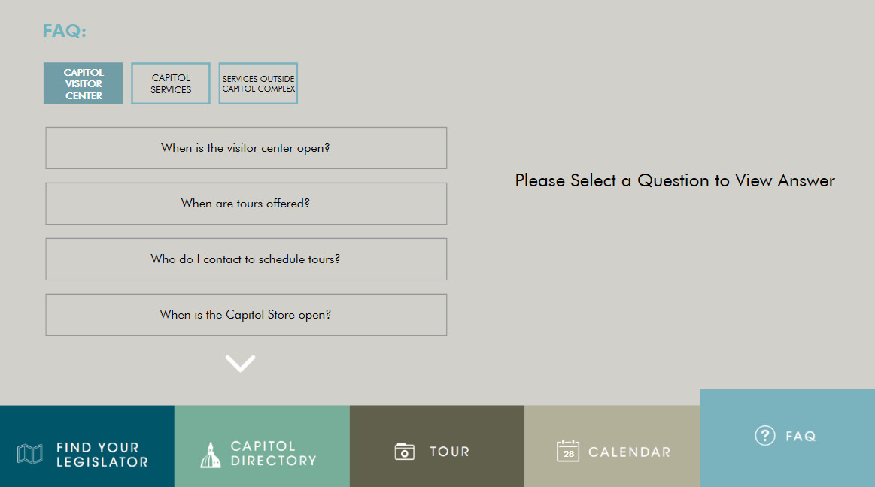
FAQ
Notes:
An FAQ provides answers to Capitol visitors’ most common questions in three categories: Capitol Visitors Centers, Capitol Services, and Services Outside the Capitol Complex.
Challenges
Determining scope of FAQs
Organizing the FAQs

Slide 19
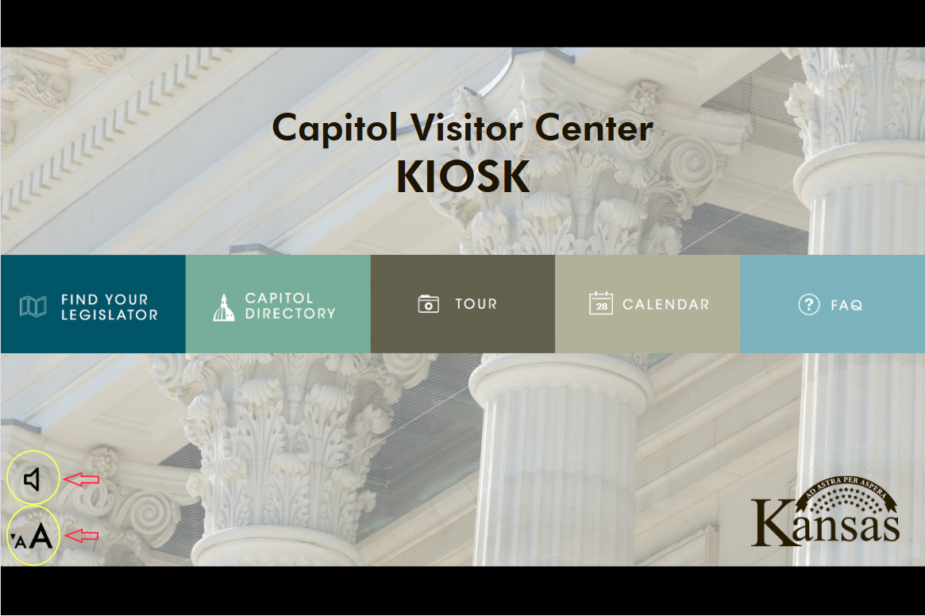
Accessibility
Speech-to-Text
Font resizing
Notes:
The kiosks were designed for ADA compliance. The free-standing enclosures allow individuals in wheelchairs to slide underneath the kiosks and interact with the touchscreen devices. Text-to-speech and font size options provide accessibility for the visually impaired.

Slide 20
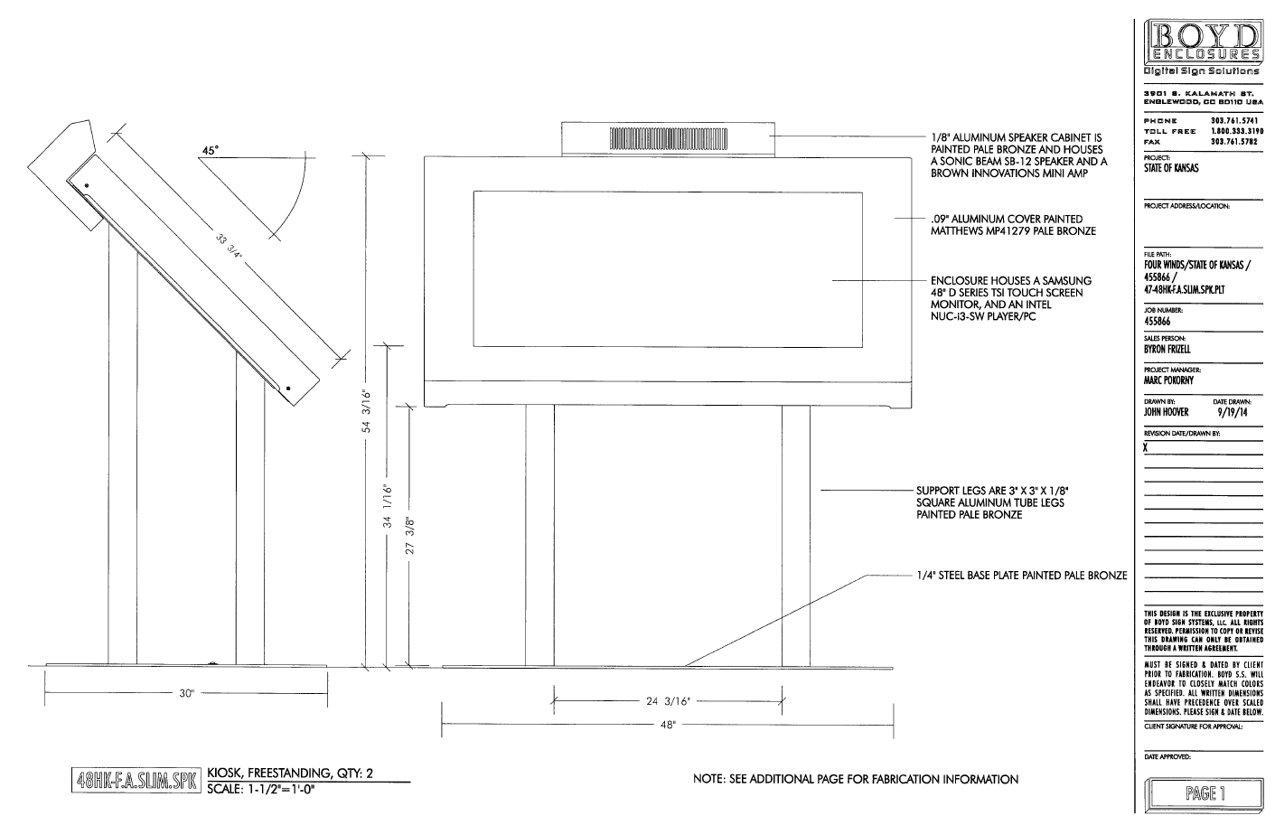
Accessibility

Slide 21
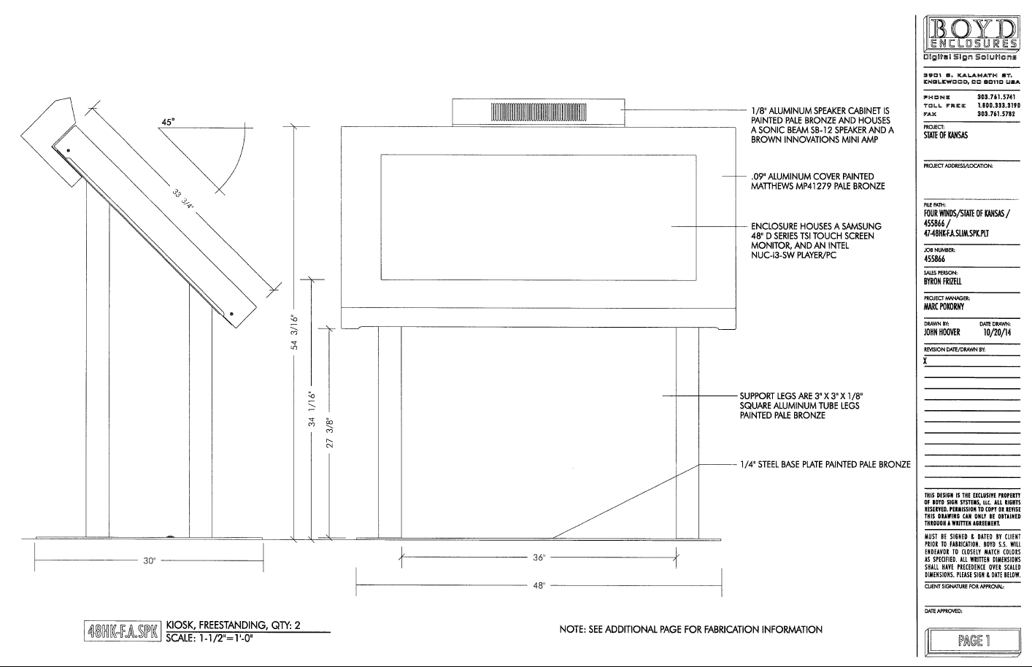
Accessibility

Slide 22
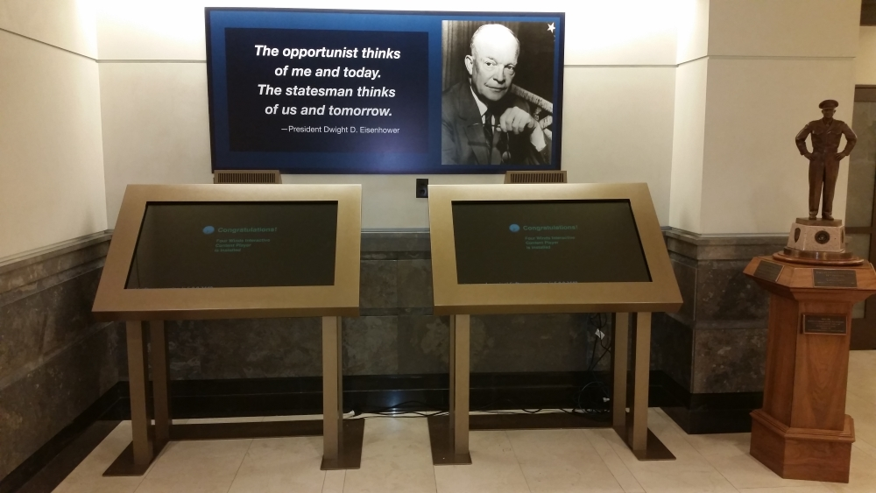
Accessibility

Slide 23
Assessment
Project delivered on time and below budget
FWi responsive to our needs – even when we pushed the scope
User feedback overwhelmingly positive
Valuable service to Capitol visitors

