Slide 1
Kansas Partnership for Accessible Technology
January 12, 2016 Meeting

Slide 2
Status Updates and Announcements

Slide 3
DOJ ANPRM
Accessibility of Web Information and Services of State and Local Governments
  Listing in the Fall 2015 Reginfo.gov agenda changed the date for NPRM from unspecified May to an unspecified date this month, but no NPRM has been published yet.
  http://go.usa.gov/cnQQC
Notes:
http://go.usa.gov/cnQQC → http://www.reginfo.gov/public/do/eAgendaViewRule?pubId=201510&RIN=1190-AA65

Slide 4
ICT Refresh
Federal ICT Standards and Guidelines
  The Fall 2015 Reginfo.gov agenda lists an unspecified date in October for final action.
  http://go.usa.gov/cnQUT
Notes:
http://go.usa.gov/cnQUT → http://www.reginfo.gov/public/do/eAgendaViewRule?pubId=201510&RIN=3014-AA37

Slide 5
G3ict Global Procurement Charter
Global charter announced December 3 by the Global Initiative for Inclusive Information and Communication Technologies (G3ict)
Calls on governments at all levels to promote the digital inclusion of persons with disabilities by adopting ICT procurement policies that include requirements for accessibility.
Charter: http://bit.ly/1n8ACbf
Press release: http://bit.ly/1Zgpcn6
Notes:
The G3ict is a digital inclusion and human rights advocacy organization launched in 2006 at the initiative of the United Nations.
http://bit.ly/1n8ACbf → http://g3ict.org/resource_center/g3ict_global_charter
http://bit.ly/1Zgpcn6 → http://hosted-p0.vresp.com/606411/6c2dbd521e/ARCHIVE

Slide 6
G3ict Global Procurement Charter Text
We believe that governments should use their purchasing power to support the innovation of accessible technology and the creation of more robust accessible technology markets in every country.
We encourage governments at all levels and around the world to promote the digital inclusion of persons with disabilities and older persons by adopting effective policies for the public procurement of accessible ICT and an international accessibility standard to support them.

Slide 7
Upcoming Training
Using AMP for Web Accessibility
  Tuesday, February 23
  Info: http://oits.ks.gov/kpat/tool/training
Notes:
“Document Accessibility” was this morning.

Slide 8
AMP Release
AMP is scheduled to be updated to the 2016.1.0 release tomorrow.
  Introduces Alchemy
  Integrates SSB University
  Integrates Help Desk
  Info on what’s new at http://bit.ly/1JzFqjV
  Notice: AMP Desktop to be retired with a future release, currently scheduled for March.
Notes:
http://bit.ly/1JzFqjV → https://support.ssbbartgroup.com/hc/en-us/articles/205725309

Slide 9
CommonLook PDF Validator
New, free PDF checker from CommonLook
Tests against Section 508, WCAG 2.0 AA, PDF/UA and HHS standards
Overview: http://bit.ly/1P38Pnx
Installation: http://bit.ly/1O9pRyh
Notes:
http://bit.ly/1P38Pnx → http://commonlook.com/accessibility-software/commonlook-pdf-validator/
http://bit.ly/1O9pRyh → http://commonlook.com/commonlook-pdf-validator-installation/

Slide 10
Survey
WHO Priority Assistive Products List
  https://extranet.who.int/dataform/355553/
  Open through March 3rd

Slide 11
State ADA Coordinator Report
Anthony Fadale
State ADA Coordinator

Slide 12
ITEC Policy 1210

Slide 13
Revision Proposal
We’ve discussed recommending a sweeping policy change in the near future, to coincide with the publication of the ICT refresh, that will adopt it and expand the scope of coverage beyond just the web.
Today I propose making a smaller revision without waiting for that forthcoming change: adding a specific “best meets” exception for COTS products.

Slide 14
IT Project Planning for COTS Items
The aim is to address a concern we explored in 2013 (cf. the July and October meeting materials)
  oits.ks.gov/kpat/meetings/past#2013-07-09
  oits.ks.gov/kpat/meetings/past#2013-10-15
The ICT refresh provides a clear way forward.
KITO, ADA Coordinator affirm need

Slide 15
Best Meets
For “commercial off-the-shelf (COTS)” products consisting of, including, or producing websites, web services, or web applications, where such a product conforming to the requirements in this policy is not commercially available, the entity shall procure the product that best meets these requirements consistent with the entity’s business needs.

Slide 16
Required Documentation
the nonavailability of conforming products, including a description of market research performed and which provisions cannot be met
the basis for determining that the product to be procured best meets the requirements
alternative means to be provided

Slide 17
Changes for Entities
Changes documentation requirements for exception request
Pushes for accessibility evaluation to occur before product is chosen, not after

Slide 18
Recommended Process
Start
Evaluate compliance of each option
Regular Evaluation
Process
Are there one or more that fully comply?
Congratulations! You will be implementing a compliant solution.
Yes
Choose from among them
Choose the one with the highest level of compliance
No
Provide documentation to ADA Coordinator
Solution not fully compliant, but best meets requirements consistent with business needs

Slide 19
Other Changes
Update undue burden language
Update URLs

Slide 20
Questions
18 month window?
Implementation and rollout steps?
Proceed?

Slide 21
Alchemy

Slide 22
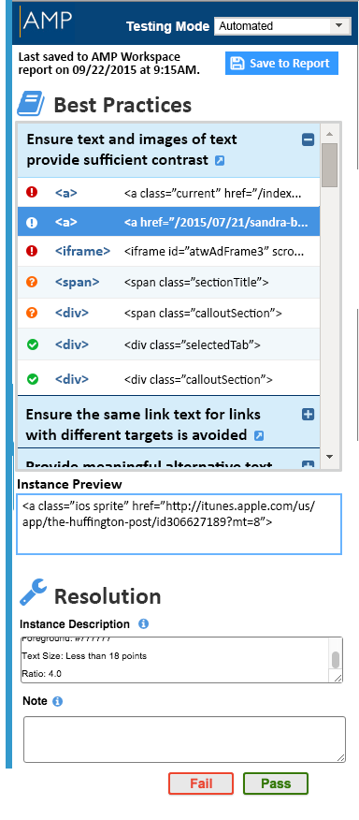
What Is Alchemy?
Alchemy is a new AMP browser extension that adds fixing functionality to the testing process.
Test
  Automatic, guided automatic and manual testing in the browser
  Results are save to AMP
Evaluate
  Access relevant Best Practices to understand the problems
  Preview each instance directly on the page
Fix
  Fix the most common and high priority issues with no development time
  Delivers fixes to the site when users load the page — with no effect on the performance or appearance of the page
  Does not change the base code, but “applies” corrected code on top of the initial code

Slide 23
What Is Included?
Included with existing AMP Enterprise subscription:
  Alchemy testing
  AMP reports on Alchemy testing results
  Specifying — but not deploying — fixes in Alchemy
Requiring an additional Alchemy subscription:
  Deploying fixes
  Future monitoring features
Cost of Alchemy subscription = cost of Enterprise AMP subscription

Slide 24
How Does it Work?
Testing:
  Install the Alchemy browser plugin
  Login to AMP
  Open the in-browser testing pane and walk through automatic and manual testing steps
Fixing:
  Complete fixing forms in the in-browser testing pane
  Paste site-specific JavaScript (similar to Google Analytics) on each page of your website
Using Fixes:
  When users load any page of your website, fixes are streamed to the page, sitting on top of the non-accessible code
  No additional development work; no plugin installation!

Slide 25
How Does Alchemy Streamline the Process?
Resolution Replay
  Alchemy recognizes like components
  (e.g., Menus or toolbars that appear
  on multiple pages)
  Like components are tagged with the
  same signature
  Review and resolve any violation once and the resolution is applied to all other instances of the same component

Slide 26
Browser Extensions
To be available for Chrome, Firefox, and Internet Explorer
  Initially only Chrome
Will eventually replace AMP Toolbar for Firefox and AMP Toolbar for Internet Explorer

Slide 27
For More Information
Archive recording of December 9 demo webinar
  http://bit.ly/1ndGmk4
Alchemy section on help site
  http://bit.ly/1ZWWlRw
Notes:
http://bit.ly/1ndGmk4 → http://info.ssbbartgroup.com/Alchemy-Demo-Webinar_Resources.html
http://bit.ly/1ZWWlRw → https://support.ssbbartgroup.com/hc/en-us/sections/201307245-Alchemy

Slide 28
Open Discussion

Slide 29
Next Meeting
Tuesday, April 12, 2016
Time:
2:30–4:30 PM
Location:
TBD

