Slide 1
Kansas Partnership for Accessible Technology
July 11, 2016 Meeting

Slide 2
Status Updates and Announcements

Slide 3
ICT Refresh
Federal ICT Standards and Guidelines
  The Spring 2016 Reginfo.gov agenda still lists an unspecified date in October for final action.
    http://go.usa.gov/xcVck
  The Access Board is saying October as well, according to Tim Springer, CEO of SSB BART Group.
    Here’s his estimated timing:
      OIRA completes final regulation review (90 Days): 9/24/2016
      OIRA review notes incorporated into draft NPRM (15 Days): 10/9/2016
      Rule approved by Board (Varies): 11/8/2016
      Final rule published in Federal Register (5 Days): 11/13/2016
      Rule effective date (60 Days): 1/12/2017
      Complaints allowed under new rules (182 Days): 5/14/2017
      FAR and procurement policy updates due (182 Days): 5/14/2017
    From “2016 Accessibility Trends Mid-Year Update” webinar
      http://info.ssbbartgroup.com/2016-Trends-Update_Gateway
Notes:
http://go.usa.gov/xcVck → http://www.reginfo.gov/public/do/eAgendaViewRule?pubId=201604&RIN=3014-AA37
OIRA = Office of Information and Regulatory Affairs

Slide 4
Enforcement Environment: ADA
That webinar also included these comments:
  Public (Title II) and private (Title III) sector orgs continues to see active litigation under ADA, related state statutes
    DoJ continues to actively pursuing [sic] web-related litigation
    Advocacy groups actively using litigation to
    accomplish access
    ADA focused attorneys now actively pursuing web-related litigation
  We expect accelerated litigation activity in this area
Notes:
Quoted from http://info.ssbbartgroup.com/2016-Trends-Update_Gateway

Slide 5
Enforcement Environment: OCR
The U.S. Department of Education’s Office for Civil Rights announced website accessibility settlements with 11 organizations in seven states and one territory June 29.
  http://go.usa.gov/xcVRQ
  OCR investigations found that on all 11 websites important images were missing alt attributes. Common problems affecting many of the websites included:
    Some important content could only be accessed by mouse, affecting those who are blind, many who have low-vision, and those with disabilities affecting fine motor control;
    Color combinations that made text difficult or impossible for people with low vision to see; and
    Videos were not accurately captioned, so they were inaccessible to people who are deaf.
Notes:
http://go.usa.gov/xcVRQ → http://www.ed.gov/news/press-releases/settlements-reached-seven-states-one-territory-ensure-website-accessibility-people-disabilities
(H/t to Joe Oborny)

Slide 6
Technology Accessibility Playbook
On June 30, the Federal CIO Council Accessibility Community of Practice announced the release of the Technology Accessibility Playbook, to provide guidance on what is needed to build and manage effective Section 508 Programs.
Announcement: http://go.usa.gov/xcVCe
Playbook: http://go.usa.gov/xcVrx
Notes:
http://go.usa.gov/xcVCe → http://www.section508.gov/content/technology-accessibility-playbook
http://go.usa.gov/xcVrx → http://section508.gov/content/it-accessibility-playbook

Slide 7
AMP Release
AMP was updated to the 2016.5.0 release July 1.
  Scalability
  Security
  Overall user interface improvements
  Info on what’s new at http://bit.ly/1JzFqjV
Notes:
http://bit.ly/1JzFqjV → https://support.ssbbartgroup.com/hc/en-us/articles/205725309

Slide 8
AMP for Mobile
Available—Contact me to be included
Training webinar May 19
Documentation at http://bit.ly/29oH1I1
21 users
Notes:
http://bit.ly/29oH1I1 → https://support.ssbbartgroup.com/hc/en-us/sections/201265479-AMP-for-Mobile

Slide 9
Screen Reader Strategy Survey
Heydon Pickering, a freelance web accessibility consultant, interface designer and writer who writes and edits for Smashing Magazine and works with The Paciello Group, did an informal screen reader strategy survey, the results of which are here: http://bit.ly/295ouRq
Notes:
http://bit.ly/295ouRq → http://www.heydonworks.com/
article/responses-to-the-screen-reader-strategy-survey
(H/t to Joe Oborny)

Slide 10
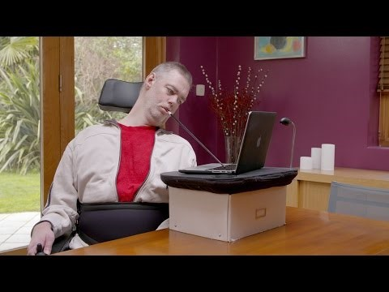
Web Accessibility Perspectives Videos
New page from WAI exploring the impact and benefits of web accessibility for everyone through a series of videos.
https://www.w3.org/
WAI/perspectives/
Example: Keyboard Compatibility
Notes:
WAI = Web Accessibility Initiative

Slide 11
ITEC Policy 1210 Update

Slide 12
ITEC Policy 1210 Update
Presented to ITAB February 16
Presented to Performance and Process Improvement ITIL Committee May 16
ITEC?
Notes:
ITIL = Information Technology Infrastructure Library

Slide 13
Accessibility of State of Kansas WEbsites

Slide 14
Assessment
60 entity home page domains
  OITS 3-Year IT Management and Budget Plans
  KPAT member entities
  52 matched to previous year
Tested with AMP
Automated testing
Spidered each site up 50,000 pages
455,897 pages scanned

Slide 15
Results Summary
The average adjusted AMP Compliance Score was 91%, up 1 percentage point from 90% the previous year.
The average number of violations per page was 5.59, down 1.17, or 17%, from 6.77 the previous year.
487,916 violations were eliminated compared to previous year, a 10% drop.

Slide 16
Entity Results Summary
51 of 60 entities (85%) had an adjusted AMP Compliance Score greater than 85%.
19 of 52 entities (37%) improved their adjusted AMP Compliance Score since the previous year.
26 of 52 entities (50%) decreased their average number of violations per page.

Slide 17
Entity Highlights
The highest adjusted AMP Compliance Score, 97%, was achieved by:
  State Board of Indigents’ Defense Services
  Department of Labor
  Kansas Board of Optometry
  Kansas Commission on Veterans Affairs Office
  Kansas Real Estate Appraisal Board
The lowest average number of violations per page, 0.01, was achieved by the Department of Labor.
The greatest year-over-year improvement, by both average number of violations per page (down 24.40) and adjusted AMP Compliance Score (up 18 percentage points), was achieved by the Kansas Water Office.

Slide 18
Violation Severity
Notes:
For all 293 Best Practices in AMP, 24% are high severity, 48% are medium, and 28% are low. This does not reflect their relative typical or natural occurrence rates, applicability, etc.

Slide 19
Top Violations
Best Practice | Severity | Noticeability | Tractability
1. Provide alternative text for images | 10 | 10 | 2
2. Provide a valid label for form fields | 10 | 6 | 2
3. Avoid the sole use of device-dependent event handlers | 8 | 7 | 2
4. Ensure headers and cells are properly associated | 10 | 7 | 4
5. Ensure link text is meaningful within context | 6 | 6 | 2

Slide 20
Department of Justice SANPRM

Slide 21
DOJ SANPRM
On April 28, the Department of Justice withdrew its NPRM on Accessibility of Web Information and Services of State and Local Government Entities.
The next day, it issued a SANPRM to replace it.
The stated purpose is to “solicit additional public comment on various issues to help the Department shape and further its rulemaking efforts.”
Comments due August 8.
Notes:
NPRM = Notice of Proposed Rulemaking
SANPRM = Supplemental Advance Notice of Public Rulemaking

Slide 22
DOJ SANPRM Links
Announcement statement: http://go.usa.gov/xcvP5
SANPRM: http://go.usa.gov/xcvy3
Notes:
http://go.usa.gov/xcvP5 → https://www.ada.gov/regs2016/sanprm_statement.html
http://go.usa.gov/xcvy3 → https://www.ada.gov/regs2016/sanprm.html

Slide 23
DOJ SANPRM Schedule
Listing in the Spring 2016 Reginfo.gov agenda now reads as follows:
Action | Date
Second ANPRM | 05/00/2016
Second ANPRM Comment Period End | 08/00/2016
NPRM | 07/00/2017
NPRM Comment Period End | 09/00/2017
http://go.usa.gov/xcvyJ
Notes:
http://go.usa.gov/xcvyJ → http://www.reginfo.gov/public/do/eAgendaViewRule?pubId=201604&RIN=1190-AA65

Slide 24
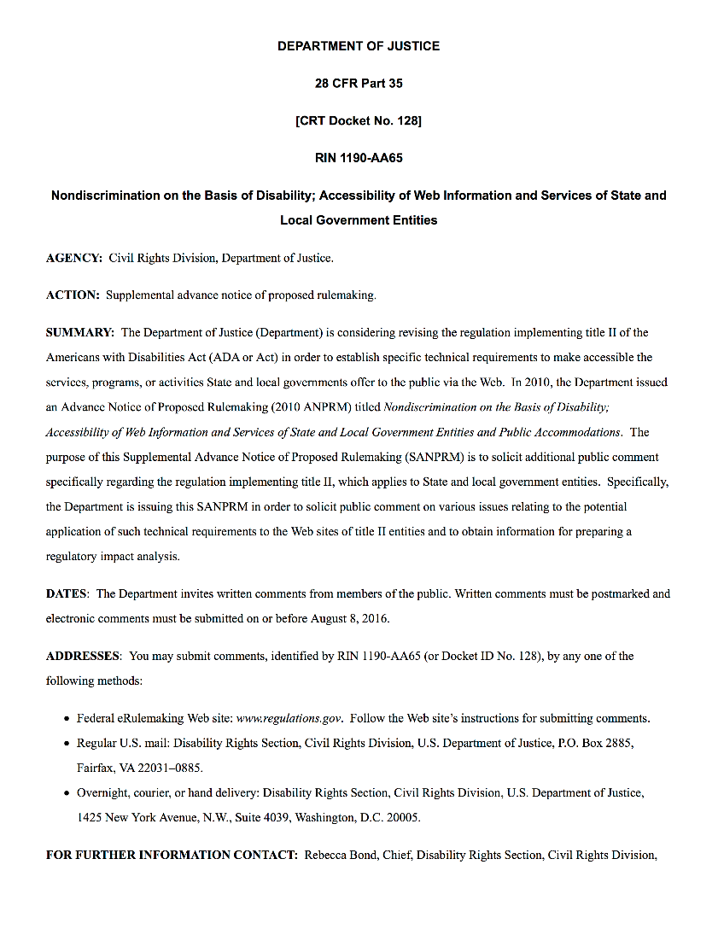
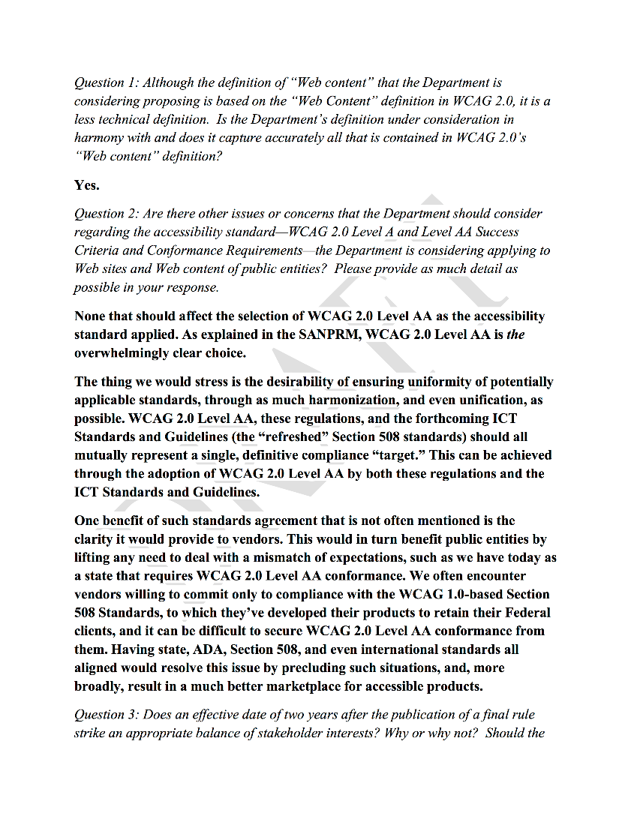
DOJ SANPRM Response

Slide 25
Open Discussion

