Slide 1
Kansas Partnership for Accessible Technology
April 13, 2017 Meeting

Slide 2
Status Updates and Announcements

Slide 3
DOJ ANPRM
Accessibility of Web Information and Services of State and Local Governments
Listing in the Fall 2016 Reginfo.gov agenda was unchanged from the previous one, with an NPRM date of 07/00/2017.
https://go.usa.gov/xXnHb
The future under the new administration is uncertain.
Notes:
https://go.usa.gov/xXnHb → https://www.reginfo.gov/public/do/eAgendaViewRule?pubId=201610&RIN=1190-AA65

Slide 4
DOJ Settlements Resource
PEAT, the Partnership on Employment & Accessible Technology, published a resource in December entitled “How is the Department of Justice Addressing Website and ICT Accessibility?”
Sections:
Accessibility of Websites and Other ICT
Technical Accessibility Standards
When is a Covered Entity Not Required to Provide Specified Services?
How to Implement Website/ICT Accessibility Policies
Appendix: View the Full List of 167 Settlement Agreements
http://www.peatworks.org/resources/policy/ DOJsettlements

Slide 5
Federal Website Accessibility Report
GSA project called Pulse
Reports results of using automated tools to measure “how U.S. government domains are following best practices for federal websites”
Accessibility is now one of three areas
Currently in beta
https://staging.pulse.cio.gov/a11y/domains
Notes:
The other two areas are the use of HTTPS and participation in the federal government’s Digital Analytics Program.

Slide 6
WCAG 2.1
To build on—not supercede—WCAG 2.0
Backward compatible with WCAG 2.0
To address technological evolution
Particular attention to:
Small-screen and touch mobile devices
Users with low vision
Users with cognitive or learning disabilities

Slide 7
WCAG 2.1 Timeline & Links
Development first proposed in October
Working Group charter approved in January
First Public Working Draft announced February 28
Likely to be completed in 2018
Blog post introducing the First Public Working Draft:
https://www.w3.org/blog/2017/02/wcag21-fpwd/
First Public Working Draft:
https://www.w3.org/TR/WCAG21/
WebAIM feedback on First Public Working Draft:
http://webaim.org/blog/wcag-2-1-feedback/

Slide 8
Silver
Project code name for next major accessibility guidelines after WCAG 2.1
(Name comes from periodic table)
Will expand scope beyond just web
Working Group already renamed Accessibility Guidelines Working Group (AGWG)
Task force doing advance research and aiming for First Public Working Draft in 2018, completion in 2020.
Community Group at https://www.w3.org/community/silver/

Slide 9
Updated W3C Resources
In December, the Web Accessibility Initiative (WAI) Education & Outreach Working Group (EOWG) announced three updated resources:
Planning and Managing Web Accessibility
https://www.w3.org/WAI/impl/
Developing Organizational Policies on Web Accessibility
https://www.w3.org/WAI/impl/pol
Web Accessibility First Aid: Approaches for Interim Repairs
https://www.w3.org/WAI/impl/improving

Slide 10
Training Update
AMP training: will be offered again
Accessibility overview: KSDE, school district webinar
Third-party webinars on KPAT training page: http://oits.ks.gov/kpat/training

Slide 11
AMP Releases
AMP was updated to the 8.0 release Friday.
Access Assistant 2.0
Access Analytics
Bug fixes and enhancements
Info on what’s new at http://bit.ly/2nYVQdh
Previous releases since we last met brought
Toolbar updates (Access Assistant)
Search widget
Product email opt-in
Improvements to:
Globals and patterns
Test creation wizard
Notes:
http://bit.ly/2nYVQdh → https://support.ssbbartgroup.com/hc/en-us/articles/115001509743-AMP-8-0-Release-What-s-New

Slide 12
AMP for Mobile
License expired April 8, was not renewed.

Slide 13

Level Access
FYI, SSB BART Group has announced that it will be rebranding to the name Level Access.

Slide 14
User1st Accessibility Suite
Similar to AudioEye (presented October 2014) and Alchemy (presented October 2015 and January 2016)
http://www.user1st.com/
Contact me for more info if desired.

Slide 15
CNET Tech Enabled
In October, technology news site CNET announced its new Tech Enabled series chronicling the role tech plays in providing new kinds of accessibility.
Announcement story:
http://cnet.co/2enIEhX
Series home:
https://www.cnet.com/tech-enabled/
Notes:
http://cnet.co/2enIEhX → https://www.cnet.com/news/for-the-disability-community-tech-is-the-great-equalizer/

Slide 16
Self-Driving Cars Survey for the Blind
University of Florida survey of blind respondents about autonomous and self driving vehicles in the United States
http://evalui.com/

Slide 17
State ADA Coordinator Report
Anthony Fadale State ADA Coordinator

Slide 18
Adopting ICT Standards and Guidelines in State Policy

Slide 19
Review: ICT Standards and Guidelines
Published in the Federal Register January 18
The final rule went into effect March 20
Compliance required January 18, 2018
https://go.usa.gov/xXnuB
Proposed policy draft based on proposed rule was presented October 2015.
Notes:
https://go.usa.gov/xXnuB → https://www.federalregister.gov/documents/2017/01/18/2017-00395/information-and-communication-technology-ict-standards-and-guidelines

Slide 20
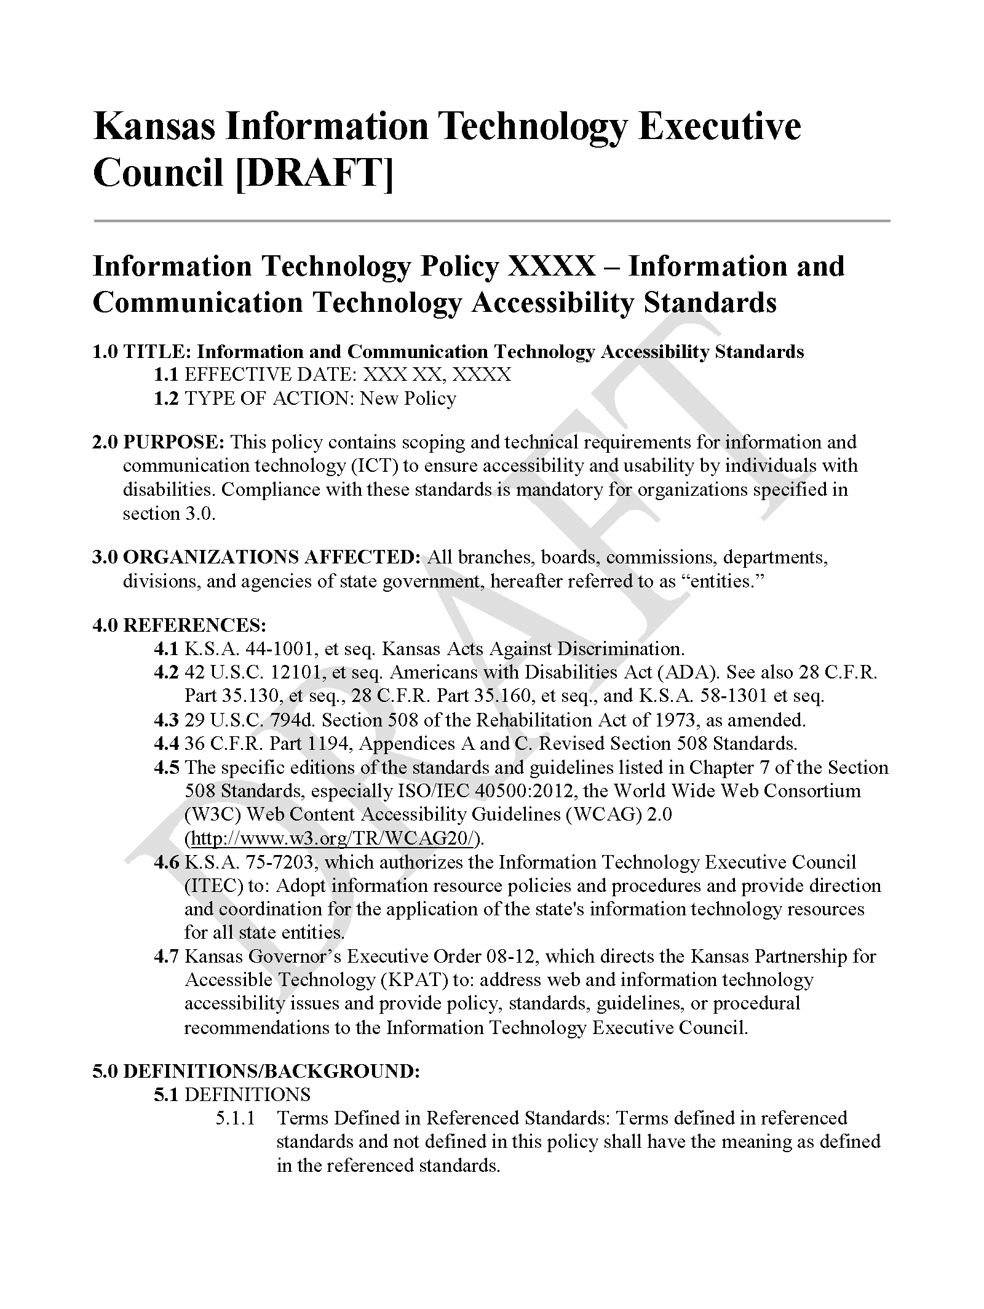
Proposed Policy Draft

Slide 21
Accessibility of State of Kansas WEbsites

Slide 22
Assessment
60 entity home page domains
OITS 3-Year IT Management and Budget Plans
KPAT member entities
Technical difficulties with 5 → 55 matched to previous year
Tested with AMP
Automated testing
Spidered each site up 50,000 pages
254,318 pages scanned

Slide 23
Results Summary
The average adjusted AMP Compliance Score was 93%, up 1 percentage point from 92% the previous year.
The average number of violations per page was 3.67, down 0.50, or 12%, from 4.01 the previous year.

Slide 24
Entity Results Summary
48 of 55 entities (87%) had an adjusted AMP Compliance Score greater than 85%.
37 of 55 entities (67%) improved their adjusted AMP Compliance Score since the previous year.
23 of 55 entities (42%) decreased their average number of violations per page.

Slide 25
Entity Highlights
The highest adjusted AMP Compliance Score, 99%, was achieved by:
State Board of Indigents’ Defense Services
Department of Labor
These two also achieved the lowest average number of violations per page, 0.00!
The greatest year-over-year improvement by average number of violations per page (down 13.43), was achieved by the Kansas Board of Barbering.
The greatest year-over-year improvement by adjusted AMP Compliance Score (up 16 percentage points) was achieved by the Department for Children and Families.

Slide 26
Violation Severity
Notes:
For all 293 Best Practices in AMP, 24% are high severity, 48% are medium, and 28% are low. This does not reflect their relative typical or natural occurrence rates, applicability, etc.

Slide 27
Top Violations
Best Practice | Severity | Noticeability | Tractability
1. Provide a valid label for form fields | 10 | 6 | 2
2. Provide alternative text for images | 10 | 10 | 2
3. Avoid the sole use of device-dependent event handlers | 8 | 7 | 2
4. Ensure headers and cells are properly associated | 10 | 7 | 4
5. Ensure complex images provide sufficient descriptions | 8 | 3 | 8

Slide 28
Open Discussion

